Slide 1
Data Warehouse
Student Data User Group
September 8, 2022
Student Data User Group – September 8, 2022

Slide 2
Remote meeting reminders
Please turn off your video function, and make sure you are on Mute.
Please enter your questions in the chat function. We will pause periodically during today’s meeting for comments and questions.
You can also use the “raise hand” reaction, so someone on our team can recognize you.
Student Data User Group – September 8, 2022

Slide 3
Agenda
  Student Name
  Term Snapshots
  Building out future terms
  Recent changes and corrections
  Q&A and Wrap-up
Student Data User Group – September 8, 2022

Slide 4
Student Name
  Assumption: When students provide a Preferred First Name, that is the name they would like to see used for most outward-facing webpages and reports.
  Assumption: The student Legal Name should be used in reports that require Legal Name; otherwise, the Preferred First Name, along with the other name fields, should be used.
  The assumptions above are consistent with legacy reporting. The student’s Name field in PERSON_ALL_V incorporated their preferred name when one was available; the student’s Legal Name was in a separate field.
Student Data User Group – September 8, 2022

Slide 5

Student Name, continued
  Currently, you can use the Preferred First Name by selecting it instead of the First Name, from STUDENT. The “Name” field, however, does not currently use the Preferred First Name.
  Name is a concatenation, formatted as: LastName,FirstName Middle
      We are proposing to change the Name field in STUDENT to be: LastName,PreferredFirstName Middle
      We are proposing to put the Legal Name into ST_NAME_OTHER
  Questions for SDUG:
    If we change the Name field in the DWNGSS_PS.STUDENT table to use the Preferred First Name, are there downstream implications?
    In your experience, what types of reports require Legal Name?
Student Data User Group – September 8, 2022

Slide 6
Term snapshots
  The plan is for the first Pennant Student Records term snapshot to be done at the time of the Fall 2022 census. That would be one week following the last day to drop a course (10/10/2022 + 7 days. Date based on drop date for part-of-term = the Full Term).
  Table structures will be the same as the regular Pennant Student Records reporting tables, with the addition of a column indicating which snapshot for the term (Census snapshot, Final snapshot, etc.)
  Questions for SDUG:
    For what purposes would you use a snapshot taken at the beginning of the term? After Advance Registration? On the first day of classes? after the end of the Add period? Or is a Census and a Final snap enough?
    Should the Final snap be based on the term_end_date in the NGSS term table? Is there a business reason to snap it later than that?
    Term-specific tables, such as ST_TERM, ST_DEGREE_TERM, ST_ADVISOR, etc. would have the current term’s information in the snapshot, but not previous terms. Is that acceptable, and if not, is there a business reason to have the entire history of previous terms captured in a snapshot?
Student Data User Group – September 8, 2022

Slide 7
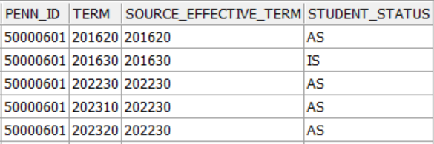
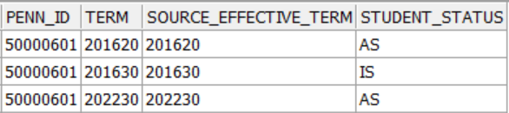
Building out future terms
  Currently, we “build out” the term-by-term views of the data to the next-next term.
  If we were to change this practice, and only build up to and including the current term, and then populate the future terms only after Advance Registration for the future terms has occurred, would that cause problems for your school’s or center’s reporting?
Student Data User Group – September 8, 2022

Slide 8

Recent changes and corrections
  CRSE_SECTION: Changed the source for the ENRL_CUTOFF_DATE and DROP_CUTOFF_DATE
  CRSE_SECTION: Changed the source for the CREDIT_HOURS_BU
Student Data User Group – September 8, 2022

Slide 9
Recent changes and corrections
  ST_ENROLLMENT: Correction to population of credits for enrollments that have rolled to Academic History.
  ST_TERM: Correction to the population of the REGISTERED_CREDIT_BU field.
    Now includes auditors, and people taking masters thesis & dissertation courses.
  ST_DEGREE_TERM: No longer populating “term statistics” (credits, Qlty Pts, GPA, etc.) for future terms or when the BU value is Null.
  (Term-based tables): Correction to the term-by-term build out for people who have separated from the University. i.e. when the student status is inactive.
Student Data User Group – September 8, 2022

Slide 10
Wrap-up
  Upcoming meetings (2nd Thursday, each month, 11:00 am – noon):
  October 13, November 10, December 8
  We will send out the meeting link ahead of time to student-wh@lists.upenn.edu
  Follow-up questions/comments: da-staff@isc.upenn.edu
  Discussions about student data: student-wh@lists.upenn.edu
Student Data User Group – September 8, 2022

