Slide 1
Data Warehouse
Student Data User Group
August 11, 2022
Student Data User Group – august 11, 2022

Slide 2
Remote meeting reminders
Please turn off your video function, and make sure you are on Mute.
Please enter your questions in the chat function. We will pause periodically during today’s meeting for comments and questions. You can also use the “raise hand” reaction, so someone on our team can recognize you.
Student Data User Group – august 11, 2022

Slide 3
Agenda
Query demo: A sampling of queries written by/for SRFS
Review of some “known issues”
Changes to the Pennant Student Records universe
Questions & Answers
Wrap-up
Student Data User Group – august 11, 2022

Slide 4
Query demo
A sampling of queries written by Christina Zhou
Operations and Data Analyst Student Registration & Financial Services
Student Data User Group – august 11, 2022

Slide 5
Review of some “known issues” and recent corrections
In the past couple of weeks, we have deployed a number of corrections to the extract, including fixing records* in the following areas:
ST_Enrollment terms without a matching ST_Degree_Term
Missing LOAs in ST_Degree_Pursual
Null values for last_enrolled_term in ST_Degree_Pursual
Populated exit reasons in ST_Degree_Term and ST_Degree_Pursual (still a work-in-progress)
Adjusting for term roll for ST_Enrollment records
Missing credit hours in Crse_Section
Add/Drop cut off dates populated in Crse_Section, based on the dates for the Part-of-Term
* Not 100% fixed yet, in some cases.
Student Data User Group – august 11, 2022

Slide 6
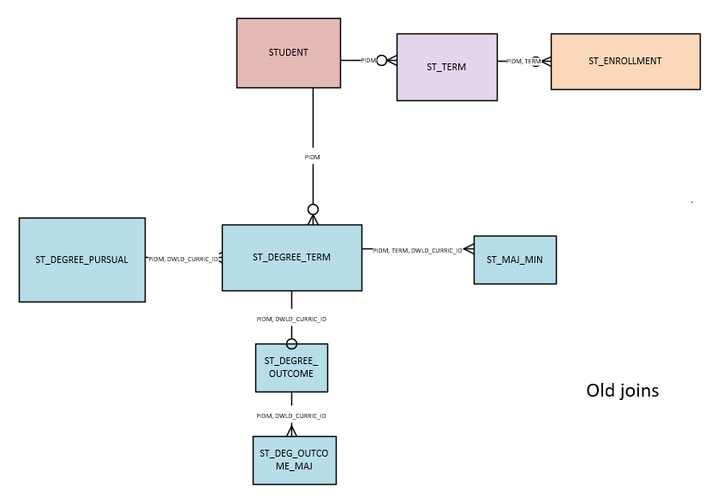
Changes to the Pennant Student Records universe
Full universe joins diagram: https://provider.www.upenn.edu/computing/da/dw/pennant-student-records/PENNANT_RECORDS_ERD_SUMMARY.pdf
Student Data User Group – august 11, 2022

Slide 7
Some questions and a few answers
What is the difference between Last_Degree_Term and Last_Enrolled_Term in ST_DEGREE_PURSUAL?
Last_Degree_Term is literally the furthest-in-time term found in ST_DEGREE_TERM for the curriculum. It indicates where the information comes from for things that are built from the latest information we have.
Last_Enrolled_Term is the last time the student was enrolled in any courses – it does not include terms in which the student registered for courses and then dropped/withdrew from everything. It is not curriculum-specific. The purpose of the column is to show the latest term that the student took any course.
Student Data User Group – august 11, 2022

Slide 8
Some questions and a few answers, continued
How are email addresses set to Active/Inactive? How are they set to Preferred?
Generally, an email address is set to Active when it is created and stays that way until it is purposely inactivated. Emails can be inactivated by the student when they manage their own emails in the Online Directory. If an email of type PEN or PERS is deleted/removed from the Directory and cannot be synched to what is in Banner, the email in Banner is inactivated.
For the warehouse we expand on the Banner preferred flag, using the following logic:
If the email address is active and has been flagged as the "Preferred" in Banner, then Preferred_Ind ='Y’.
If there is no preferred active one in Banner, then look for an active email address of type 'PEN'. If there is more than one active email address of type 'PEN' use the most recent one.
If there is no active email of type 'PEN' then look for an active email address of type 'PERS'. If there is more than one active email address of type 'PERS' use the most recent one.
See https://provider.www.upenn.edu/computing/da/dw/pennant-student-records/st_email.e.html
Student Data User Group – august 11, 2022

Slide 9
Some questions and a few answers, continued
What’s the best way to find people who have graduated?
Look in the ST_DEGREE_OUTCOME table, for records where the degree has been awarded (degree_status = ‘AW’)
Student Data User Group – august 11, 2022

Slide 10
Some questions and a few answers, continued
When does “current_academic_term” in the PRESENT_PERIOD table change?
Currently, the term moves forward on the day following the last day of the term, using the dates in Banner’s term table, which is found in the warehouse in DWNGSS.V_TERM.
So, for example, the current_academic_term will switch from Fall to Spring on 12/23/2022, and from Spring to Summer on 5/10/2023, i.e., the day following the last day of each of those terms:
Student Data User Group – august 11, 2022

Slide 11
Wrap-up
Upcoming meetings (2nd Thursday, each month, 11:00 am – noon):
September 8, October 13, November 10
We will send out the meeting link ahead of time to student-wh@lists.upenn.edu
Follow-up questions/comments: da-staff@isc.upenn.edu
Discussions about student data: student-wh@lists.upenn.edu
Student Data User Group – august 11, 2022

