Slide 1
Data Warehouse
Student Data User Group
May 26, 2022
Student Data User Group – May 26, 2022

Slide 2
Remote meeting reminders
Please turn off your video function, and make sure you are on Mute.
Please enter your questions in the chat function. We will pause periodically during today’s meeting for comments and questions.
You can also use the “raise hand” reaction, and when we pause for questions one of our team members will call on you.
Student Data User Group – May 26, 2022

Slide 3
Agenda
Degree Planning and Audit data collection
Pennant Student Records: Where we are and what’s next
Student Term, Degree Term, and Degree Pursual
Q&A
Wrap-up
Student Data User Group – May 26, 2022

Slide 4
Degree Planning and Audit Data Collection
With NGSS, advising and degree auditing has moved to Degree Works and is accessible via PATH for most advisors.
Need to replace Academic Planning Worksheets
As of last week, new tables in WHSE and new Business Objects Universe: Degree Planning and Audit
If you have access to Academic Planning and Worksheet – you should have access to the new data collection.
If you need access, the Academic Planning Worksheet link is still the one that is up on the eforms site – we need to update that so that it will be updated to “Degree Planning and Audit”.

Slide 5
Degree Panning and Audit Data Collection - cautions
As of 5/26/2022 – still some issues being worked out with the warehouse tables being populated
Structure exists – some production data is available for some students, but:
Students missing. Currently a patch being worked on in Dev to correct this issue on the source side.
The data reflects the scribe rules that are in Degree Works – if any program or set of programs is still having some things cleaned up, the audit data in the warehouse will show most recent version available.
That being said – table is there with some production data. While structure has been reviewed, not a lot of use yet.

Slide 6
How you would want to join to the tables
To join to other student tables in the warehouse:
PENN_ID
PROGRAM
To join within the collection tables:
PENN_ID
PROGRAM
DEGREE_REQ_ID
REQUIREMENT_ID

Slide 7
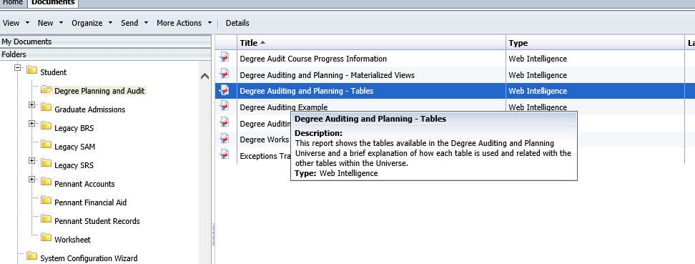
Degree Planning and Auditing Resources
ISC website: https://www.isc.upenn.edu/degree-planning-and-audit-data-collection
Public Reports: Public Folders/Student/Degree Planning and Audit
Please note – the working group suggested two materialized views to help see some data more easily, these are missing in production but should be in soon.

Slide 8
Degree Planning and Auditing: What is Next
Communicate to group within next two weeks once patch is in production.
Also include update on materialized views.
A separate smaller session for Academic Worksheet Business Objects users with a demo on how you could use the collection.

Slide 9
Pennant Student Records: Where we are and what’s next
  Data for terms < Spring 2022: most of the student data for SRS terms prior to the current term were converted in mid-March. Exceptions: degrees received, and academic history/milestone information that will go on the transcripts. These will be part of the June conversion.
  Spring 2022 data: Spring enrollment data and course sections are still only in SRS. Academic history for 202210 will be migrated to Pennant after the term processing is complete, in mid-June 2022. SRS is currently the system of record for the Spring term academic information and all degrees awarded at Penn. Pennant is the system of record for current address information.
  Data for terms > Spring 2022: Future term data exists only in Pennant.
  After the June conversion is complete, Pennant will be the system of record for everything, including all degrees and transcripts for students who attended Penn in fall 2010 and after.
  Reference: https://apps.srfs.upenn.edu:44306/secure/Pennant-Training/Pennant-records-Spring-2022-Guidelines.pdf
Student Data User Group – May 26, 2022

Slide 10
Pennant Student Records curriculum-related tables
  The following slides will focus on
    ST_TERM
    ST_DEGREE_TERM
    ST_DEGREE_PURSUAL
  For warehouse reporting, “curriculum” refers to the combination of data elements that go into defining the pursual of a degree. Depending on the rules for each school and division, the definition can incorporate a combination of:
  division, degree, primary major, level, campus, program
Student Data User Group – May 26, 2022

Slide 11
ST_TERM
  Student Term (DWNGSS_PS.ST_TERM)
  This table contains data from the “General Student” record in Banner. It includes some curriculum information, but only for the student’s primary program. It also provides the information about the student in the term that is not curriculum-specific.
      One row per student per term
      Is where you go to find the student’s status
      Has the primary division, primary degree, primary program, primary major including associated concentration, and primary classification
      Includes rows where the student is on leave (status ‘AL’)
      Rows are built out to the next-next term
      Includes the row when the student became inactive (status like ‘I%’), including final rows that extend beyond their curriculum rows.
Student Data User Group – May 26, 2022

Slide 12
ST_DEGREE_TERM
  Degree Term (DWNGSS_PS.ST_DEGREE_TERM)
  This table contains data from the “Curriculum” record in Banner. It has information specific to each curriculum that the student is in, in each term.
      One row per student per curriculum (aka degree pursual) per term
      Converts the source “term-effective” model into “term-by-term” by including rows from when a curriculum becomes effective until something changes: a new curriculum is inserted and the previous one ends, or the student exits the curriculum, or they graduate from the curriculum, or they go to an inactive status
      Rows are built out to the next_next term
      Contains the DWLD_CURRIC_ID, which helps us find all the rows for the same degree program across time and is used to link to the correct row in other tables containing curriculum information. DWLD_CURRIC_ID is a warehouse-construct only, should not be stored or used outside of the warehouse, and it can change.
Student Data User Group – May 26, 2022

Slide 13
ST_DEGREE_PURSUAL
  Degree Pursual (ST_DEGREE_PURSUAL)
  This table is a rollup of the information from degree term.
      One row per student per curriculum
      Related to ST_DEGREE_TERM, ST_MAJOR_MINOR, and ST_DEGREE_OUTCOME based on curriculum (join on DWLD_CURRIC_ID)
      Starting information, like Admit_Term, come from the earliest rows in degree term for the curriculum.
      Ending information, like Exp_Grad_Term and Last_Degree_Term, come from the latest rows in degree term for the curriculum.
      Summary and aggregated information are as-of the latest term.
      Data elements that are student-level-specific are repeated across degree pursual rows (example: GPA, which is by level and not by curriculum).
Student Data User Group – May 26, 2022

Slide 14
RECAP
  ST_TERM
  Use to find the student status (active or not) in a term, and other term-related information
  Use to find students in terms along with their primary program information
  Related to ST_ADVISOR, ST_ENROLLMENT, ST_ATTRIBUTE, ST_COHORT : universe joins on penn_id and term
  ST_DEGREE_TERM
  Use to find students in specific programs in terms, and/or all programs for a student in a term
  Use to find term-specific stats
  Related to ST_MAJOR_MINOR : universe joins on DWLD_CURRIC_ID and term
  ST_DEGREE_PURSUAL
  Use to find overall picture of students in programs -- when they started, when they expect to finish
  Use to find the latest summary stats
  When joining between ST_DEGREE_PURSUAL and term tables be sure to identify which term
Student Data User Group – May 26, 2022

Slide 15
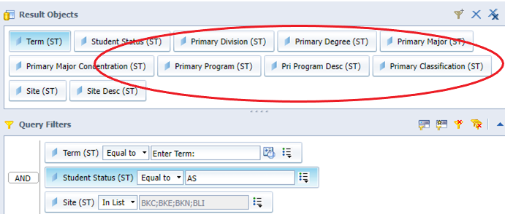
Use Student Term (ST_TERM) by itself, if it has everything you need
Example: get all students in specific Study Abroad activities, and show their primary curriculum information
Student Data User Group – May 26, 2022

Slide 16
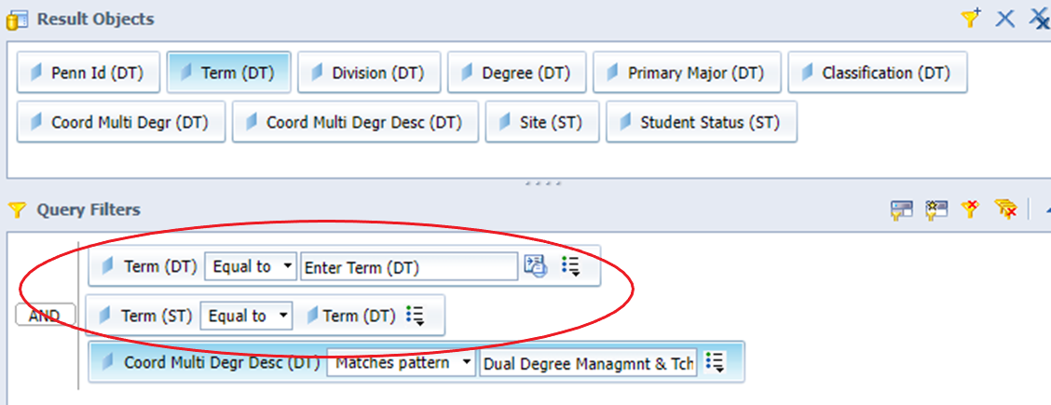
Using Degree Term (ST_DEGREE_TERM) and Student Term
  Make sure you are looking at the same term in both
  Note that the query may return multiple rows per student (the example below definitely will)
Student Data User Group – May 26, 2022

Slide 17
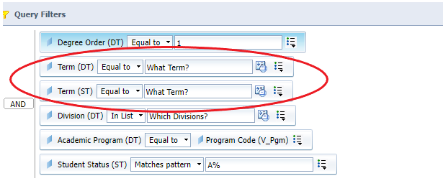
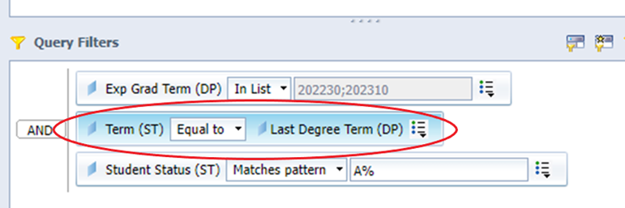
Using Degree Pursual (ST_DEGREE_PURSUAL) and term-specific tables
  Make sure you identify the term you want
Student Data User Group – May 26, 2022

Slide 18
Other recent Q&A
  Q: Which student email address should be used on reports?
  A: It depends – but for most purposes, we recommend that you use the address from ST_EMAIL where the Preferred_Ind = ‘Y’. The business rules used to set that indicator are at https://provider.www.upenn.edu/computing/da/dw/pennant-student-records/st_email.e.html#elmt7
  Q: When can we expect to see the class cohort on incoming first year undergraduates?
  A: The OUR will post the Admissions Class-Of cohort on the first day of classes in the Fall (in case of deferrals and gap years and cancellations)
  Q: Where can I find the admissions ID?
  A: That’s one we’re still working on, and as often happens, the answer is: It depends on which admissions ID you need, and from which admissions source.
  There is an admissions ID found in the restricted table ST_ADM_INFO. However: if you are looking for specific application ids, you can use the ST_ADDL_ID table. That table is part of the general Pennant Student Records collection, and no additional access is required. You will need to filter for the desired “TYPE” -- For example, if you are looking for the SLATE reference ID number for incoming undergrads, look for the Additional_ID that has an ADDL_ID_TYPE of ‘SLTE’ (Slate). The valid types are found in DWNGSS.V_ADDITIONAL_ID.
Student Data User Group – May 26, 2022

Slide 19
Other recent Q&A
  Q: What is the relationship between the activity date and the refresh date in the warehouse?
  A: Usually any activity in the source that happens during the day will get extracted to the warehouse that night. In some of our tables, there are data coming from multiple places. The Activity Date is the main table that the data come from, but in fact, if any of the source data change, the Refresh Date will reflect that.
  Q: When does the warehouse extract run?
  A: There are a number of jobs that run, and the dependencies between them makes it difficult to specify an exact time. The Pennant Student Records extract usually kicks off some time after midnight, and usually finishes in the early hours of the morning.
  You can now check the Load Status page when the latest refresh ran: https://warehouse.apps.upenn.edu/warehouse/jsp/fast.do
  Note: the Pennant warehouse tables are now always available, even during the refresh. There is no longer any ‘down time’ when the tables cannot be queried during the refresh.
Student Data User Group – May 26, 2022

Slide 20
Wrap-up
  Reminders:
  June conversion blackout dates: June 17-20 – warehouse static but available (both legacy and Pennant)
  After June 20, 2022: legacy warehouse available but static
  Follow-up questions/comments: da-staff@isc.upenn.edu
  Discussions about student data: student-wh@lists.upenn.edu
Student Data User Group – May 26, 2022

