Slide 1
Data Warehouse
Student Data User Group
April 21, 2022
Student Data User Group – April 21, 2022

Slide 2
Remote Meetings Best Practices
Turn off your video function
Please go on Mute unless you are speaking
Please enter your questions in the chat function. We will pause periodically throughout today’s meeting to take questions. When your question is being answered, you can go off Mute to ask follow-up questions.
Student Data User Group – April 21, 2022

Slide 3
Agenda
Conversion questions and known issues
The definition of a “Degree Pursual”
Reporting reminders
Frequently Asked Questions
Wrap-up
Student Data User Group – April 21, 2022

Slide 4

Conversion
Graduation Term
Until the actual degrees awarded are put into Banner, for the data warehouse graduation term fields we are using the expected degree term in place of the actual term a degree was awarded. We do not put a grad term for future terms, or when the expected degree term is earlier than the end of the term range for the program. Using expected grad term causes some records to have odd looking or even missing graduation terms, when the source dates in SRS are out of sync:
    This student graduated in SRS from both programs in 2018B, but there is an expected grad term on only one of the records in SRS.
    For the other record, there was no exp grad term in SRS, so the conversion logic had to rely on the exit date, which put the exp grad term
    of 201730 on a row with no actual graduation and no other exit action.
The graduation terms will be included in the June conversion (June 17-20). After that conversion, we will have actual Outcomes (Penn degrees awarded) in Pennant.
Student Data User Group – April 21, 2022

Slide 5
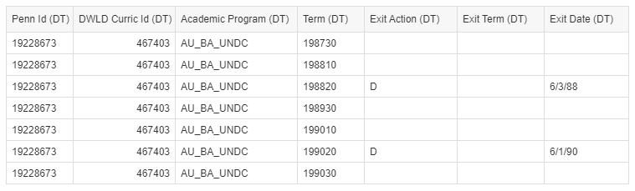
Conversion, continued
Exit Action dates vs Exit Action Terms
Sometimes, when the SRS exit date and exit term were out of sync, the exit action converted to a term before the last term.
  The student in this example entered, dropped, re-entered, re-dropped, and the drop dates were not consistent with the drop terms. In SRS, the student was last here in Spring of 1990, their exit term was Fall of 1990 and the exit date was in Summer of 1990. Conversion used the date, putting the exit action on the next-to-the-last term. The results is a final term without the exit action. This also has an impact on the exit information on ST_DEGREE_PURSUAL, which looks at the max term.
Situations like the above will have to be part of a data cleanup effort in the source.
Student Data User Group – April 21, 2022

Slide 6
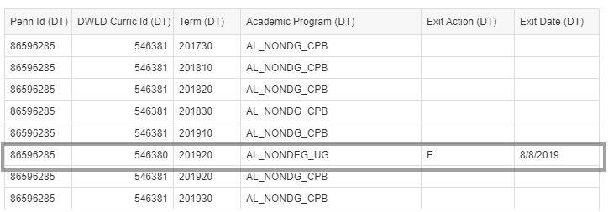
Conversion, continued
Students who were converted into two Programs when they really are in just one.
This student ended their program in the Summer of 2019, but SRS did not have a term record for 2019B – it only shows up in the APS. The conversion program depended on some data elements from the SRS term file. Since there was no SRS term file in 2019B, the row inserted for that term got assigned to a different program. Meanwhile, the other program continued on for one additional term beyond the actual exit.
Student Data User Group – April 21, 2022

Slide 7
Conversion: recap
    Some missing information will be taken care of as part of the June conversion activities.
    Some issues are part of ongoing data cleanup activities.
    The resolution of some things depends on how we are going to handle the business rules related to what data elements go into the definition of a degree at Penn. See the next sides about the “Definition of a Degree Pursual.”
Student Data User Group – April 21, 2022

Slide 8
Definition of a Degree Pursual
PIDM, Division
PIDM, Division, Degree
EU division
AU, NU, WU divisions
MBAs and PHDs
AB division with BAAS degree pursued
AL division with BA degree pursued
Student Data User Group – April 21, 2022

Slide 9
Definition of a Degree Pursual, continued
PIDM, Division, Degree, Level, Primary Major, Campus, Program
PIDM, Division, Degree, Level, Primary Major, Campus
AC, AE, AH, AM, AS divisions
AB division and NOT BAAS degree pursued
AL division and NOT BA degree pursued
All Others
Student Data User Group – April 21, 2022

Slide 10
Reminders
Starting in Summer 2022, you will need to use the Pennant Student Records data collection for reporting on current students.
The legacy collection will remain in the warehouse, for reporting on things not found in Pennant, such as:
    pre-202220 course sections and their instructors
    pre-202220 enrollments in non-graded sections
    students who have not been active since 2010
The ISC team is working on the public reports in the “Student” folder
You will need to re-write the reports you need in your personal folders.
Reports in school and center folders are the responsibility of the school or center.
Student Data User Group – April 21, 2022

Slide 11
Reminders, continued
“Where can I find…”? (Tips for using https://www.isc.upenn.edu/pennant-student-records )
If you can’t find a particular field or table, try using the “search” feature on the Pennant Student Records site
When searching the “old-to-new” spreadsheet, if you see an element from the legacy table that is “yellowed out” on the left side of the page, that means it is a new data element. If it is “yellowed out” on the right side, that means it isn’t available in Pennant Student Records
Student Data User Group – April 21, 2022

Slide 12
Frequently Asked Questions
Q: When will we see enrollment data for Summer and Fall?
A: For Summer: Tuesday, April 19th
For Fall: around May 11th
Q: When will the Enrollment Status get populated and will it ever be anything other than ‘EL’? Where would I look to see if someone is actually registered?
A: ST_TERM.Term_Enrollment_Status tells us whether the student is eligible to register for that term.
It gets populated with ‘EL’ when either of the following things happen:
            the student registers for any scheduled section in the term, or
            as a result of a batch job run for students in full-time programs, prior to the first billing for the term.
To see if someone is actually registered in courses: look in the ST_ENROLLMENT table, or in ST_DEGREE_TERM where Term_Attempted_Credit > 0.
Student Data User Group – April 21, 2022

Slide 13
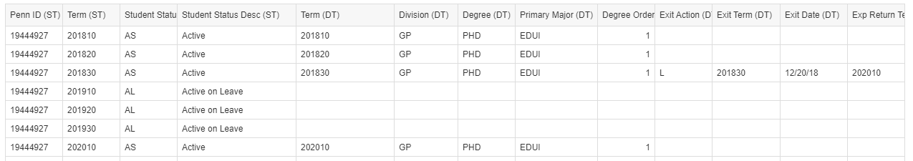
Frequently Asked Questions, continued
Q: Student Status in ST_TERM: how does that relate to exit actions in ST_DEGREE_TERM?
A: It depends. If a student has an exit at the end of a term, or well into the term, their status changes in the next term:
  In warehouse we are building out term-by-term for people on leave (status AL). Not every leave record has an expected return term. In many converted records, expected return term wasn’t available in SRS.
If their exit is at the beginning of the term, their status changes for that same term. If they are in two programs and exit one but not the other, their status does not change. They must exit from all concurrent programs in order for their status to change.
Note: If you are using the underlying DWNGSS_PS tables instead of the universe, you will notice fields called “Curric Status” and “Curric Current Ind” in ST_DEGREE_TERM. Those should not be used to find active students.
Student Data User Group – April 21, 2022

Slide 14
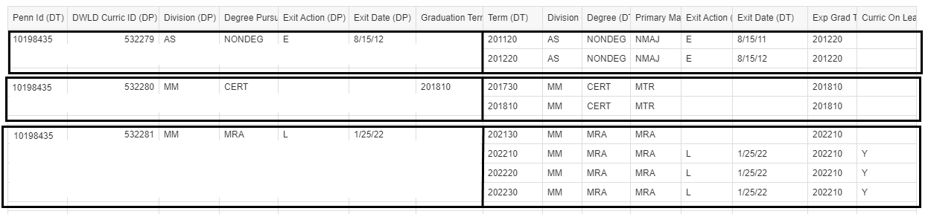
Frequently Asked Questions, continued
Q: What’s the difference between Curric on Leave this Term in ST_DEGREE_TERM vs the leave information in ST_DEGREE_PURSUAL?
A: ST_DEGREE_PURSUAL has the latest information (based on the max term) for each student in each of their curricula.
Student Data User Group – April 21, 2022

Slide 15
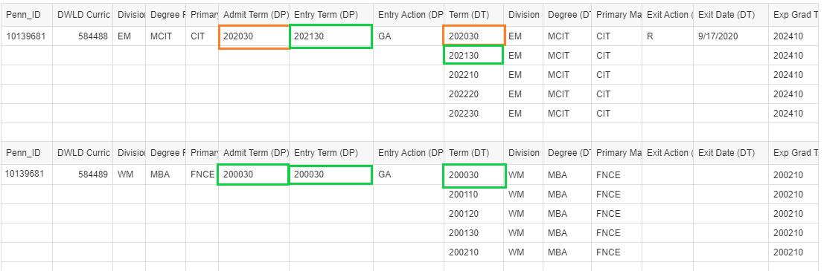
Frequently Asked Questions, continued
Q: What is the difference between Admit Term vs Entry Term in ST_DEGREE_PURSUAL?
A: Entry Term is when the student actually started working on the degree pursual.
If they matriculated and immediately deferred or had a cancelled admit, and then started later,
the Admit Term and Entry term will be different. Otherwise, they’ll be the same.
Student Data User Group – April 21, 2022

Slide 16
Frequently Asked Questions, continued
Q: What things will I still have to use the legacy collection for?
A: You will need to continue to use the SRS-sourced data in the warehouse for:
  Course sections that were taught prior to Summer 2022, including all instructor information
  Student enrollment information prior to Summer 2022, for enrollment in course sections that were not graded
  Degrees received from other (non-Penn) institutions that were stored in the SRS record
  Any reporting on students who have not been active at all since the Fall of 2010
Student Data User Group – April 21, 2022

Slide 17
Additional resources
The warehouse gets its data about students, instructors, and courses from the source Pennant system. While we can build data structures in the warehouse to facilitate reporting, we cannot correct data problems. Those need to be addressed in the source.
  The Project team and the Provost Office send important Pennant Records communications to various advisory groups, including:
PATH Advisory Group (PATH)
Pennant Records Advisory Group (PRAG)
If you are not yourself a member of one of these groups, it would be a good idea for you to work closely with your school or center’s representatives in PATH or PRAG, to make sure you are kept in the loop re the source data in Pennant. The groups’ membership lists can be found at: https://ngss.srfs.upenn.edu//ngss-penn-engagement.html
  If you have questions or concerns about the source data in Pennant, please open a ticket at
  Pennant Records Resources & Support | Penn Student Registration & Financial Services| Penn Srfs (upenn.edu)
  If you are not sure whether the problem you are looking at is a warehouse issue or a data source issue, please contact da-staff@isc.upenn.edu
Student Data User Group – April 21, 2022

Slide 18
Wrap-up
  June conversion blackout dates: June 17-20 – warehouse static but available (both legacy and Pennant)
  After June 20, 2022: legacy warehouse available but static
  Next SDUG meeting: May 19th
  Follow-up questions/comments: da-staff@isc.upenn.edu
  Discussions about student data: student-wh@lists.upenn.edu
Student Data User Group – April 21, 2022

