Slide 1
Data Warehouse
Student Data User Group
FEBRUARY 10, 2022
Student Data User Group – FEBRUARY 10, 2022

Slide 2
Remote Meetings Best Practices
Turn off your video function
Please go on Mute unless you are speaking
Please enter your questions in the chat function. We will pause periodically throughout today’s meeting to take questions. When your question is being answered, you can go off Mute to ask follow-up questions.
Student Data User Group – February 10, 2022

Slide 3
Agenda
Announcements
Recent changes to Pennant Student Records data collection
New Course Sections report
Cutover to Pennant – timing considerations
Changes coming to Pennant Accounts universe
Changes to Present_Period, and identifying the “current term”
Upcoming meetings
Student Data User Group – February 10, 2022

Slide 4
Announcements
  The Spring 2022 census date will be Monday, February 28. The census data will be available in the warehouse on Tuesday, March 1.
  SRS is still the source, for this one last term.
  This is the last census that will be in the STDTTERM universe.
  Future census data will be in snapshots of Pennant Student Records.
  New training to be deployed to Knowledge Link
        draft of the tutorial content available at https://provider.www.upenn.edu/computing/da/dw/student/SDUG_Past_Mtgs.html
Student Data User Group – February 10, 2022

Slide 5
Recent changes to Pennant Student Records in the warehouse
New table: CRSE_SECT_GRADE_MODE
  Grade Mode column in the CRSE_SECTION table not used at Penn (and has been removed from the universe)
  Course sections have multiple grade modes
  Students’ selected grade mode in ST_ENROLLMENT table
Student Data User Group – February 10, 2022

Slide 6
Course Sections report
This public report has a comprehensive look at all the details about course sections so that departments and schools can review what has been entered in CLSS and passed to Banner.
The report prompts for a term and can be run for a specific subject area or an entire school.
It includes tabs for:
Overall section information
Grade modes allowed for section
Section instructors
Section overrides
Section meeting days, times, and locations
Section registration restrictions
Section reserved seating
Student Data User Group – February 10, 2022

Slide 7
Cutover to Pennant – timing considerations
 | Date | Event | Warehouse impact
1. | February 18, 2022 | Schools review advisor assignments in SRS and make any changes Students and advisors make curriculum changes Students encouraged to declare/change field of study, if known | Production (WHSE): SRS changes still coming into the legacy Student collection, Courses and Course sections for Summer 2022 and beyond come into Pennant Student Records, and all other Pennant data still in development (DWHE)
2. | March 3-13, 2022 | System Blackout and conversion - Systems will NOT be available: SRS, Pennant Accounts, Advisor InTouch, Penn InTouch, and Courses InTouch | WHSE and DWHE available, but no new data loaded during system blackout
3. | March 14, 2022 | Go-Live After Go-Live, SRS will continue to be updated with any changes to Spring 2022 information | Starting the week of 3/14: All student data in production WHSE Legacy collection: Spring 2022 reporting Pennant Student Records: Summer 2022 and beyond Also use Pennant Student Records for most up-to-date student addresses and email addresses, and Pennant Student Records will have pre-2022 academic history. (DWHE will continue to be our test/dev environment for future enhancements)
4 | April 4, 2022 | System Opens to Students Students will gain access to new course registration and academic planning tools (provides 3-week window for administrators and faculty to validate data in new systems before students gain access)
5. | April 18–May 1, 2022 | Summer 2022 & Fall 2022 Course Registration April 18: Start of Summer 2022 Registration April 18–May 1: Fall 2022 Advance Registration
Student Data User Group – February 10, 2022

Slide 8
Changes coming to the Pennant Accounts universe
Pennant Accounts currently contains tables from both the Banner student billing system and from the legacy SRS student records system.
During the cut-over period in early March, when systems are “frozen,” the warehouse and BI universes will still be available. However, during that window is when we are going to make changes to the Pennant Accounts universe.
We will make a copy of the existing universe, and name it “Pennant Accounts – Old”. That universe, pointing to the legacy data, will remain available so that you can continue to look at things “the old way” if needed.
The universe named “Pennant Accounts” will then be updated to use the new data from the Pennant Student Records tables. Data from the billing tables will remain unchanged. We will let you know when the universe is ready to use again.
Most student records objects in the universe will remain, even though the underlying data will change. You will see some new data elements available that weren’t there before. Your queries will not break, but the results will look different than they did before things changed.
In preparation for the cut-over, we strongly recommend that you run your Pennant Accounts reports and save the results before March 2nd.
Student Data User Group – February 10, 2022

Slide 9
Changes coming to the PRESENT_PERIOD table
DWADMIN.PRESENT_PERIOD contains exactly one row, with numerous columns.
The academic terms columns in PRESENT_PERIOD are currently in SRS format and will remain so until the end of the Spring 2022 term.
When we switch from Spring to Summer, all of the academic terms in PRESENT_PERIOD will be in Banner Format.
The new format will not be in PRESENT_PERIOD before Summer 2022, and the old format will not be in PRESENT_PERIOD once we cut over to Summer 2022
Student Data User Group – February 10, 2022

Slide 10
PRESENT_PERIOD, continued
So: between mid-March until late May: what should you do? Answer: it depends.
If you want to return an academic term in SRS-format, continue to use the PRESENT_PERIOD table until the end of the Spring term.
If you want to return an academic term in Banner format, there are two workarounds…
(The information on the following slides is explained in more detail in the training digest “PRESENT_PERIOD and how to identify the Current Term” found at https://www.isc.upenn.edu/pennant-student-records#Training )
Student Data User Group – February 10, 2022

Slide 11
Alternate method for finding just the CURRENT academic terms
If you only need the current term, you can continue to join to DWADMIN.PRESENT_PERIOD. Instead of looking at the CURRENT_ACADEMIC_TERM, use the column named BANNER_TERM
The BANNER_TERM column is currently in production and is the Banner equivalent of the SRS current term.
Student Data User Group – February 10, 2022

Slide 12
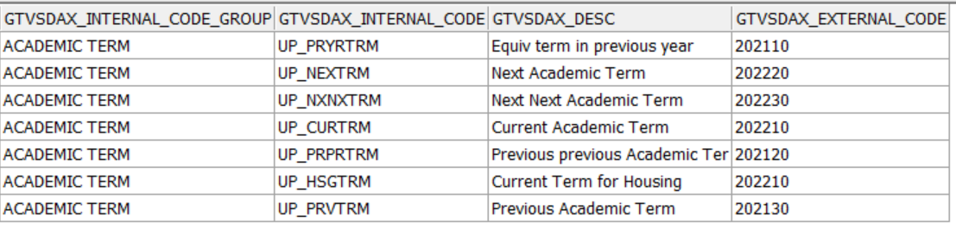
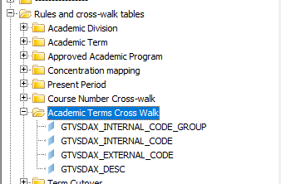
Alternate method for finding all the academic terms
For people writing their own SQL:
  Use the table DWNGSS.XWALK_GTVSDAX
  where GTVSDAX_INTERNAL_CODE_GROUP = ‘ACADEMIC TERM’
For people using the Pennant Student Records universe:
  Use the objects located in the
  “Academic Terms Cross Walk” folder
  This table will continue to be available in the future,
  with current and future term values.
Student Data User Group – February 10, 2022

Slide 13
Upcoming meetings
No SDUG in March – look for announcements via student-wh@lists.upenn.edu
April 14th 11:30 am -12:30 pm
Student Data User Group – February 10, 2022

Slide 14
Wrap-up
  Questions/comments
  Follow-up questions/comments: da-staff@isc.upenn.edu
  Discussions about student data: student-wh@lists.upenn.edu
Student Data User Group – February 10, 2022

