Slide 1
Data Warehouse
Student Data User Group
DECEMBER 9, 2021
Student Data User Group – December 9, 2021

Slide 2
Remote Meetings Best Practices
Turn off your video function
Please go on Mute unless you are speaking
Please enter your questions in the chat function. We will pause periodically throughout today’s meeting to take questions. When your question is being answered, you can go off Mute to ask follow-up questions.
Student Data User Group – December 9, 2021

Slide 3
Agenda
Recent changes to Pennant Student Records tables
Follow-up from the November SDUG
Demo query using ST_ENROLLMENT
Preview of Degree Works reporting
Student Data User Group – DECEMBER 9, 2021

Slide 4
Latest Changes to DWNGSS_PS tables and views
Added all of the related “parts” of a section id to the following tables
CRSE_SECT_SCHED_WITH
Primary_CourseID, Primary_Course_Num, Primary_Section_Num, Primary_Subject, Primary_CRN
ST_CRSE_FEE
Course_ID, Course_Num, Subject, Section_ID, Section_Num
CRSE_SECTION
Primary_CourseID, Primary_Course_Num, Primary_Section_Num, Primary_Subject, Primary_CRN, Xlist_Family (“Also Offered As” family), Sched_With_Group,
The above changes have been made in both the development and production environments.
Student Data User Group – December 9, 2021

Slide 5
Latest Changes to DWNGSS_PS tables and views, continued
Also added to CRSE_SECTION: Link_Conn
The link connector will be explained in more detail later in today’s meeting
Also added to CRSE_SECTION: Sched_With_Ind
As requested at last SDUG, this provides a way to identify sections that are scheduled with. Values are ‘Y’ or null. Sections that are not scheduled with any other sections will be their own “primary” and will not have the SCHED_WITH_IND.
Additions to CRSE_EQUIV: Legacy_Equiv_Ind
CRSE_EQUIV contains some records showing the equivalency back to an old SRS course. The Legacy_Equiv_Ind provides a way to identify such record.
(Note that, as with the XWALK_COURSE_NUMBER mapping table, not every old course from SRS will have an equivalent new Banner course in the CRSE_EQUIV table.)
The above changes have been made in both the development and production environments.
Student Data User Group – December 9, 2021

Slide 6
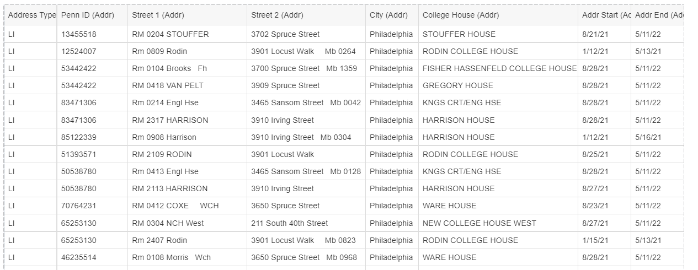
Latest Changes to DWNGSS_PS tables and views, continued
College House is now populated using a cross-walk table, instead of deriving it from a substring of the Address 1 field. (note: this is a change from the explanation provided at the November SDUG meeting)
Student Data User Group – December 9, 2021

Slide 7
Reporting on meeting times and days
Student Data User Group – December 9, 2021

Slide 8
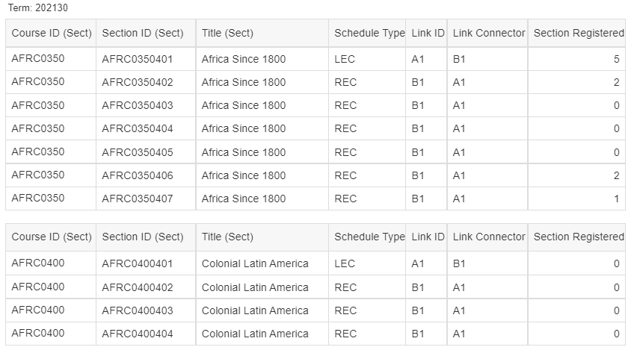
Linking Course Sections
Student Data User Group – December 9, 2021

Slide 9
Demonstration: querying ST_ENROLLMENT
Student Data User Group – December 9, 2021

Slide 10
ST_ENROLLMENT: some key points to remember *
One row per term, student, course section
Contains both enrollment from academic history as well as the current term
For columns with credit information, ST_ENROLLMENT contains both the Banner Units (BU) and the translated units in Penn currency. For schools that use “CU” credit type, the BU and Penn currency fields will contain identical information.
New concepts:
Registration Status - see values in V_REG_STATUS table
Grade Mode - similar to SRS “grade type” but with some differences, notably: PF and Aud are in Reg Status and not Grade Mode
Part of Term:
Similar to SRS “term sessions”
The full term has a POT designation
* Reporting on student enrollment is complex – please start exploring the data available in the development universe!
Student Data User Group – December 9, 2021

Slide 11
Preview of Degree Works reporting
With move to Pennant Student Records, there will be a move away from Academic Worksheets
PATH – Registration, Planning and Advising
Banner data
Displays degree progress information from Degree Works
How will we utilize the Degree Works data for reporting?
Today, will discuss what the plans are for Degree Works data, our timeline, and where we are.
Student Data User Group – December 9, 2021

Slide 12
Degree Works
September 2021 – the start of plans to create tables for the data warehouse.
A working group with individuals involved with Degree Works meet about once a month
What are the reporting needs?
What can we deliver and in what timeframe?

Slide 13
Degree Works
Challenge:
Degree Works data located in database with not a lot of analysis on how to use data while existing reporting needs exist.
Original thought process:
Connect database to ODS and produce some reports while working on tables for data warehouse.
Through data analysis and understanding reporting needs:
In process of creating tables that should be ready to go-live around Release 2.

Slide 14
Degree Works
Early on – discovered that trying to effort to try to figure out how to map out fields for reporting needs would help plan out data warehouse tables
Focus: creation of data warehouse tables to provide reporting capabilities on degree progress and auditing
Timeline:
September – preliminary discussion on reporting needs and what to focus on
October – discovery, on-going discussion, start mapping of tables
November/December – Build in tables in DEV
January/February – Test tables
March/April – Move tables into production. Provide public Business Objects reports.

Slide 15
Degree Works
Looking at reporting needs
Requirements fulfilled
Major GPA/Degree GPA
PDR
9 tables created and being reviewed in development.
Examples of questions that these tables can answer
Percent of major complete, percent of degree complete, major GPA, degree GPA, etc.
How many currently enrolled juniors in BIOL need BIOL 2410 to graduate and have not taken it yet?
How currently enrolled students used either a FREN or a RUSS course to satisfy one of the 16CU in Arts and Sciences Requirement?
How many HIST students still have outstanding requirements for the Geographic Distribution requirement?
For current PSCI seniors, provide e a list of courses needed to fulfill their major requirements – along with a count per course.

Slide 16
Degree Works
At this point – will continue to develop tables
Make sure tables can be joined easily with other Pennant Student Records tables.
Test scenarios and validate data.
Possibly in February – demo reporting capabilities with data warehouse tables.

Slide 17
Wrap-up
Questions/comments
Follow-up questions/comments: da-staff@isc.upenn.edu
Discussions about student data: student-wh@lists.upenn.edu
Student Data User Group – December 9, 2021

