Slide 1
Remote Meetings Best Practices
Turn off your video function
Please go on Mute unless you are speaking
Please enter your questions in the chat function. When your question is being answered, you can go off Mute to ask follow-up questions
Please do not use the chat function for off-topic discussions
Student Data User Group – November 11, 2021

Slide 2
Data Warehouse
Student Data User Group
NOVEMBER 11, 2021
Student Data User Group – NOVEMBER 11, 2021

Slide 3
Agenda
Latest changes to the Pennant Student Records data collection
Also-Offered-As Courses, and Scheduled-With Course Sections
Where to find reports in the public Webi folders
Other announcements and wrap-up
Student Data User Group – November 11, 2021

Slide 4
Latest Changes to student data collections
STUDENT - added ETHNICITY_DESC, ROLLUP_RACE_DESC
Note: Z=Multi-racial no longer exists. Is it still needed?
Ethnicity | Ethnicity_Desc | Rollup_Race | Rollup_Race_Desc
1 | Not Hispanic or Latino | 1,3 | American Indian or Alaska Native;Black or African American
2 | Hispanic or Latino | 2,H | Asian;Hispanic
Student Data User Group – November 11, 2021

Slide 5
Latest Changes to student data collections
ADDRESS - added COLLEGE_HOUSE
  Derived from Street1 – not coded, no lookup table
  Address type=LI (Local Penn Institution)
  Length is 15 characters, may contain spaces
  Some examples ->
College_House
ASHHURST RCH
BIRTHDAY RCH
BUTCHER WCH
CLEEMANN RCH
COXE WCH
THOM PNN RCH
Student Data User Group – November 11, 2021

Slide 6
Latest Changes to student data collections
DWLD_CURRIC_IDs were reassigned based on the revised business rules approved by the Pennant Data Standards (PDS) Group.
Curriculum (Degree Pursuals) are uniquely identified by one of these.
For EU division: PIDM and Division
2) For AU, NU, WU divisions : PIDM and Division and Degree
3) For Degree pursued in (MBA,PHD): PIDM and Division and Degree
4) For AL division with BA degree pursued:PIDM and Division and Degree
5) For division in (AB,AC,AE,AH,AM,AS): PIDM, Division, Degree, Level, 1stMajor, Campus, Program
6) For AL division and degree is not BA: PIDM, Division, Degree, Level, 1stMajor, Campus, Program
7) For All Others: PIDM, Division, Degree, Level, 1st Major, Campus
Student Data User Group – November 11, 2021

Slide 7
Latest Changes to student data collections
Corrections made to EXP_GRAD_TERM
  in ST_DEGREE_PURSUAL and ST_DEGREE_TERM
  function that calculates a Term from a Date was giving unexpected results based on lookup table for TERMs.
  Logic now looks at the month portion of Expected Graduation date, not the day of the month.
Student Data User Group – November 11, 2021

Slide 8
Also-Offered-As Courses, and Scheduled-With Course Sections
    Some definitions:
    Course
      An item in the catalog of Penn’s courses
      Identified by the Course_ID (Subject Area + Course Number)
      Also-Offered-As Course
        When a course is offered under more than one subject area or more than one course number
    Course Section
      A scheduled offering of a course in a term, into which students can register
      Identified by the Section_ID (Subject Area + Course Number + Section Number)
      Scheduled-With Course Sections
          When multiple course sections meet on the same day/same time/same location
          taught by the same instructors
Student Data User Group – November 11, 2021

Slide 9
Also-Offered-As Courses
  Groups of courses in an Also-Offered-As relationship share an xlist_family code in the warehouse, found in both the COURSE and the COURSE_XLIST tables.
  There will always be one and only one course in the xlist_family that is identified as the primary.
  Also-Offered-As courses are representations of the same course.
Student Data User Group – November 11, 2021

Slide 10
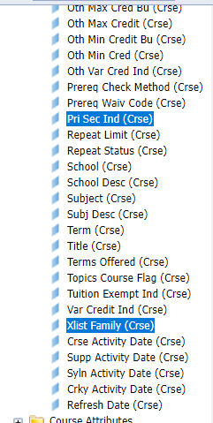
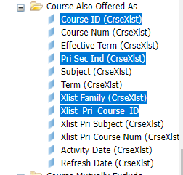
Where to find
Also-Offered-As Courses in the Pennant Student Records universe
In “COURSE ALSO OFFERED AS”:
In “COURSE”:
Note: all courses are in COURSE ALSO OFFERED AS
Student Data User Group – November 11, 2021

Slide 11
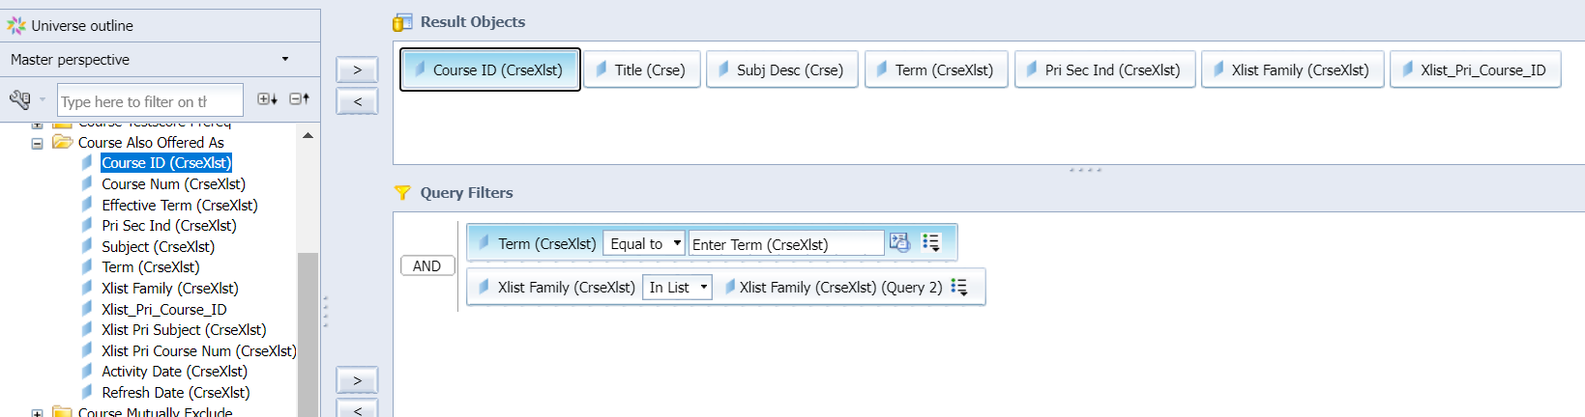
Demonstration query
Student Data User Group – November 11, 2021

Slide 12
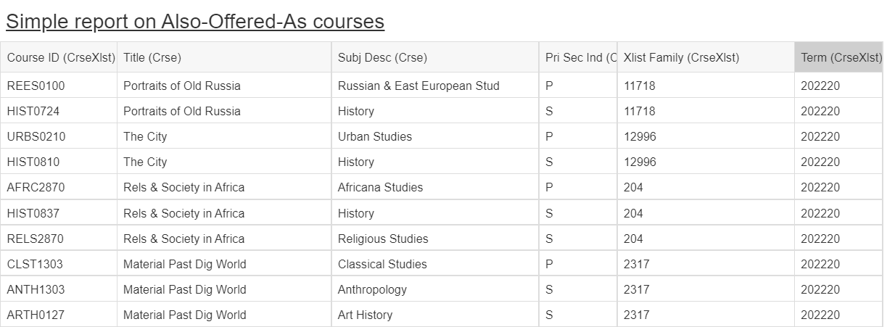
Demonstration query
Student Data User Group – November 11, 2021

Slide 13
Questions about Also-Offered-As courses?
Up next: Scheduled-With Course Sections…..
Student Data User Group – November 11, 2021

Slide 14
Scheduled-With Course Sections
  Course sections that are scheduled-with each other share a sched_with_group code in the warehouse, found in the CRSE_SECT_SCHED_WITH and CRSE_SECT_SCHED_WITH_GRP tables.
  There will always be one and only one course section in the sched_with_group that is identified as the primary
  Scheduled-With course sections can be the same course, but they do not have to be (for example: course sections at different levels that share resources and are not Also-Offered-As in the catalog, can still be scheduled with each other).
Student Data User Group – November 11, 2021

Slide 15
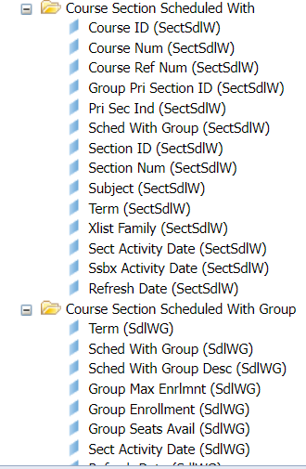
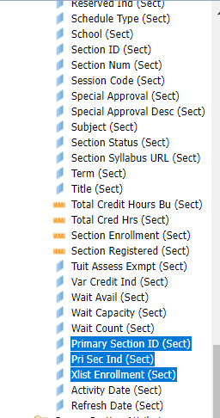
Where to find
Scheduled-With Course Sections in the Pennant Student Records universe
In “course section scheduled with” and “course section scheduled with group”
In “COURSE SECTION”
Student Data User Group – November 11, 2021

Slide 16
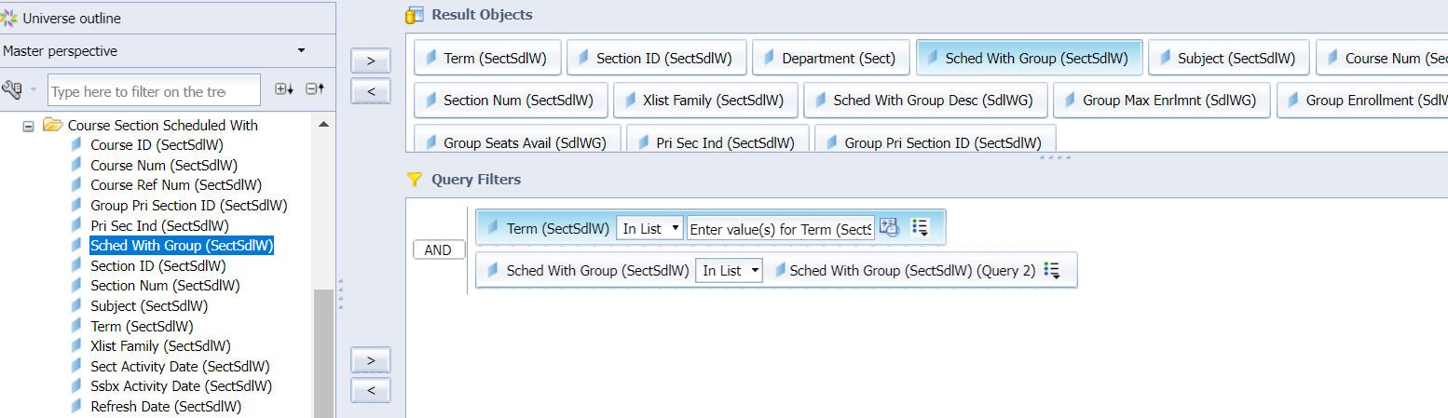
Demonstration query
Student Data User Group – November 11, 2021

Slide 17
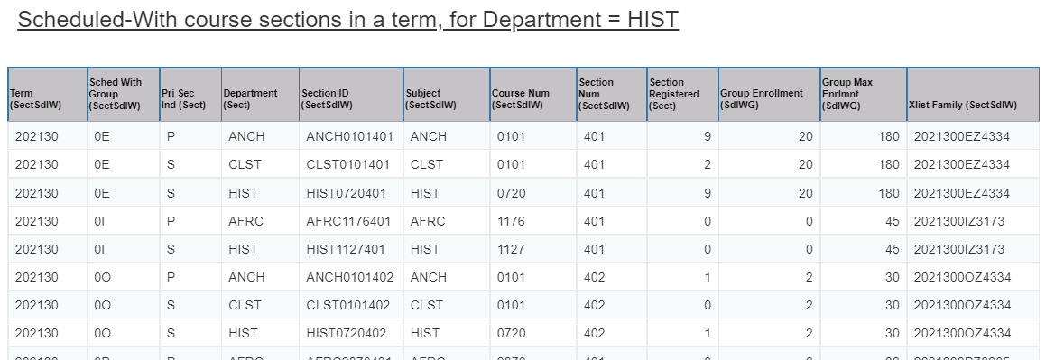
Demonstration query
Note: the above example is from Pennant Student Records - DWHE
Student Data User Group – November 11, 2021

Slide 18
Questions about
Scheduled-With course sections?
Up next: where to find canned pre-written queries…
Student Data User Group – November 11, 2021

Slide 19
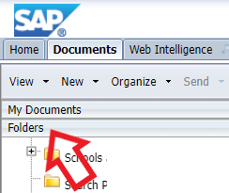
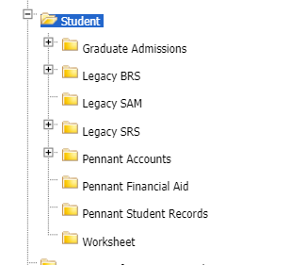
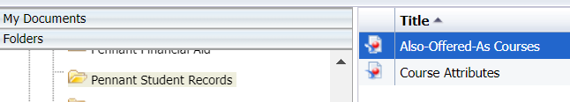
Webi public folders
… and scroll down to “Student”
… and open Pennant Student Records
In the Documents tab, expand the Folders
Student Data User Group – November 11, 2021

Slide 20
Some additional resources
  More about Also-Offered-As courses and Scheduled-With course sections: PSR_training_digest
  Warehouse documentation about tables and what they contain: https://www.isc.upenn.edu/pennant-student-records
  On the srfs.upenn.edu site for faculty/staff resources: Pennant Records | Penn Student Registration & Financial Services| Penn Srfs (upenn.edu)
Student Data User Group – November 11, 2021

Slide 21
Wrap-up
  Questions/comments
  Topics to be covered in future meetings
  Enrollments
  Advanced Registration
  Follow-up questions/comments: da-staff@isc.upenn.edu
  Discussions about student data: student-wh@lists.upenn.edu
Student Data User Group – November 11, 2021

