Slide 1
Remote Meetings Best Practices
Turn off your video function
Please go on Mute unless you are speaking
Please enter your questions in the chat function. When your question is being answered, you can go off Mute to ask follow-up questions
Please do not use the chat function for off-topic discussions
Student Data User Group – October 14, 2021

Slide 2
Data Warehouse
Student Data User Group
October 14, 2021
Student Data User Group – October 14, 2021

Slide 3
Agenda
An overview of the various environments
Pointing to SIT and how that impacts people using DWHE
Recent Changes in Development Pennant Student collection
Financial Aid update
Reporting on Course data in production WHSE
Getting ready for Section data – coming to prod soon
Announcements and wrap-up
Student Data User Group – October 14, 2021

Slide 4
Over the coming weeks and months… for Student Records *, we will be working in multiple places, concurrently:
Name/description | Database | Schemas | universes
PRODUCTION Legacy Student Data Collection | WHSE | DWADMIN, DWST | STDTCANQ, STDTTERM
DEVELOPMENT Pennant data collection Source is a non-production Banner region. More about that in the next slide… | DWHE | DWNGSS, DWNGSS_PS | Pennant Student Records - DWHE
PRODUCTION Pennant data collection – Source is production Banner. In Sept. 2021, we started with Course data tables. | WHSE | DWNGSS, DWNGSS_PS | Pennant Student Records
* note: this slide is specifically about Student Records data, but the same environments apply to Financial Aid
Student Data User Group – October 14, 2021

Slide 5
New Source for the
Development Pennant data collections
Coming this week – the source for the development warehouse data will change from the project’s Functional Object Testing to the System Integration Testing (SIT) environment
The data will still be in the development warehouse, only the underlying source will change
The data in SIT is more complete – especially in terms of Degree Term, Outcomes, Major, and Minor data
During SIT testing later this fall, a complete test of registration processes will run – meaning that there will be more current term registrations available for querying
Student Data User Group – October 14, 2021

Slide 6
Recent Changes in
Development Pennant Student data collection
ST_DEGREE_TERM: New and renamed columns; See Appendix for details.
ST_DEGREE_PURSUAL: New, renamed, and removed columns; See Appendix for details.
ALLOWABLE_GRADES: New table
  Grades that an Instructor can use on course section grading sheets for any TERM, LEVEL, and GRADE_MODE.
  Sample usage: Join from ST_ENROLLMENT to ALLOWABLE_GRADES on term, primary student level, and grade mode.
Student Data User Group – October 14, 2021

Slide 7
Recent Changes in
Development Pennant Student data collection
New columns in the CRSE_SECTION table:
  FINAL_GRADE_IND
  PART_OF_TERM_DESC
  SPECIAL_APPROVAL_DESC
  SYLLABUS_URL
And COURSE_ID was added to the following tables:
  CRSE_SECT_ATTTRIBUTE
  CRSE_SECT_INSTRUCTOR
  CRSE_SECT_MEETING
  CRSE_SECT_OVERRIDE
  CRSE_SECT_SCHED_WITH
Student Data User Group – October 14, 2021

Slide 8
Financial Aid update
The Pennant Aid (DWNGSS_PF) tables in production have been live since October 1st.
  Main source of data is from Banner.
    Being used for aid applicants for the next aid year (2022-2023)
  SAM and current Financial Aid data warehouse tables (DWSFA) are main source of data for current aid year.
Eform to request access to the Pennant Aid information has been available since October 4th.
Student Data User Group – October 14, 2021

Slide 9
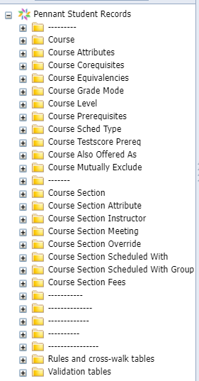
Now in Production:
Course and Course Section
In the production warehouse and in the production universe Pennant Student Records you now can see the tables and views for Course and Course Section
(along with the rules and validation tables and views)
All other tables and views are only available in the development warehouse and in the development universe:
Pennant Student Records - DWHE
Student Data User Group – October 14, 2021

Slide 10
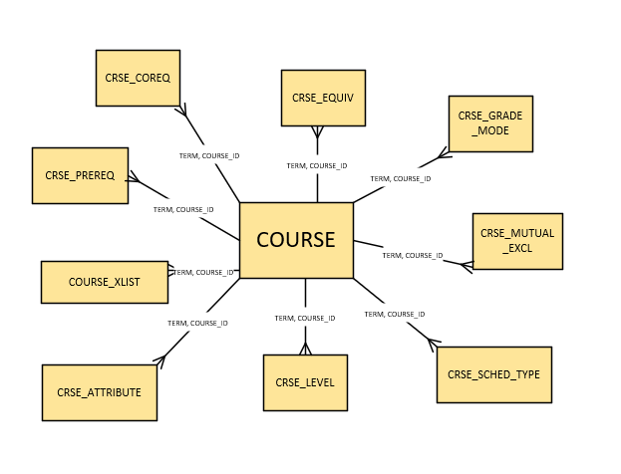
The COURSE table, and related tables
Descriptions of the tables and what they contain: https://www.isc.upenn.edu/pennant-student-records
Student Data User Group – October 14, 2021

Slide 11
Course records are term-effective in the source (Banner), but are stored term-by-term in the warehouse
In the legacy Course_Inventory
table, we had to look at the start/end
Terms. In Pennant Student Records,
we will have one row per term.
This makes it easier to join between
Course tables, and to join to the
Course Section tables, using Term.
To get just one row per Course,
always specify the Term
in your queries. Otherwise, you’ll get multiple rows back, as in this example:
Course ID (Crse) | Effective Term (Crse) | Term (Crse) | Title (Crse)
AAMW5020 | 202220 | 202220 | Mesopotamia 2200-1600bce
AAMW5020 | 202220 | 202230 | Mesopotamia 2200-1600bce
AAMW5020 | 202220 | 202310 | Mesopotamia 2200-1600bce
AAMW5020 | 202220 | 202320 | Mesopotamia 2200-1600bce
AAMW5230 | 202220 | 202220 | Narrative in Ancient Art
AAMW5230 | 202220 | 202230 | Narrative in Ancient Art
AAMW5230 | 202220 | 202310 | Narrative in Ancient Art
AAMW5230 | 202320 | 202320 | Comparative Narratives in Art
Student Data User Group – October 14, 2021

Slide 12
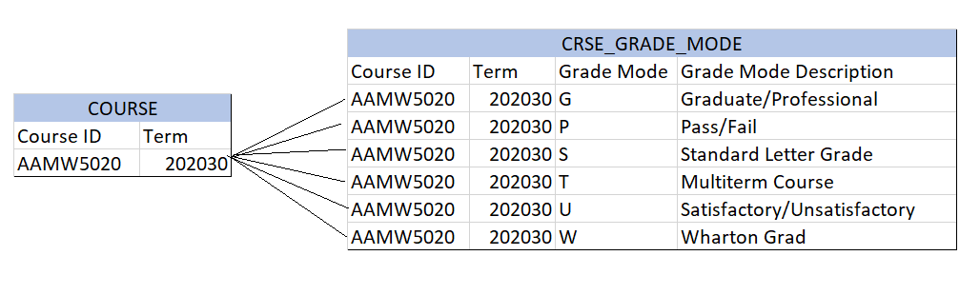
How the COURSE table relates to other tables with course information
“One-to-Many”
For example: In a specified term, for on specified course, there can be multiple available grade modes:
Student Data User Group – October 14, 2021

Slide 13
Recap: reporting on Course data
Main points covered today:
The Course (aka catalog) data are now in the production warehouse. (for Webi users: Pennant Student Records universe)
Course data are term-effective in Banner. To facilitate warehouse reporting, we are storing the Course data term-by-term.
There are numerous tables that join to COURSE on Course_ID and Term.
The relationship between COURSE and the other tables is “one-to-many”.
Student Data User Group – October 14, 2021

Slide 14
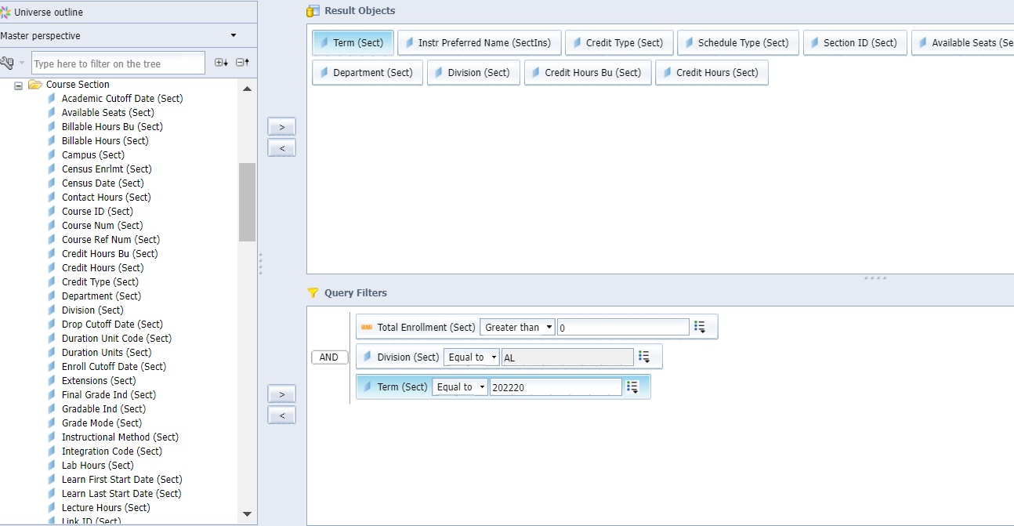
Coming Soon: Course Section data
Table: CRSE_SECTION
Universe folder:
Course Section
Data for Summer 2022 and Fall 2022 sections will be in the warehouse in November 2021
Student Data User Group – October 14, 2021

Slide 15
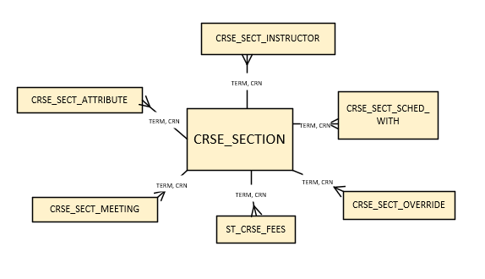
The CRSE_SECTION table, and related tables
Descriptions of the tables and what they contain: https://www.isc.upenn.edu/pennant-student-records
Student Data User Group – October 14, 2021

Slide 16
Some new vocabulary for Course Sections
CRN vs Section ID
  The CRN, or Course Reference Number, is Banner’s internal identifier for a course section.
  Section ID is something we use in the warehouse to uniquely identify a course section. It is the concatenation of the Subject area, the Course number, and the Section number.
  EITHER ONE can be used to uniquely identify a course section in the warehouse Pennant Student Records data collection.
Scheduled With
  In the legacy system, we referred to course sections that were offered at the same time in the same location taught by the same instructors as “cross-listed”
  In Pennant, these are now referred to as sections that are “scheduled with” each other.
We will have a more detailed look at course sections at an upcoming SDUG meeting.
Student Data User Group – October 14, 2021

Slide 17
Recap: reporting on Course Section data
Main points covered today:
The Course Section tables are now in the production warehouse (Pennant Student Records universe) but not section data. Expect to start seeing section data in November 2021, for sections scheduled for Summer 2022 and Fall 2022.
The relationship between CRSE_SECTION and the other tables is “one-to-many”; the universe joins are on CRN and Term.
We have some new terminology and new ways of looking at section data.
You can explore the new tables with test data now in the development warehouse (Pennant Student Records–DWHE universe)
Student Data User Group – October 14, 2021

Slide 18
Announcements
  The University Registrar’s census date this term is Monday, October 18.
  SRS Census data will be available in the warehouse on Tuesday, October 19.
Student Data User Group – October 14, 2021

Slide 19
Wrap-up
  Questions/comments
  Feedback/ Suggestions for future meetings?
  Follow-up questions/comments: da-staff@isc.upenn.edu
  Discussions about student data: student-wh@lists.upenn.edu
Student Data User Group – OCTOBER 14, 2021

Slide 20
Appendix: Changes to specified tables in the Development Pennant Student Records data collection
Changes to ST_DEGREE_TERM
renamed TERM_GPA_CREDIT to TERM_GPA_HOURS
renamed TERM_CUMULATIVE_EARNED_CREDIT to TERM_CUM_EARNED_CREDIT
renamed TERM_CUMULATIVE_QUALITY_POINTS to TERM_CUM_QUALITY_POINTS
renamed TERM_CUMULATIVE_GPA_CREDIT to TERM_CUM_GPA_HOURS
Added these columns:
TERM_ATTEMPTED_CREDIT_BU
TERM_EARNED_CREDIT_BU
TERM_QUALITY_POINTS_BU
TERM_GPA_HOURS_BU
TERM_CUM_EARNED_CREDIT_BU
TERM_CUM_QUALITY_POINTS_BU
TERM_CUM_GPA_HOURS_BU
Student Data User Group – October 14, 2021

Slide 21
Appendix (continued): Changes to specified tables in the Development Pennant Student Records data collection
renamed LAST_DEG_TERM_STATUS to LAST_ENROLLED_TERM_STATUS
renamed LAST_DEG_TERM_STATUS_DESC to LAST_ENROLLED_TERM_STATUS_DESC
renamed HRS_ATTEMPTED_PENN to ATTEMPTED_CREDIT
renamed HRS_ATTEMPTED_PENN_BU to ATTEMPTED_CREDIT_BU
renamed HRS_EARNED_PENN to EARNED_CREDIT
renamed HRS_EARNED_PENN_BU to EARNED_CREDIT_BU
renamed HRS_EARNED_EXT to TRANSFER_CREDIT
renamed HRS_EARNED_EXT_BU to TRANSFER_CREDIT_BU
renamed QUAL_PTS_PENN to QUALITY_POINTS
renamed QUAL_PTS_PENN_BU to QUALITY_POINTS_BU
renamed PENN_GPA to GPA
Deleted these 12 columns:
HRS_ATTEMPTED_EXT, HRS_ATTEMPTED_EXT_BU, HRS_ATTEMPTED_TOTAL, HRS_ATTEMPTED_TOTAL_BU, HRS_EARNED_TOTAL, HRS_EARNED_TOTAL, HRS_EARNED_TOTAL_BU, OVERALL_GPA, QUAL_PTS_EXT, QUAL_PTS_EXT_BU, QUAL_PTS_TOTAL, QUAL_PTS_TOTAL_BU, TRANSFER_GPA
Added these 2 columns:
GPA_HOURS
GPA_HOURS_BU
Changes to
ST_DEGREE_PURSUAL
Student Data User Group – October 14, 2021

