Slide 1
Remote Meetings Best Practices
Turn off your video function
Please go on Mute unless you are speaking
Please enter your questions in the chat function. When your question is being answered, you can go off Mute to ask follow-up questions
Please do not use the chat function for off-topic discussions
Student Data User Group – SEPTEMBER 9, 2021

Slide 2
Data Warehouse
Student Data User Group
SEPTEMBER 9, 2021
Student Data User Group – SEPTEMBER 9, 2021

Slide 3
Agenda
Announcements
Release 1: Pennant Financial Aid
Release 1: Pennant Student Records
Wrap-up
Student Data User Group – SEPTEMBER 9, 2021

Slide 4
Announcements
Changes and additions to tables:
ST_TERM column name changes: BILLING_RATE to RATE and BILLING_RATE_DESC to RATE_DESC
CRSE_SECT_INSTRUCTOR new column: INSTRUCTOR_EMAIL
ST_ACTIVITY new column: ACTIVITY_DESC
V_SUBJECT and V_SUBJECT_V new columns: SCHOOL_CODE and ORG_CODE
ST_DEGREE_PURSUAL and ST_DEGREE_TERM new columns: ACAD_PROG_TYPE, ACAD_PROG_TYPE_DESC, CREDENTIAL_IND, DEGREE_SEEKING_IND
ST_TERM and ST_DEGREE_TERM: Graduation Term and Graduation Date have been removed and in ST_DEGREE_PURSUAL, we now have GRADUATION_TERM, GRADUATION_DATE, and GRADUATION_ACAD_YEAR
Student Data User Group – SEPTEMBER 9, 2021

Slide 5
Announcements, continued
Curriculum Management enhancements and new columns
  Banner prereqs and Banner prereqs CL, Course attributes, Credits (change to the way it was stored), Schedule type hours,
  Multi-term indicator and Multi-term details
  Collection documentation: https://www.isc.upenn.edu/curriculum-management-data-collection
Student Records Release 1.0 in production in early September
Financial Aid Release 1.0 will be in the production warehouse end of September
In early October we will be using a different source: SIT or system integration testing environment (the data available for development and query re-writing should be more complete than what we have had so far)
Student Data User Group – SEPTEMBER 9, 2021

Slide 6
Release 1: Pennant Financial Aid
Pennant Financial Aid is the new financial aid data warehouse that uses Banner as the main source of data.
Pennant Financial Aid tables will be available in production at the end of September.
An email will be going out to the Financial Aid Data Warehouse user listserv sometime within the next week with link for eform to request access.
For aid year 2021-2022, SAM and current Financial Aid data warehouse should be source of data analysis.
  For R1 - Banner is being used to process applicants for Fall 2022 (Financial Aid Year 2022-2023)
Student Data User Group – SEPTEMBER 9, 2021

Slide 7
Release 1: Pennant Student Records database tables
Production Database Tables in DWNGSS_PS
Course tables:
COURSE
COURSE_XLIST
CRSE_ATTRIBUTE
CRSE_COREQ
CRSE_EQUIV
CRSE_GRADE_MODE
CRSE_LEVEL
CRSE_MUTUAL_EXCL
CRSE_PREREQ
CRSE_SCHED_TYPE
CRSE_TESTSCORE_PREREQ
Course Section tables:
CRSE_SECTION
CRSE_SECT_ATTRIBUTE
CRSE_SECT_INSTRUCTOR
CRSE_SECT_MEETING
CRSE_SECT_OVERRIDE
CRSE_SECT_SCHED_WITH
CRSE_SECT_SCHED_WITH_GRP
ST_CRSE_FEES
Note: This is the initial list; additional tables may be added later
Student Data User Group – SEPTEMBER 9, 2021

Slide 8
Pennant Student Records tables, continued
Production Database Tables in DWNGSS
All of the validation tables that support Course and Course Sections: tables all start with V_,
for example (note: the following is not a complete list!)
    V_BUILDING
    V_CAMPUS
    V_CRSE_DURUNIT
    V_CRSE_PROG_ATTR
    V_CRSE_TERMS_OFFR
    V_DEPARTMENT
    V_DIVISION
    V_SCHOOL
See https://www.isc.upenn.edu/pennant-student-records for the table and element descriptions
Student Data User Group – SEPTEMBER 9, 2021

Slide 9
Pennant Student Records tables, continued
A note about validation tables and views:
When a V_ table contains a Long Description, there can be multiple rows: long descriptions have start/end terms. To get back just one row, with just the most recent long description, use the view related to that table.
For example: V_DEPARTMENT has both a short and a long description for each department code.
Over time, departments could potentially have a name change. (below is a made-up example)
The view called V_DEPARTMENT_V will have just the most recent row for each description.
See later slide in this presentation for what these will look like in the Pennant Student Records Universe…
DEPT_CODE | DEPT_DESC | DEPT_DESC_LONG | LONG_DESC_START_TERM | LONG_DESC_END_TERM
ENGL | English | English | 201920 | 999999
WHCP | Wharton Communication Pgm | Wharton Communication Program | 201920 | 999999
VBMS | Veterinary & Biomed Science | Veterinary & Biomedical Science | 201920 | 202220
VBMS | Veterinary & Biomed Science | Veterinary and Biomedical Science | 202230 | 999999
Student Data User Group – SEPTEMBER 9, 2021

Slide 10
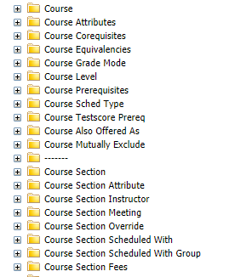
Pennant Student Records Universe
Pennant Student Records Universe in production will only display the folders and objects related to Courses and Course Sections
The validation tables will be at the bottom of the list of classes
The rest of the production universe will be available in March of 2022
Student Data User Group – SEPTEMBER 9, 2021

Slide 11
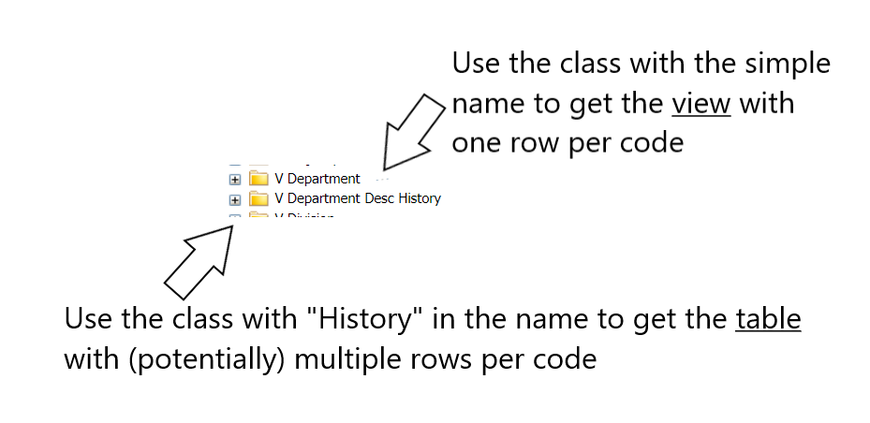
Pennant Student Records Universe, continued
A note about validation tables and views:
When a validation table contains a long description, there will be two classes in the Universe…
Student Data User Group – SEPTEMBER 9, 2021

Slide 12
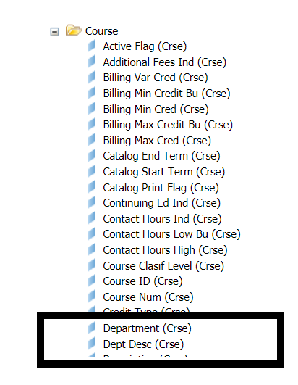
Pennant Student Records Universe, continued
If you do not need the long description, in most situations you might not even need to go to the validation tables because the universe classes will contain both the code and the Banner description.
Student Data User Group – SEPTEMBER 9, 2021

Slide 13
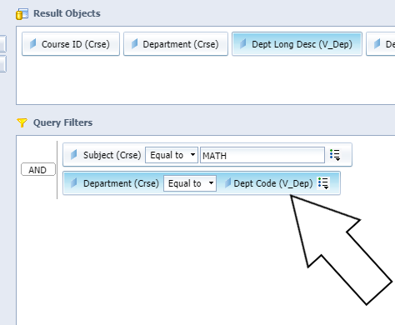
Pennant Student Records Universe, continued
If you are getting a long description from a validation table, be sure to include the join in your universe query filters
Student Data User Group – SEPTEMBER 9, 2021

Slide 14
Pennant Student Records data
Initially, the only data you will see in production Pennant Student Records will be for Courses (data coming from the Course Catalog).
Later on, as departments begin to create their section data in CLSS, we will begin to see some Course Section data, for course sections that will be offered in the 202220 (Summer 2022) and 202230 (Fall 2022).
Reminder: No student data is included in this release.
If you are in “development mode” and working on getting your queries Pennant-ready, we recommend that you continue to use the development environment. That universe is now named:
Pennant Student Records - DWHE
Student Data User Group – SEPTEMBER 9, 2021

Slide 15
Wrap-up
  Questions/comments
  Feedback/ Suggestions for future meetings?
  Follow-up questions/comments: da-staff@isc.upenn.edu
  Discussions about student data: student-wh@lists.upenn.edu
Student Data User Group – SEPTEMBER 9, 2021

Slide 16
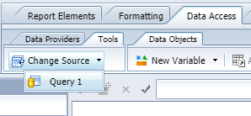
Post-meeting demo: pointing a Webi query to a different universe
If you already have Webi queries that pointed to Pennant Student Records, and you want to continue developing and thus need to point them to Pennant Student Records – DWHE, do the following:
1. Modify the report. From the Data Access tab, select
the Tools sub-tab, and click on Change Source, and select your query.
Student Data User Group – SEPTEMBER 9, 2021

Slide 17
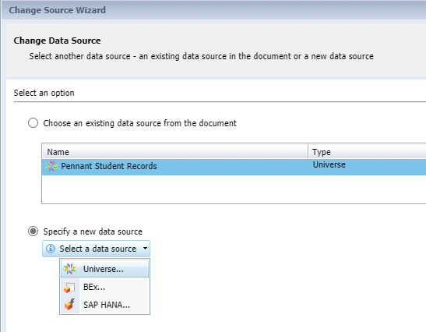
Pointing to a different universe
(continued)
2. A Change Data Source window will open. Click on
the radio button for “Specify a new data source”, and
select Universe…
Not shown:
3. Select Pennant Student Records – DWHE
from the available universe list.
4. Click on OK, then click on Next (twice).
You’ll notice that all of the same objects are in
both universes.
5. Click on Finish and refresh your report.
Student Data User Group – SEPTEMBER 9, 2021

