Slide 1
Remote Meetings Best Practices
Turn off your video function
Please go on Mute unless you are speaking
Please enter your questions in the chat function. When your question is being answered, you can go off Mute to ask follow-up questions
Please do not use the chat function for off-topic discussions
Student Data User Group – AUGUST 12, 2021

Slide 2
Data Warehouse
Student Data User Group
AUGUST 12, 2021
Student Data User Group – AUGUST 12, 2021

Slide 3
Agenda
Announcements
What happened to SRS Special Programs?
Wrap-up
Student Data User Group – AUGUST 12, 2021

Slide 4
Announcements
Potential load delays
Please be aware that we are coming into a very busy time of year. Last year around this time we experienced overall delays in many of the warehouse collections.
This year we anticipate a similar situation could occur on Monday evening, August 16. The Student Data collection (current collection, sourced from SRS, available via STDTCANQ) may not be refreshed until later than usual on Tuesday, August 17. Please watch for notification to the warehouse listserv on 8/17.
Student Data User Group – AUGUST 12, 2021

Slide 5
Announcements, continued
Three new columns in CRSE_SECTION:
PRI_SEC_IND: For stand-alone course sections, this column will default to 'P'. For cross-listed courses where the section is the primary section, this column will be 'P'.
For cross-listed courses where the section is not the primary section, this column will be 'S’
PRIMARY_SECTION_ID: For stand-alone course sections, this is the same as the SECTION_ID. For cross-listed courses where the section is the primary section, this is the same as the SECTION_ID.
For cross-listed courses where the section is not the primary section, this is the SECTION_ID of the primary member of the cross-list group.
XLIST_ENRLMT: For stand-alone course sections, this is the same as the enrollment for just that one section. For cross-listed courses, this is the sum of the enrollments for all sections in the cross-list group.
Student Data User Group – AUGUST 12, 2021

Slide 6
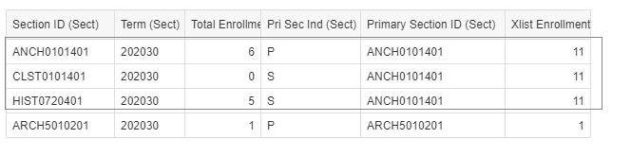
CRSE_SECTION new fields in Pennant Student Records universe
Pennant Student Records documentation
https://www.isc.upenn.edu/pennant-student-records#Tables-and-Data-Elements
and learning “digests”:
https://www.isc.upenn.edu/pennant-student-records#Training
Student Data User Group – AUGUST 12, 2021

Slide 7
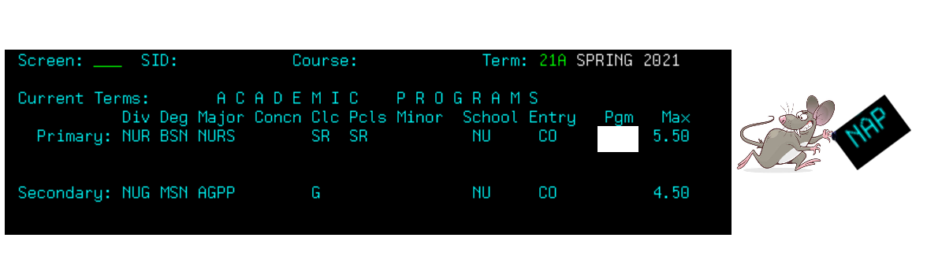
What happened to SRS Special Programs?
OR: Who moved my cheese?
Student Data User Group – AUGUST 12, 2021

Slide 8
Rationale
The Special Program field in SRS has had a wide and varied usage in SRS’s 30+ year history.
It has been used primarily to drive tuition and fee rules, but also is used for reporting and transcript notations.
Banner does not have an element for “Special Program” but does have many elements that can be on a student’s record. These include Student Attribute, Rate Code, Site Code, Cohort, and Academic Program.
NGSS Project design has mapped SRS Special Programs to the appropriate element(s) in Banner.
Student Data User Group – AUGUST 12, 2021

Slide 9
Mapping example 1
Study Abroad and Exchange programs
Special Program Code | Special Program Name | Rule | Rate Code | Site Code
ABJ | PENN_IN_BEIJING | Use SITE CODE for the specific location | FREE | ABJ
BBB | STUDY ABROAD AT UNIV SAO PAOLO BRAZIL | Use either the RATE CODE, or SITE codes starting with ‘B’, Or the SITE CODE for the specific location | STDYB | BBB
FHI | IDC HERZLIYA IN ISRAEL | Use SITE CODE for the specific location | FREE | FHI
SITE is term-specific. Students can have only one SITE per term. In the warehouse, SITE is found in ST_TERM.
Note: we’ll be talking about the “FREE” rate codes in a later slide during today’s presentation.
Student Data User Group – AUGUST 12, 2021

Slide 10
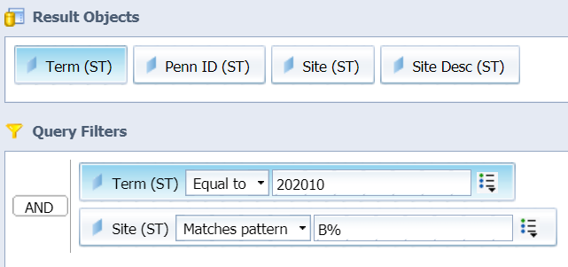
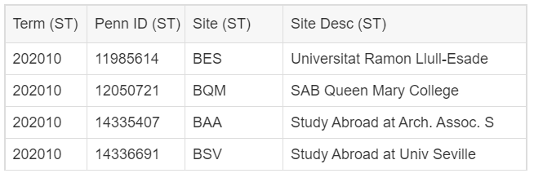
Example 1 using Webi to find Study Abroad
In ST_TERM, filter for Site codes that start with B (see note**)
Note ** Site codes starting with A are the old A** special program codes
Site codes starting with B are the old B** special program codes
Site codes starting with F are the old F** special program codes
Student Data User Group – AUGUST 12, 2021

Slide 11
Mapping example 2
Nursing Accelerated Program (NAP)
Special Program Code | Special Program Name | Rule | Program Code
NAP | ACCELERATED NURSING STUDENTS | Use PROGRAM CODE | NU_BSN_NAP
Students can have multiple overlapping academic programs – also known as curricula -- per term. But they can have only one PROGRAM_CODE per curriculum per term.
Program is found in ST_TERM (for just the primary program), ST_DEGREE_TERM, ST_DEGREE_PURSUAL, and ST_DEGREE_OUTCOME.
Student Data User Group – AUGUST 12, 2021

Slide 12
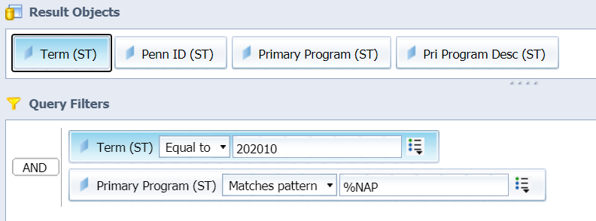
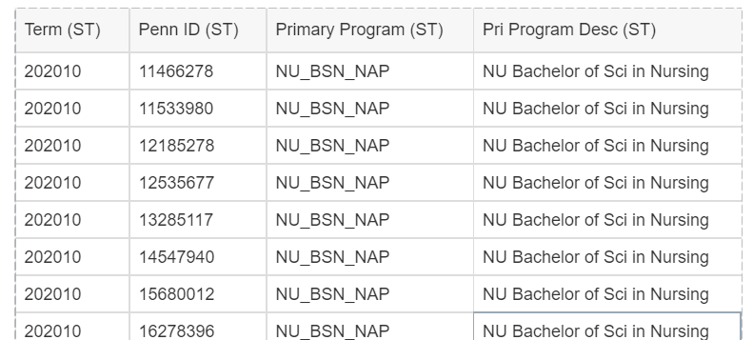
Example 2 using Webi to find NAP students
Filter for Programs ending with NAP (in this example, using ST_TERM):
Student Data User Group – AUGUST 12, 2021

Slide 13
Mapping example 3
Graduate School of Education “E” codes
Special Program Code | Special Program Name | Rule | Rate Code
EAP | ASPIRING PRINCIPALS | use RATE CODE | GMEAP
EBW | EDUCATION WORK-BASED | use RATE CODE | GMEBW
EP2 | EPHRATA 2 | use RATE CODE | GMEP2
EMR | MID CAREER STUDENTS IN REGULAR DISSERTATION | use RATE CODE | GMEMR
RATE is term-specific. Students can have only one RATE per term.
In the warehouse, the data element is called BILLING_RATE, and is found in ST_TERM.
Student Data User Group – AUGUST 12, 2021

Slide 14
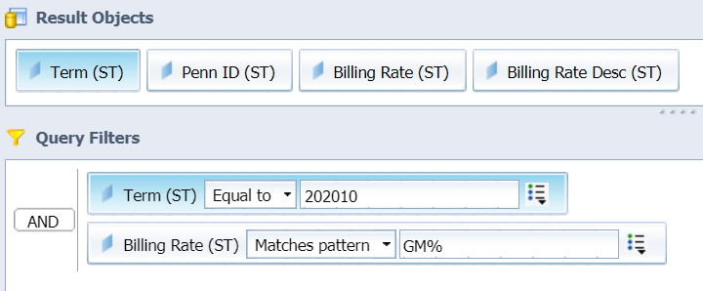
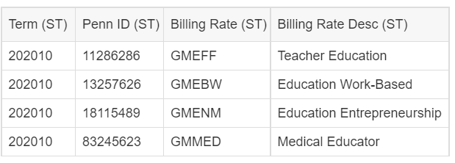
Example 3 using Webi to find Grad Educ rates
In ST_TERM, filter for Billing Rate codes that start with GM
Student Data User Group – AUGUST 12, 2021

Slide 15
Mapping example 4
RATE codes of “FREE”
Special Program Code | Special Program Name | Rule | Rate Code | Site Code
FIB | INDIAN SCHOOL OF BUSINESS | use RATE = ‘FREE’ and SITE CODE | FREE | FIB
FLO | LONDON BUSINESS SCHOOL, U.K. | use RATE = ‘FREE’ and SITE CODE | FREE | FLO
FST | STOCKHOLM SCHOOL OF ECONOMICS, SWEDEN | use RATE = ‘FREE’ and SITE CODE | FREE | FST
‘Free’ rate codes indicate that the Tuition and Fee process will not result in charges for that Term.
SITE and RATE are term-specific. Students can have only one SITE and only one RATE per term. In the warehouse, both are found in ST_TERM.
Student Data User Group – AUGUST 12, 2021

Slide 16
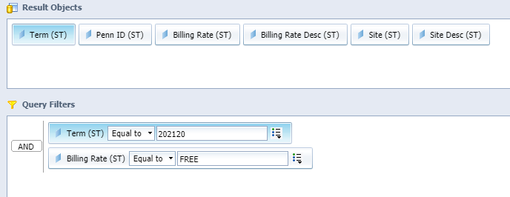
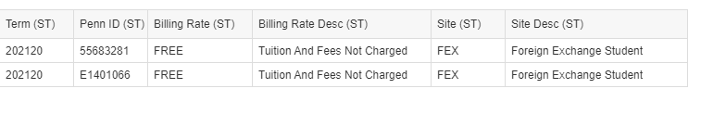
Example 4 using Webi to look at programs with the “FREE” rate code
In ST_TERM, filter for Billing Rate = ‘FREE’ and also return the Site codes
Student Data User Group – AUGUST 12, 2021

Slide 17
Mapping example 5
Wharton Executive program
Special Program Code | Special Program Name | Rule | Cohort Code | Program Code
WWE | WHARTON WEST EVEN | use COHORT CODE and PROGRAM CODE | WEMBAEVEN | WX_MBA_SFO
WWO | WHARTON WEST ODD | use COHORT CODE and PROGRAM CODE | WEMBAODD | WX_MBA_SFO
WEE | WHARTON EAST EVEN | use COHORT CODE and PROGRAM CODE | WEMBAEVEN | WX_MBA_PHL
WEO | WHARTON EAST ODD | use COHORT CODE and PROGRAM CODE | WEMBEODD | WX_MBA_PHL
Students can have only one program code per curriculum per term. Program is found in ST_TERM (primary program), ST_DEGREE_TERM, ST_DEGREE_PURSUAL, and ST_DEGREE_OUTCOME.
Students can have multiple cohorts per term. Cohort is found in ST_COHORT.
Student Data User Group – AUGUST 12, 2021

Slide 18
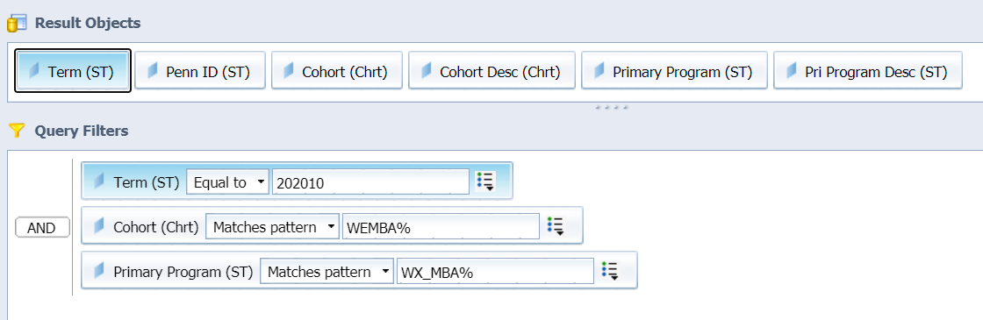
Example 5 using Webi to look at Wh Exec programs
Filter for Cohorts starting with WEMBA
Filter for Programs starting with WX_MBA
This is just one example of looking at Wharton Executive programs. See next slide for other options.
Student Data User Group – AUGUST 12, 2021

Slide 19
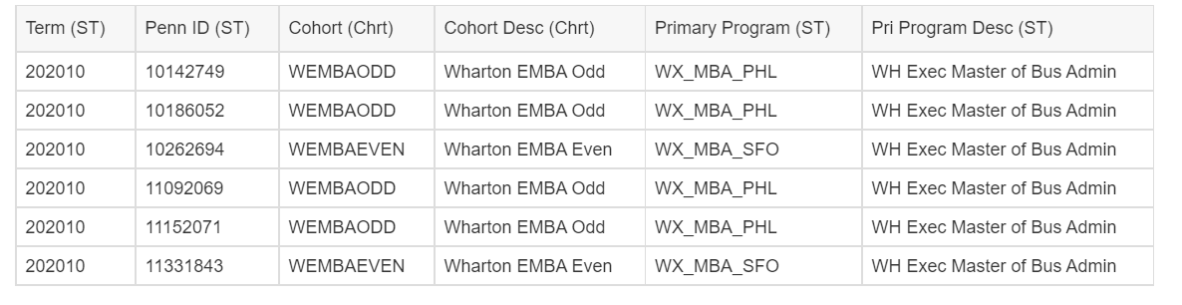
Wharton Executive program, continued
The above is the result of filtering on cohorts like ‘WEMBA%’. You can also filter for Cohorts ending in ODD or EVEN, Or: filter for Programs ending in _PHL or _SFO, if you are looking for a particular campus,
Or: filter for a specific Program code, if that’s what you need…
Student Data User Group – AUGUST 12, 2021

Slide 20
Mapping example 6
Special Program “T” and “X” codes
Special Program Code | Special Program Name | Rule
TND | NUR – NURSING ONLINE DNP PROGRAM | Not mapped
TNM | WHARTON NO MAJOR CERTIFICATE PROGRAM | Not mapped
XBM | BRYN MAWR CONSORTIUM PROGRAM | Not mapped
XHV | HAVERFORD CONSORTIUM PROGRAM | Not mapped
There is no need for these indicators in Banner as the Banner Tuition and Fee Rule process can be granular and can utilize Banner elements to calculate the correct Tuition and Fees.
These codes will continue to exist in the current STDTCANQ Universe, but not the Pennant Student Records Universe.
Student Data User Group – AUGUST 12, 2021

Slide 21
A look at the mapping spreadsheet
  Latest draft is available at https://provider.www.upenn.edu/computing/da/dw/pennant-student-records/Special_Program_Mapping_for_training.xlsx
  Or, from the U@Penn site: https://portal.apps.upenn.edu/penn_portal/u@penn.php
  You can go to the Data Warehouse page, from there to the Student section, then to Pennant Student Records
Student Data User Group – AUGUST 12, 2021

Slide 22
Wrap-up
  Questions/comments
  Feedback/ Suggestions for future meetings?
  Follow-up questions/comments: da-staff@isc.upenn.edu
  Discussions about student data: student-wh@lists.upenn.edu
Student Data User Group – AUGUST 12, 2021

