Slide 1
Data Warehouse
Student Data User Group
MARCH 25, 2021
Student Data User Group – MARCH 25, 2021

Slide 2
Remote Meetings Best Practices
Turn off your BlueJeans video function
Please go on Mute unless you are speaking
Please enter your questions in the chat function. When your question is being answered, you can go off Mute to ask follow-up questions
Please do not use the chat function for off-topic discussions
Student Data User Group – MARCH 25, 2021

Slide 3
Agenda
Welcome
Pennant Student Records data collection:
Navigating cross-walk tables
Call for queries
Wrap-up
Student Data User Group – MARCH 25, 2021

Slide 4
Cross-walks
New vs. Old data values
  Many of the codes used in SRS are changing when we move to Pennant
  In most situations where codes have changed, you won’t see the old codes in Pennant, but we will have cross-walks in the warehouse where you will be able to find the mapping of old-to-new
  Some fields in Pennant are derived from multiple source fields in SRS.
  Some SRS fields are converting into more than one place in Pennant
  …Cross-walk tables plus documentation will explain how things were converted
Student Data User Group – MARCH 25, 2021

Slide 5
There are essentially three cross-walk “types”
1. Cross-walks that provide look-ups to get the old values
  The data in Pennant will have the new codes on all records.
  If the old code is really needed on a report, you can join to the warehouse table that contains the old-to-new values.
2. Cross-walks that explain how things got converted
  The data in Pennant will have the new codes on all records.
  The cross-walks and documentation will show you how the data were converted.
3. Cross-walks that are for longitudinal reporting
  For just this type of cross-walk, the data in Pennant will have the
  new value on new records, and the old value on old records.
  You will need the cross-walk to compare things across terms (going back to older terms).
Student Data User Group – MARCH 25, 2021

Slide 6
1. Cross-walks that provide look-ups to get old values
  The data in Pennant will have the new codes on all records.
  If it’s really needed, you can join to the warehouse cross-walk tables to display the old SRS value, and get the descriptions. Examples:
      School and Division codes
      Degree and Coordinated Multi degree codes (formerly known as “Joint Degree”)
      Major, Minor, Concentration codes
      Institution codes
      Athletic participation codes
Student Data User Group – March 25, 2021

Slide 7
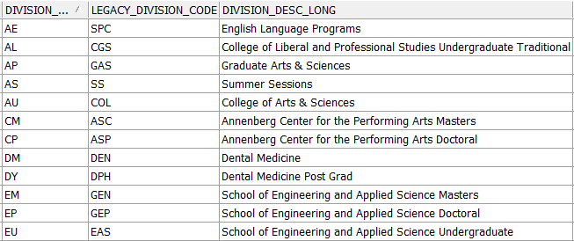
Cross-walk type #1 continued
Often the old-to-new values can be found in the validation tables (labeled “legacy”), and no additional cross-walk will be needed.
Remember: for most things, all of the data in Pennant Student Records will have the new codes. The old-to-new information is stored in the warehouse to just help you get acclimated.
Student Data User Group – March 25, 2021

Slide 8
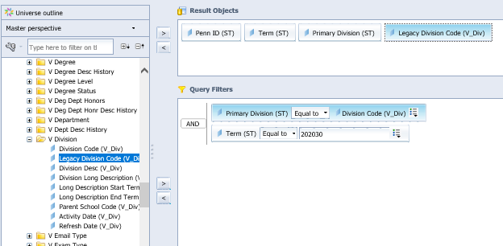
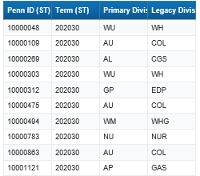
If for some reason you want to get the old code, you can join to the table that has the old-to-new codes, matching on the code, to get what you want to display on your report…
Student Data User Group – MARCH 25, 2021

Slide 9
2. Cross-walks that explain how things got converted into Banner
  The data in Pennant will have the new codes on all records.
  The documentation will show you how the data were converted.
  In some cases, these more complex cross-walks have a single SRS field that maps into various fields in Pennant. An example of this type of cross-walk is the Special Program cross-walk.
  In some cases, a complex cross-walk table with have multiple SRS fields, and various combinations of those legacy fields map to a single Pennant field. An example of this type of cross-walk is the Admit Codes cross-walk.
Student Data User Group – MARCH 25, 2021

Slide 10
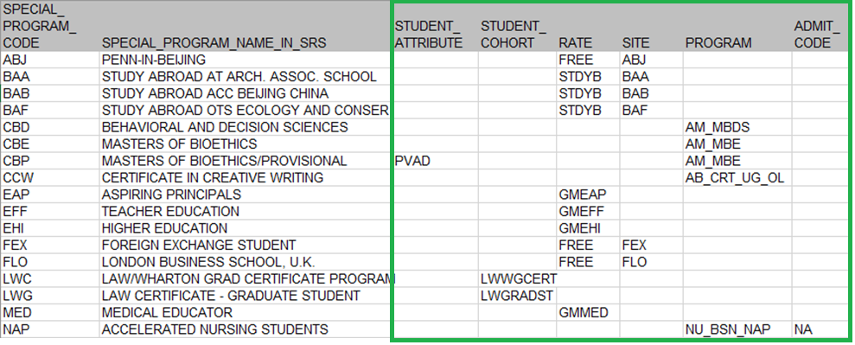
Special Programs – a “special” type of cross-walk
  As discussed at our last Student Data User Group meeting, SRS Special Programs are converting into various places in Pennant, depending on their function or purpose:
Student Data User Group – MARCH 25, 2021

Slide 11
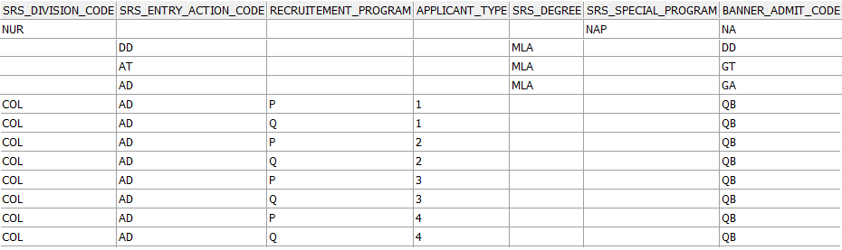
Admit Codes – another “special” type of crosswalk
  A combination of SRS division and/or degree and/or entry action and/or undergraduate admissions fields determined what was converted into the Banner Admit Code:
Student Data User Group – MARCH 25, 2021

Slide 12
Admit Codes, continued
LOV table in Banner: STVADMT
LOV table in the warehouse: V_ADMIT_TYPE
DD | Dual Degree Admit
DF | Defer EDP -> RDP UGAO Admit
ED | Early Decision Prog UGAO-EDP
GA | Graduate/Professional Admit
GP | Hold-over/Gap student UGAO
GT | Transfer Grad/Prof Admit
HS | High School Admit
IT | Internal Transfer
JD | Joint Degree Admit
NA | Nursing Accelerated Admit
ND | Non-Degree Admit
NT | Non-Traditional UG Admit
PB | Post- Bacc Admit
PR | Athletics Pre-Read UG
QB | Questbridge Admit UGAO
R1 | Readmitted
RD | Reg Decision Prog UGAO-RDP
RI | Reinstated after Suspension
RL | Return from Leave
RX | Return to Study
SB | Submatriculant Admit
SE | External Submatriculant Admit
TR | Transfer Admit UGAO
VE | Visiting/Exchange Student Admit
How you will use these depends on what you need to do.
In Pennant, we can query on more specific admit codes than we previously had in SRS.
Sometimes you may need to filter on multiple types. Example: InList(RD;ED;GP;QB)
Remember: all of the data in Pennant Student Records will have the new admit codes, so even if you go back in time for converted students, you won’t see the old SRS Entry Actions.
Student Data User Group – MARCH 25, 2021

Slide 13
3. Cross-walks that are for longitudinal reporting
Course Re-numbering cross-walk
Current courses from the SRS course inventory are being converted into their new numbers. Old (closed in SRS) are not being converted and will not be in the new data collection. They will remain in the old warehouse data collection.
Students’ completed course sections will convert into their Academic History with the old numbers.
Students’ enrollment in anything starting with Summer 2022 will be in the new numbers.
Any time you need to compare across time to the old data, you will need to use the course re-numbering cross-walk table.
Student Data User Group – MARCH 25, 2021

Slide 14
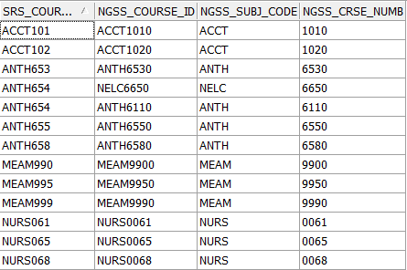
Course re-numbering, continued
The Course re-numbering cross-walk will provide a way to map from the new number back to the old or from the old to all of the related new numbers **
** note! All images in today’s presentation are from a test environment – the data may end up looking a little different in production.
Student Data User Group – MARCH 25, 2021

Slide 15
Call for queries
  To help you (and us) get started:
  You are invited to send one query to us, that currently uses the STDTCANQ universe. We will work with you to convert it and test it (with the understanding that our test data is somewhat unlike real production data). If the query you send is very similar to someone else’s, we may form small groups to work together.
  Some considerations when picking which one to send:
      A query that you use often or is critical to your work
      A query that you thoroughly understand, and you are willing to help us work on the conversion process
  Send via Business Objects to the BI4 InBox for “squant” and then let us know via email that you have sent it.
Student Data User Group – MARCH 25, 2021

Slide 16
Wrap-up
  Questions/comments
  Feedback/ Suggestions for future meetings?
  Follow-up questions/comments: da-staff@isc.upenn.edu
  Discussions about student data: student-wh@lists.upenn.edu
Student Data User Group – MARCH 25, 2021

