Slide 1
Data Warehouse
Student Data User Group
FEBRUARY 3, 2021
Student Data User Group – FEBRUARY 3, 2021

Slide 2
Remote Meetings Best Practices
Turn off your BlueJeans video function
Please go on Mute unless you are speaking
During the Q&A, please enter your questions in the chat function. When your question is being answered, you can go off Mute to ask follow-up questions
Please do not use the chat function for commentary
Student Data User Group – FEBRUARY 3, 2021

Slide 3
Agenda
NGSS Project Updates
Production go-live dates
Release 1 & Release 2 Activities
Downstream Data Consumers
Financial Aid data in the warehouse
​Existing (STDTCANQ) to New Universe comparisons
General Announcements
Student Data User Group – FEBRUARY 3, 2021

Slide 4
NGSS Project updates
Financial Aid and Pennant Records (Courses, instructors) Release 1 scheduled for August 2021
Financial Aid and Pennant Records Release 2 (Students, Academic History, Enrollments) scheduled for March 2022 to support Advanced Registration for Summer and Fall 2022
Go-Live with all Banner modules is Summer 2022
Student Data User Group – February 3, 2021

Slide 5
Release 1 activities
Nearing the end of Systems Integration Testing
Preparing for Regression testing with the currently installed Accounts Receivable application base
Subsequently, the team will initiate Performance and User Acceptance Testing
Student Data User Group – February 3, 2021

Slide 6
Release 2 activities
Functional and Technical specifications currently being developed
Technical development currently underway
Planning for Systems & Integration, Regression, Performance, and User Acceptance testing has started – schedule TBD
Student Data User Group – February 3, 2021

Slide 7
Downstream Data Consumers
Many downstream systems use the current Student Data Warehouse as a source of data
The project team has begun outreach to key downstream integration partners with the following goals:
Determine the systems’ data needs
Map the current data usage to new data models
Provide specifications and documentation to partners
Student Data User Group – February 3, 2021

Slide 8
Student Data User Group – FEBRUARY 3, 2021

Slide 9
Financial Aid Data Warehouse
Working group includes representation from:
Institutional Research
Financial Aid
Enterprise Information & Analytics
Started meeting toward the end of July every two weeks with our last meeting on January 25th.
Student Data User Group – FEBRUARY 3, 2021

Slide 10
Financial Aid Data Warehouse continued
The discussion by the group has focused on the overall structure as well as making improvements based on Banner functionality.
For Example
Additional award disbursement fields and dates (ie: paid, cancelled, memoed, etc)
Periods tied to aid years
Table structure and design with consideration for security purposes as well as reporting needs.
Student Data User Group – FEBRUARY 3, 2021

Slide 11
Financial Aid Data Warehouse continued
We have put the meeting with the group on pause as data warehouse tables are being built in Development environment.
Currently built – aid year and period tables, award tables, and a few validation tables
In progress – bio table, information similar to what is in the current applicant table, needs analysis, requirements, budget, etc.
After build in DEV env is complete, likely in March, meetings and testing of the tables and structure will resume.
Student Data User Group – February 3, 2021

Slide 12
Student Data User Group – FEBRUARY 3, 2021

Slide 13
From “Old” to “New”
Introducing new concepts: how things were done using STDTCANQ, as compared to how they will be used in the Pennant Student Records data collection.
Things covered today include examples of:
Site codes
Rate codes
Attribute codes
Cohort codes
Program codes
Activity codes
Student Data User Group – February 3, 2021

Slide 14
Some Examples from SRS where they are going in the new system
Special Programs Site, Rate, Attribute, Cohort and/or Program codes
Honors Programs Attribute codes
On Dissertation and/or Masters’ Thesis Attribute codes
“Joint” Degree Programs Cohort and Program codes
Veterans Cohort (and the veterans’ info table)
Athletes Activities (and the sports’ info table)
Student Data User Group – February 3, 2021

Slide 15
SITE codes
SRS Special Program
Study Abroad codes
will convert into Site codes.
In the warehouse, Site codes and descriptions will be in the ST_DEGREE_TERM table.
Validation table is V_SITE.
Note: there is also a RATE code for Study Abroad: ‘STDYB’
Student Data User Group – February 3, 2021

Slide 16
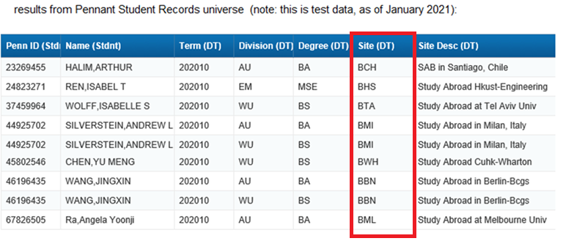
SITE codes - continued
Here is a very simple example of what a report using SITE codes might look like.
Note that some things, like the Term and Division codes, are different from SRS code values.
The Site Codes that were converted from SRS use the SRS Study Abroad code values.
(Also note: in this query, the division and degree come from ST_DEGREE_TERM and there was no filter on
Degree Order, so people in multiple programs have more than one row.)
Student Data User Group – February 3, 2021

Slide 17
SITE codes, continued
More examples of things that will be available via SITEs :
Students on reciprocal programs with partner universities
Students on the Washington Semester
Students typically on the Philadelphia campus who are temporarily at San Francisco campus, and visa-versa
Sites indicate the location where the student is studying for ALL their courses in a specific term.
Please note that the above is not an exhaustive list.
Student Data User Group – February 3, 2021

Slide 18
RATE codes
SRS Special Programs
Grad School of Educ codes
(in this example, “Teach for
America” code ETA) will
convert into Rate codes.
In the warehouse, Billing Rate
Codes will be in the ST_TERM
table.
Validation table is V_RATE.
Student Data User Group – February 3, 2021

Slide 19
RATE codes, continued
More examples of things that will be available via RATEs :
Students in Graduate School of Education programs that have specific billing rules
PhD students billed at the “high” rate, and those billed at the “low” rate
Part-time billing for students in full time schools
No tuition/no fees
Rate codes are used by Pennant Accounts.
Please note that the above is not an exhaustive list.
Student Data User Group – February 3, 2021

Slide 20
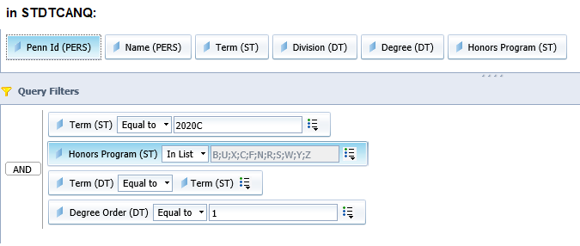
ATTRIBUTE codes
SRS Honors Programs
will convert into Attribute
Codes.
In the warehouse, Attributes
are in the ST_ATTRIBUTE
table.
Validation table is
V_STDNT_ATTR
Student Data User Group – February 3, 2021

Slide 21
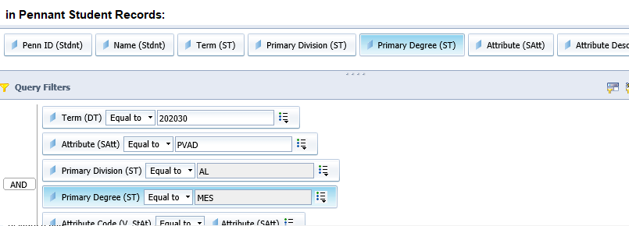
ATTRIBUTE codes, continued
Some specific SRS Special
Program designations,
such as this example of a
Provisional Admit
Program, will convert
into Attributes, that can be
used in combination with
Division and Degree filters.
(Note the primary curriculum
fields that will be in ST_TERM.)
Student Data User Group – February 3, 2021

Slide 22
ATTRIBUTE codes, continued
More examples of things that will be available via ATTRIBUTEs :
Penn-classification
Year in program for Law, Dental, Med, Vet
Students on Dissertation and/or Masters’ Thesis
PhD year (1 – 10, and “over 10”)
Clinical fee attributes
Attributes are things that categorize students and can change from term-to-term.
Please note that the above is not an exhaustive list.
Student Data User Group – February 3, 2021

Slide 23
COHORT codes
Some Special Program codes
in this example
WEMBA east and west,
will convert into Cohort codes.
In the warehouse, Cohorts are
in ST_COHORT.
Validation table is V_COHORT
Student Data User Group – February 3, 2021

Slide 24
COHORT codes, continued
SRS “joint degree”
(Coordinated
Multiple Degree) codes
will convert into
Cohorts.
All Cohort codes starting
with ‘ZMDC’ are coordinated
dual degree codes.
Student Data User Group – February 3, 2021

Slide 25
COHORT codes, continued
More examples of things that will be available via COHORTs :
The class year a student was admitted into (“Class of ___”)
For veterans, the specific branch of the military
PENNCAP and PFP
Transfer admit classification
Wharton cohorts
Cohorts are things that categorize students that typically do not change from term-to-term.
Please note that the above is not an exhaustive list.
Student Data User Group – February 3, 2021

Slide 26
ACTIVITY codes
Some things will be in more than one place. For example, Athetic codes will convert into Activity codes, in ST_ACTIVITY, and can also be found in the ST_SPORT table.
Validation tables:
V_ACTIVITY, V_ATHLETIC_ELIG and V_SPORT_STATUS
Student Data User Group – February 3, 2021

Slide 27
ACTIVITY codes, continued
More examples of things that will be available via Activities :
Greek Life
ROTC
Potentially other things that are not currently in SRS…
Activities are things in which students participate. Activities are stored by term and may or may not change from term-to-term.
Please note that the above is not an exhaustive list.
Student Data User Group – February 3, 2021

Slide 28
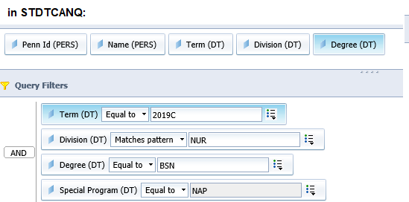
PROGRAM codes
Program codes tell us a great deal
about the student’s curriculum.
In this example, it can be used to
find students in the
Nursing Accelerated program.
Program code standard format:
Division_Degree [_other program info]
Programs are found in ST_TERM, ST_DEGREE_TERM,
ST_DEGREE_PURSUAL, ST_DEGREE_OUTCOME
Validation table: V_PROGRAM
Student Data User Group – February 3, 2021

Slide 29
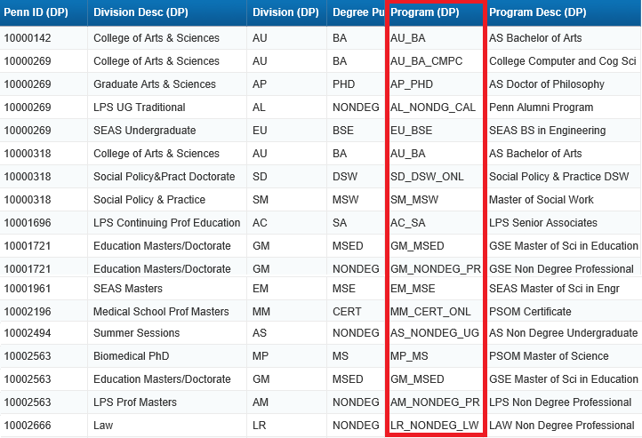
PROGRAM codes, continued
Here is a very simple example showing a variety of Program codes, alongside the related division and degrees.
When there is something in the Program code beyond the division and degree, that provides information that distinguishes people in those programs from the “traditional” programs identified by just division and degree.
Some of the old SRS Special Programs code are reflected in the Pennant Program Codes, for example the Penn Alumni Program in LPS, and Senior Associates.
Student Data User Group – February 3, 2021

Slide 30
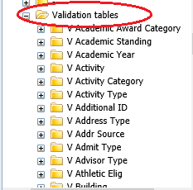
Lookup, or LOV (List of Values) tables in the warehouse
In many cases, the table containing the student data will also provide a decoded value for you. For example, ST_DEGREE_TERM has the division code and the division description. But even if the decoded value you need is not automatically provided, you can always do the lookup yourself to the relevant LOV tables, by joining on the code to get the description.
All of the LOV tables will be in the DWNGSS schema. They all start with ‘V_’
In the Pennant Student Records universe, they are grouped together at the end of the folders list in a folder called “Validation tables”:
General Announcements
Student Data User Group – February 3, 2021

Slide 31
Student Data User Group – FEBRUARY 3, 2021

Slide 32
General Announcements
RX entry action The OUR recently deployed a new Entry Action code in SRS = ‘RX’ - Return to Study. The new code will function in very much the same way as ‘RL’ – Return from Leave. The only difference is in the way SRS will handle what prints on the transcript. Entry actions that relate to Returns from Leave are found in the Student_APS and Leave tables.
KnowledgeLink Tutorial Temporarily Unavailable
Using the Student Data Collection in the Data Warehouse
Training for the current data collection
Business Objects Upgrade in late-Spring
Support patch – no visible differences, backend Oracle DB upgrades to 19C
Student Data User Group – February 3, 2021

Slide 33
Wrap-up
Questions/comments
Feedback/ Suggestions for future meetings?
Follow-up questions/comments: da-staff@isc.upenn.edu
Discussions about student data: student-wh@lists.upenn.edu
Student Data User Group – FEBRUARy 3, 2021

