Slide 1
Data Warehouse
Student Data User Group
AUGUST 13, 2020
Student Data User Group – AUGUST 13, 2020

Slide 2
Remote Meetings Best Practices
Turn off your BlueJeans video function
Please go on Mute unless you are speaking
During the Q&A, please enter your questions in the chat function. When your question is being answered, you can go off Mute to ask follow-up questions
Please do not use the chat function for off-topic commentary
Student Data User Group – AUGUST 13, 2020

Slide 3
Agenda
General announcements
  Address types
  Processing DW load overflow/backlogs
​Pennant Student Records universe
  Q&A since the July SDUG meeting
  query demo
Student Data User Group – August 13, 2020

Slide 4
Announcements
Address types in SRS:
    “T” is now “Learning From address”
    “B” is now “Diploma address”
  Warehouse nightly load backlog
  As-of 8/10/2020, the overflow caused by the changes to all “B” addresses is completely caught up.
  From now on, any time there are records in the overflow, whatever changes happened that day in SRS will get processed first, before the load processes go to the overflow file to catch up on any backlog.
Student Data User Group – august 13 2020

Slide 5
Using the new
Pennant Student Records universe
Remember: we are in a DEVELOPMENT environment
  “Missing or wrong data?” that’s to-be-expected.
    When you run queries you will notice that some tables are completely empty, and most (probably all!) will not match the real SRS data. So please don’t worry if you don’t see data in any particular table, or if you don’t see “your” students.
  “Weird lookups?” also to-be-expected.
    The validation tables are also still being worked on, so please don’t worry if you don’t see a value in a lookup table that you are expecting to see.
Expect changes
  We are working on additional tables, and changing the existing structure every day, so don’t be alarmed if something moves around or something new shows up. We will try to keep this Student Data User Group appraised of new developments when something major happens, but in the interest of keeping too much “noise” off the STUDENT-WH discussion listserv, we won’t be sending out an alert every time something changes!
Student Data User Group – august 13, 2020

Slide 6
Q&A regarding Pennant Student Records
From the last SDUG meeting:
Q: Term snapshots. Who gets to decide how many snapshots we have and when they will happen? Will we have clear names for the different snapshots taken of student data and what they mean? Will there be easily available documentation about the census and other snapshots?
A: All still being discussed. Final decisions about the timing and naming of the snapshots will be up to the University Registrar. We expect to have a preliminary term snapshot universe available in the development environment by the end of this calendar year.
We will have documentation available on the Data Warehouse website, and that will include the timing of the snapshots, what each extract is called and how to query the extract/snapshot code to get the one you need.
Student Data User Group – august 13, 2020

Slide 7
Q&A continued
From the last SDUG meeting:
Q: Course Section Instructor. Will we be able to tell whether an instructor is a TA? Will we be able to tell which instructor is the "primary instructor"?
A: In the Pennant Student Records universe, the CRSE_SECT_INSTRUCTOR table is linked to the HCM_PERSON_V view, where you will be able to find the Primary_Job_Profile_Name = "Teaching Assistant“ as well as any other job profile names in the HCM system.
Correction to previously published statements about primary instructors: coming from CLSS and the new Pennant system, we will have a field on the course section record indicating which instructor is the primary instructor – this is the instructor considered “primary” for operational functions.
We will revisit the topic of course sections and instructors in more detail at a later SDUG meeting this fall.
Student Data User Group – august 13, 2020

Slide 8
Q&A continued
From emails to the Pennant reporting team
Q: Special Program study abroad codes. We currently use the SPECIAL_PROGRAM field to identify study abroad and exchange students. I wonder which tables will capture those students in Banner.
A: The SRS Special Programs will convert into different places in the new system, depending on their function and purpose. For example: Since Study Abroad codes tell us where the student is, the Study Abroad codes in the new system will be in something called “Site” -- a student’s site can change from term-to-term and identifies the location where they are studying in a specific term. The Site code is found in the ST_TERM table. The validation table is V_SITE.
The Special Program mapping to Banner documentation was developed many months ago and is now undergoing additional review. The old version is here: https://upenn.box.com/s/wkkgu6lpoa3vbtq9tbn9pvz0ji6oobo5
We will post a link to the latest-greatest Special Program mapping, as soon as it is available.
Student Data User Group – august 13, 2020

Slide 9
Q&A continued
From emails to the Pennant reporting team
Q: Is it possible to have a view table to see the relationship between degree and degree level? For example, what kind of degrees are categorized as the degree level 'undergrad’? How is degree level assigned to certificates? Is there a way to differentiate between undergraduate or graduate certificates?
Note: this is about Degree Level (in SRS, “D U M P”)
which is a different data element from a student’s level
or the level of a course.
Degree Levels in Banner will be:
A: Yes, we can associate a degree with a degree level. Even if that ends
up not being maintained in Banner, we can certainly come up
with a view in the warehouse. Thanks for the suggestion!
Code (2) | Description (30)
AS | Associate
BA | Bachelor
DR | Doctorate
LA | Less than Associate
MA | Master
OT | Other
PR | Professional
Student Data User Group – august 13, 2020

Slide 10
Q&A continued
We received lots of questions about the validation tables. Remember: those are still being worked on by the functional team. We may not have answers about specific codes, but we can help with the overall structure of the validation tables, for example:
Q: V_ACTIVITY, V_ACTIVITY_CAT, and V_ACTIVITY_TYPE. Activity table seems to only include sports? Why is that? Will more types of activity categories be added? Activity type seems to be broader, not just sports.
A: The data in the dev environment is limited at this time. When we go live, activities will include much more than just sports.
Activities will roll up into Categories, for example: NCAA Women's Sport, Fraternity/Sorority Life Org, Reserve Officer Training Corps, Office of Student Affairs
Activities also are assigned to broader groupings called Types, for example: Political & Advocacy, Religious & Spiritual, Sports & Recreational, Student Governance
Each row in the Activity validation table will tell you the Category and the Type to which that activity belongs. Example of how this could be used: “give me anyone in any activity that is of type Student Governance” etc.
Student Data User Group – august 13, 2020

Slide 11
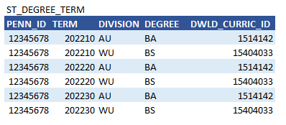
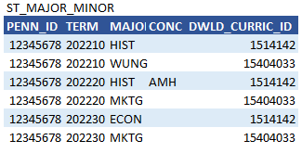
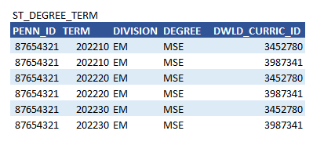
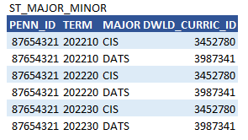
DWLD_CURRIC_ID: “Data Warehouse Curriculum ID” provides an easy way to join rows from ST_DEGREE_TERM to the associated rows in other tables, like ST_MAJOR_MINOR.
And DWLD_CURRIC_ID provides a way to identify rows that belong to the same curriculum within ST_DEGREE_TERM, in situations where that might otherwise be difficult:
DWLD_CURRIC_ID is a warehouse construct only. It is not in Banner or any other system or database.
Student Data User Group – august 13, 2020

Slide 12
Query demo….
Student Data User Group – august 13, 2020

Slide 13
In the coming weeks, if you have the time, we could really use your help:
Play
  See if you are able to start a new report using this universe
  Poke around and see if you can create a simple query
Ask questions
  Send your questions to squant@upenn.edu or budischa@upenn.edu. We will collect your questions and will try to address as many as we can at the next SDUG meeting.
Student Data User Group – august 13, 2020

Slide 14
Wrap-up
  Questions/comments
  We will be holding Fall SDUG meetings online – dates tbd.
  As always, follow-up questions/comments after SDUG meetings can be sent to: da-staff@isc.upenn.edu Discussions about student data can be initiated by writing to our moderated list: student-wh@lists.upenn.edu
Student Data User Group – august 13, 2020

