Slide 1
Data Warehouse
Student Data User Group
July 15, 2020
Student Data User Group – JULY 15, 2020

Slide 2
Remote Meetings Best Practices
Turn off your BlueJeans video function
Please go on Mute unless you are speaking
During the Q&A, please enter your questions in the chat function. When your question is being answered, you can go off Mute to ask follow-up questions
Please do not use the chat function for commentary
Student Data User Group – July 15, 2020

Slide 3
Agenda
Project Update
Production go-live dates
Student Warehouse development and testing
Student Warehouse production releases
Financial Aid data warehouse
​Pennant Student Universe – updates on design and coming attractions
Student Data User Group – July 15, 2020

Slide 4
But first… a small STDTCANQ Universe Change
Join from Course Section to Enrollment was modified
Previously an “equi” join, now an “outer” join
Query result rows will now remain even when no students are enrolled in a course section.
Example Class list for 2020C where Course Section=CHIN721401.
Student Data User Group – July 15, 2020

Slide 5
Project updates
The Pennant Records and Financial Aid projects are delayed 1 year
Financial Aid and Pennant Records (Courses, instructors) Release 1 scheduled for August 2021
Financial Aid and Pennant Records Release 2 (Students, Academic History, Enrollments) scheduled for March 2022
Student Data User Group – July 15, 2020

Slide 6
Development updates
Development for the Student Data Warehouse will continue as scheduled – currently about 85% complete
Some outstanding questions on individual data elements
Testing may require some amount of re-work to definitions and table structures
Student Data User Group – July 15, 2020

Slide 7
Testing Timeline
DEV warehouse collection released to working group in January
Wider release to SDUG in July
Courses and Instructors, basic student data
will include WebI universe and some documentation
corporate documents rolled out sometime after that
R2 (student, academic history) data available sometime Fall of 2020 (schedule TBD)
Student Data User Group – July 15, 2020

Slide 8
Production Releases
August 2021 –
course and section information available in new warehouse
future terms (Summer 2022 and beyond) will be reported from the new course structures
March 2022 –
Full conversion of all SRS (and other systems) into Banner – new student warehouse available
SRS is still system of record – Banner is used for advanced registration for future terms (Summer 2022 and beyond)
May/June 2022 – final conversion of SRS student data into Banner – all student reporting comes from new student data warehouse collection
Student Data User Group – July 15, 2020

Slide 9
Financial Aid Data Warehouse
Kick off for FA data warehouse scheduled for July 20th, 2020
Initial working group include representation from:
Institutional Research
Financial Aid
Enterprise Information & Analytics
Student Data User Group – July 15, 2020

Slide 10
New universe: Pennant Student Records
Universe design
Structure is approximately 85% complete – more folders and objects will be added as the project moves forward
Setup & security
The universe is currently pointing to the development warehouse: DWHE
We will put everyone currently in the Webi Student Data Users security folder into the group that can use this universe.
If you can access Student Data in prod today, you will be able to launch a Webi report using the development Pennant Student Records universe.
In DWHE, we’re using a hard-coded password for this universe. Once the universe is ready to move to production, it will use each user’s own login credentials.
Student Data User Group – July 15, 2020

Slide 11
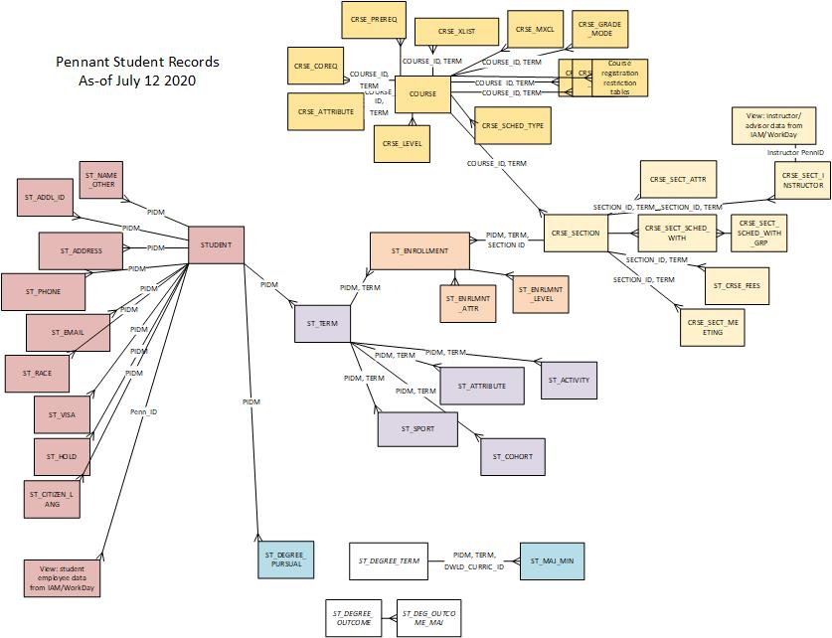
More tables coming soon…
Student Data User Group – July 15, 2020

Slide 12
Universe demo….
Student Data User Group – July 15, 2020

Slide 13
Using the new universe…
Remember: we are in a DEVELOPMENT environment
“Missing or wrong data?” that’s to-be-expected.
When you run queries you will notice that some tables are completely empty, and most (probably all!) will not match the real SRS data. So please don’t worry if you don’t see data in any particular table, or if you don’t see “your” students.
“Weird lookups?” also to-be-expected.
The validation tables are also still being worked on, so please don’t worry if you don’t see a value in a lookup table that you are expecting to see.
Expect changes
We are working on additional tables, and changing the existing structure every day, so don’t be alarmed if something moves around or something new shows up. We will try to keep this Student Data User Group appraised of new developments when something major happens, but in the interest of keeping too much “noise” off the student-wh discussion listserv, we won’t be sending out an alert every time something changes!
Student Data User Group – July 15, 2020

Slide 14
So what can you do, in this still-under-construction universe?
Play
See if you are able to start a new report using this universe
Poke around and see if you can create a simple query
Ask questions
The development team is actively working on a lot of things and we may not have time to answer everyone’s questions in a timely manner. But that doesn’t mean you shouldn’t ask!
Send your questions to squant@upenn.edu or budischa@upenn.edu. We will collect your questions and will try to address as many as we can, either in a newsletter format sent out to everyone via the listserv, or at the next SDUG meeting.
Student Data User Group – July 15, 2020

Slide 15
Wrap-up
Questions/comments
Feedback about holding SDUG meetings online
How did today go?
Suggestions for future online meetings?
As always, follow-up questions/comments after SDUG meetings can be sent to: da-staff@isc.upenn.edu Discussions about student data can be initiated by writing to our moderated list: student-wh@lists.upenn.edu
Student Data User Group – July 15, 2020

