Slide 1
Data Warehouse
Student Data User Group
MARCH 25, 2020
Student Data User Group – MARCH 25, 2020

Slide 2
Remote Meetings Best Practices
Turn off your BlueJeans video function
Please go on Mute unless you are speaking
During the Q&A, please enter your questions in the chat function. When your question is being answered, you can go off Mute to ask follow-up questions
Please do not use the chat function for commentary
Student Data User Group – MARCH 25, 2020

Slide 3
Agenda
Project Update
Development status and Testing timeline
Timing for Production Releases​
Misc Items – Not Converted/Converted, FinAid collection
​Pennant Student Universe – Design, documentation
Student Data User Group – MARCH 25, 2020

Slide 4
Project updates
The Pennant Records and Financial Aid projects are delayed 1 year
Financial Aid and Pennant Records (Courses, instructors) Release 1 scheduled for August 2021
Financial Aid and Pennant Records Release 2 (Students, Academic History, Enrollments) scheduled for March 2022
Student Data User Group – MARCH 25, 2020

Slide 5
Development updates
Development for the Student Data Warehouse will continue as scheduled – currently about 80% complete
Some outstanding questions on individual data elements
Testing may require some amount of re-work to definitions and table structures
Student Data User Group – MARCH 25, 2020

Slide 6
Testing Timeline
DEV warehouse collection released to working group in January
Wider release to SDUG in April/May timeframe
should be fully converted data of R1 data (courses, instructors)
will include WebI universe and some documentation
corporate documents rolled out sometime after that
R2 (student, academic history) data available sometime Summer of 2020 (schedule TBD)
Student Data User Group – MARCH 25, 2020

Slide 7
Production Releases
August 2021 –
course and section information available in new warehouse
future terms (Summer 2022 and beyond) will be reported from the new course structures
March 2022 –
Full conversion of all SRS (and other systems) into Banner – new student warehouse available
SRS is still system of record – Banner is used for advanced registration for future terms (Summer 2022 and beyond)
May/June 2022 – final conversion of SRS student data into Banner – all student reporting comes from new student data warehouse collection
Student Data User Group – MARCH 25, 2020

Slide 8
Other items
Non-converted population
The initial conversion population of students is being re-evaluated
At go-live, only students who were converted to Banner will be available in the new warehouse collection – non converted students will be in the current student data warehouse
There will be a conversion of the remaining population into the new warehouse structures post go-live of Release 2
Financial Aid
kick off for FA warehouse design in April
Student Data User Group – MARCH 25, 2020

Slide 9
New universe: Pennant Student Records
Universe design
Partially complete – more will be added as the project moves forward
Does not exactly mirror STDTCANQ, but maintains core functionality
Setup & security
The universe is currently pointing to the development warehouse: DWHE
Small advisory group is doing initial testing
All underlying tables and views are granted to the SCHOOL_ROLE
Student and Course data tables are in schema DWNGSS_PS
Validation (“lookup”) tables and shared Rules tables are in schema DWNGSS
Student Data User Group – MARCH 25, 2020

Slide 10
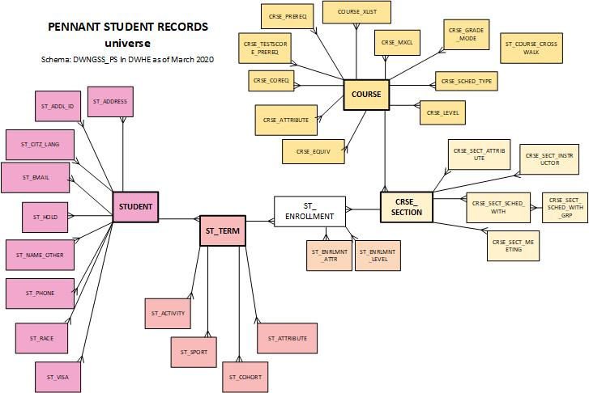
…. More tables coming soon!

Slide 11
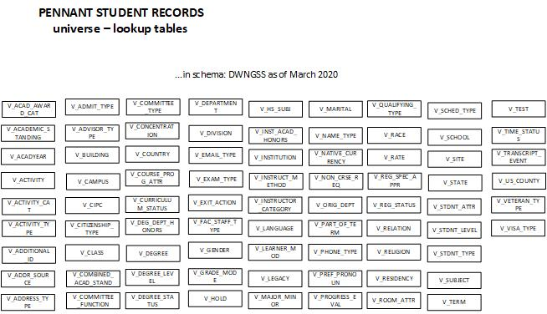
… stayed tuned for more…
…. More tables coming soon!

Slide 12
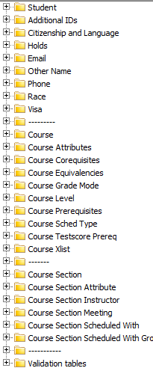
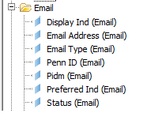
The new universe has the folders grouped by “type”
Within the folders, objects are listed alphabetically

Slide 13
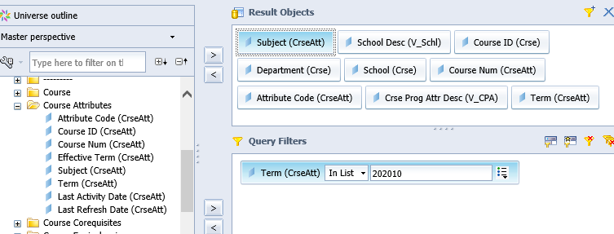
Sample query

Slide 14
Sample query output

Slide 15
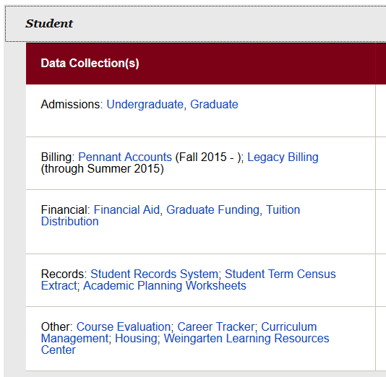
Documentation will be added to the existing warehouse website: https://www.isc.upenn.edu/enterprise-information-analytics
under the “Student” area,
in the “Record” section,
there will be a new link
for Pennant Student Records
In the coming months, we will be looking for volunteers to assist with editing and reviewing data documentation….

Slide 16
Wrap-up
Questions/comments
Feedback about holding SDUG meetings online
How did today go?
Suggestions for future online meetings?
As always, follow-up questions/comments after SDUG meetings can be sent to: da-staff@isc.upenn.edu Discussions about student data can be initiated by writing to our moderated list: student-wh@lists.upenn.edu
Student Data User Group – MARCH 25, 2020

