Slide 1
Data Warehouse
Student Data User Group
November 13, 2019

Slide 2
Agenda
New Student data warehouse collection
​
Timeline - Design, Development, Testing
Timing for Production data – into NGSS, in new DW tables​
Transition planning​
Deep Dive – new tables for Course data​
  COURSE, COURSE _GRADE_MODE, COURSE_XLIST
  CRSE_SECTION, CRSE_SECT_SCHED_WITH_GRP, CRSE_SECT_SCHED_WITH
News items​

Slide 3
Student Data Warehouse Timeline
Design
​
New table structures definition complete​
Initial set of corporate documents defined​
WebI universe design will start November 2019, scheduled to complete February 2020.​
Technical specifications approximately 75% complete​

Slide 4
Student Data Warehouse Timeline
Development
​
Development started August 2019​
Estimated completion of table build and ETL processes January 2020
WebI universe development complete March 2020

Slide 5
Student Data Warehouse Timeline
Testing
​
Initial test phase for internal project team and early adopters scheduled for
October 2019-March 2020​
Availability of tables and WebI universe to wider Penn Community in April 2020​
Initial data set will be limited test data available in the Functional Object Testing instance of Banner​
Test data of total converted population available in June 2020​
Initial set of Corporate Documents available in June 2020​

Slide 6
Timing for production data *: when will “my data” start going into NGSS?
mid Spring 2021: Banner is system-of-record for Advance Reg for Summer and Fall 2021
Starting in Summer 2021: Banner is system-of-record for all student data
Fall 2020:
Summer and Fall 2021 course sections will be built in CLSS ** and stored in Banner
Until end of Spring 2021 term: SRS is system-of-record for most student data, except….
* Test data will be available sooner… this slide speaks to the actual production data
** CLSS is the 3rd-party system in which departmental admins will maintain course sections

Slide 7
Timing for production data: when will “my data” be available in the new warehouse tables?
Fall term 2020: if you are looking for course sections that will be taught in Summer or Fall 2021, look in the new DWNGSS_PS tables. Else, look in the old data collection to report on courses and sections taught in Spring 2021 or earlier.
Mid-Spring term 2021: if you are looking for registration in Summer or Fall 2021 courses, look in the new DWNGSS_PS tables. Else, look in the old data collection. NOTE: reporting on Spring 2021 graduation should be done out of the old data collection.
Starting in Summer term 2021:
  All students from SRS will have their BIO data converted into Banner.
  All students who were active in 2010 or any time since then will have all of their Academic activity converted into Banner.
  There will be a period of time in which you will still need to go back to the old legacy data collection for students who have not been active since 2010.

Slide 8
Timing: to help us plan for this transition, we need your input
What reports do you typically run in May/June/July every academic year?
Of those, what reports are the most critical?
Please take a look at the proposed list of canned reports (see next slide) and let us know if you have a critical report that isn’t covered in some fashion by that list.

Slide 9
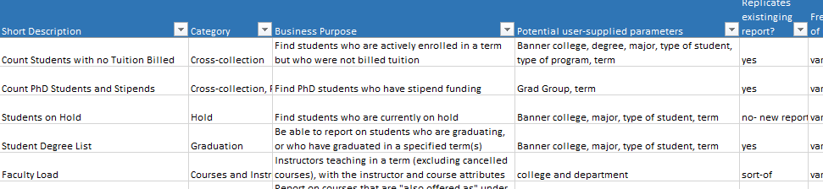
Proposed Pennant Records corporate documents: https://upenn.box.com/s/7bwnyvhwgg4b1tsgccjtm9fnw5terqw9
The list has a short name and description of the proposed report, what user-supplied parameters might be available, and other properties like the intended audience, etc.

Slide 10
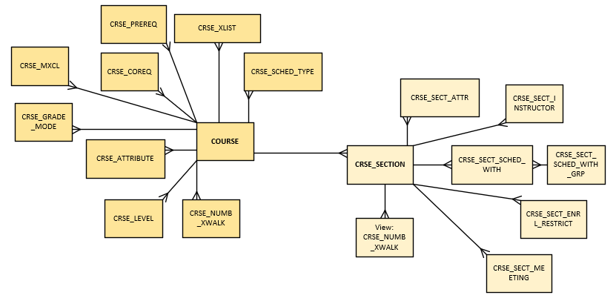
Deeper dive: new tables for COURSE data
COURSE, COURSE _GRADE_MODE, COURSE_XLIST
CRS_SECTION, CRS_SECT_SCHED_WITH_GRP, CRS_SECT_SCHED_WITH

Slide 11
COURSE
COURSE_ID | SUBJECT | COURSE_NUM | EFFECTIVE_TERM | TERM | CATALOG_START_TERM | CATALOG_END_TERM | SCHOOL | DEPARTMENT | ACTIVE_FLAG | TITLE | LONG_TITLE | COURSE_ADMIN_CODE
AFRC0002 | AFRC | 0002 | 202120 | 202120 | 202120 | 999999 | A | AFRC | A | Intro to Sociology | Introduction to Sociology | 2C
AFRC0002 | AFRC | 0002 | 202120 | 202130 | 202120 | 999999 | A | AFRC | A | Intro to Sociology | Introduction to Sociology | 2C
AFRC0002 | AFRC | 0002 | 202210 | 202210 | 202120 | 999999 | A | AFRC | A | Intro to Sociology | Introduction to Sociology and Culture | 2C
AFRC0002 | AFRC | 0002 | 202210 | 202220 | 202120 | 999999 | A | AFRC | A | Intro to Sociology | Introduction to Sociology and Culture | 2C
SOCI0001 | SOCI | 0001 | 202120 | 202120 | 202120 | 999999 | A | SOCI | A | Intro to Sociology | Introduction to Sociology | 2C
SOCI0001 | SOCI | 0001 | 202120 | 202130 | 202120 | 999999 | A | SOCI | A | Intro to Sociology | Introduction to Sociology | 2C
SOCI0001 | SOCI | 0001 | 202210 | 202210 | 202120 | 999999 | A | SOCI | A | Intro to Sociology | Introduction to Sociology and Culture | 2C
SOCI0001 | SOCI | 0001 | 202210 | 202220 | 202120 | 999999 | A | SOCI | A | Intro to Sociology | Introduction to Sociology and Culture | 2C
The COURSE table (i.e., course inventory) will store records term-by-term. The following slides explain why…

Slide 12
COURSE, if we used term-effective
SUBJECT | COURSE_NUM | EFFECTIVE_TERM | SCHOOL | DEPARTMENT | LONG_TITLE
AFRC | 0002 | 202120 (Summer 2021) | A | AFRC | Introduction to Sociology
AFRC | 0002 | 202210 (Spring 2022) | A | AFRC | Introduction to Sociology and Culture
In the source database, Course has a “term effective” row

Slide 13
CRSE_GRADE_MODE, term-effective
SUBJECT | COURSE_NUM | EFFECTIVE_TERM | GRADE_MODE_CODE
AFRC | 0002 | 202120 (Summer 2021) | S (standard grade)
AFRC | 0002 | 202130 (Fall 2021) | P (pass/fail)
AFRC | 0002 | 202130 (Fall 2021) | S (standard grade)
Each of the tables that are related to COURSE, for example here the Grade Mode table, also is stored in the source using term-effective. They each can have different term-effective terms, and can be different from the term-effective term on the base COURSE table. This makes joining between tables difficult.

Slide 14
COURSE term-by-term
SUBJECT | COURSE_NUM | TERM | SCHOOL | DEPARTMENT | LONG_TITLE |  | EFFECTIVE_TERM
AFRC | 0002 | 202120 (Summer 2021) | A | AFRC | Introduction to Sociology | Everything about these first two records is exactly the same, except the TERM. We will have a record for every possible TERM that this definition is in effect. | 202120 (Summer 2021)
AFRC | 0002 | 202130 (Fall 2021) | A | AFRC | Introduction to Sociology |  | 202120 (Summer 2021)
AFRC | 0002 | 202210 (Spring 2022) | A | AFRC | Introduction to Sociology and Culture | As soon as something changes, we get a new Effective Term. From then on everything is the same except the TERM. We will have a record for every possible TERM that this definition is in effect. | 202210 (Spring 2022)
AFRC | 0002 | 202220 (Summer 2022) | A | AFRC | Introduction to Sociology and Culture |  | 202210 (Spring 2022)
AFRC | 0002 | 202230 (Fall 2022) | A | AFRC | Introduction to Sociology and Culture |  | 202210 (Spring 2022)
So instead, in the warehouse, we will store all Course related tables with one row per course per term, making it easy to join together everything that was happening for any given course in any given term.

Slide 15
CRSE_GRADE_MODE term-by-term
SUBJECT | COURSE_NUM | TERM | GRADE_MODE_CODE | EFFECTIVE_TERM
AFRC | 0002 | 202120 (Summer 2021) | S (standard grade) | 202120 (Summer 2021)
AFRC | 0002 | 202130 (Fall 2021) | P (pass/fail) | 202130 (Fall 2021)
AFRC | 0002 | 202130 (Fall 2021) | S (standard grade) | 202130 (Fall 2021)
AFRC | 0002 | 202210 (Spring 2021) | P (pass/fail) | 202130 (Fall 2021)
AFRC | 0002 | 202210 (Spring 2021) | S (standard grade) | 202130 (Fall 2021)
The tables that are all related to COURSE can have multiple rows per term. For example, in the Grade Mode table, you will see one row for each allowable grade mode for each course in every term.

Slide 16
CRSE_XLIST term-by-term
COURSE_ID | SUBJECT | COURSE_NUM | TERM | XLIST_FAMILY | PRI_SEC_IND | XLIST_PRI_SUBJECT | XLIST_PRI_COURSE_NUM | EFFECTIVE_TERM | ACTIVITY_DATE
AFRC002 | AFRC | 0002 | 202120 | 7140 | P | AFRC | 0002 | 202120 | 11/8/2019 14:48
SOCI0001 | SOCI | 0001 | 202120 | 7140 | S | AFRC | 0002 | 202120 | 11/8/2019 14:48
AFRC002 | AFRC | 0002 | 202130 | 7140 | P | AFRC | 0002 | 202120 | 11/8/2019 14:48
SOCI0001 | SOCI | 0001 | 202130 | 7140 | S | AFRC | 0002 | 202120 | 11/8/2019 14:48
AFRC002 | AFRC | 0002 | 202210 | 7140 | P | AFRC | 0002 | 202120 | 11/8/2019 14:48
SOCI0001 | SOCI | 0001 | 202210 | 7140 | S | AFRC | 0002 | 202120 | 11/8/2019 14:48
AFRC002 | AFRC | 0002 | 202220 | 7140 | P | AFRC | 0002 | 202120 | 11/8/2019 14:48
SOCI0001 | SOCI | 0001 | 202220 | 7140 | S | AFRC | 0002 | 202120 | 11/8/2019 14:48
AFRC002 | AFRC | 0002 | 202230 | 7140 | P | AFRC | 0002 | 202230 | 11/8/2019 14:48
SOCI0001 | SOCI | 0001 | 202230 | 7140 | S | AFRC | 0002 | 202230 | 11/8/2019 14:48
ANTH0003 | ANTH | 0003 | 202230 | 7140 | S | AFRC | 0002 | 202230 | 11/8/2019 14:48
An example of what the course Crosslist table will look like.
Notice that this table will tell you:
The crosslist “family” id
Whether the course is the Primary, or one of the Secondary members of the family
References back to the primary from each of the secondaries.

Slide 17
CRSE_SECTION
TERM | SECTION_ID | SUBJECT | COURSE_NUM | SECTION_NUM | SCHOOL | DIVISION | DEPARTMENT | PART_OF_TERM | PTRM_START_DATE | PTRM_END_DATE | PTRM_WEEKS | SECTION_STATUS | SCHEDULE_TYPE | CAMPUS | TITLE
202210 | AFRC0002001 | AFRC | 0002 | 001 | A | AU | AFRC | 1 | 1/12/2022 | 5/10/2022 | 16 | A | LEC | PHL | Intro to Sociology
202210 | AFRC0002011 | AFRC | 0002 | 011 | A | AU | AFRC | 1 | 1/12/2022 | 5/10/2022 | 16 | A | REC | PHL | Intro to Sociology
202210 | AFRC0002012 | AFRC | 0002 | 012 | A | AU | AFRC | 1 | 1/12/2022 | 5/10/2022 | 16 | A | SEM | PHL | Intro to Sociology
202210 | SOCI0001001 | SOCI | 0001 | 001 | A | AU | SOCI | 1 | 1/12/2022 | 5/10/2022 | 16 | A | LEC | PHL | Intro to Sociology
202210 | SOCI0001011 | SOCI | 0001 | 011 | A | AU | SOCI | 1 | 1/12/2022 | 5/10/2022 | 16 | A | REC | PHL | Intro to Sociology
202210 | SOCI0001012 | SOCI | 0001 | 012 | A | AU | SOCI | 1 | 1/12/2022 | 5/10/2022 | 16 | A | SEM | PHL | Intro to Sociology
The Course Section table has one row per scheduled section offering of a course (each schedule type is a separate section) per term.

Slide 18
CRSE_SCHED_WITH (for an xlist family)
TERM | SCHED_WITH_GROUP | COURSE_REF_NUM | SECTION_ID | SUBJECT | COURSE_NUM | SECTION_NUM | XLIST_FAMILY | PRI_SEC_IND
202210 | 9786 | 34567 | AFRC0002001 | AFRC | 0002 | 001 | 7140 | P
202210 | 657 | 54387 | AFRC0002011 | AFRC | 0002 | 011 | 7140 | P
202210 | 658 | 14790 | AFRC0002012 | AFRC | 0002 | 012 | 7140 | P
202210 | 9786 | 5432 | SOCI0001001 | SOCI | 0001 | 001 | 7140 | S
202210 | 657 | 87432 | SOCI0001011 | SOCI | 0001 | 011 | 7140 | S
202210 | 658 | 9 | SOCI0001012 | SOCI | 0001 | 012 | 7140 | S
Course sections that are offered at the same time in the same room taught by the same instructors are “Scheduled With”. Cross-listed courses are just one type of “scheduled with” sections. Sections that are “scheduled with” each other are assigned to the same “scheduled with group”

Slide 19
CRSE_SCHED_WITH_GRP
TERM | SCHED_WITH_GROUP | SCHED_WITH_GROUP_DESC | GROUP_MAX_ENRLMNT | GROUP_ENROLLMENT | GROUP_SEATS_AVAIL
202210 | 9786 | Intro Sociology cross-lists Lec | 30
202210 | 2435 | Modern Architecture | 25
The “scheduled with group” controls the number of students that can enroll.

Slide 20
CRSE_SCHED_WITH (non xlist example)
TERM | SCHED_WITH_GROUP | COURSE_REF_NUM | SECTION_ID | SUBJECT | COURSE_NUM | SECTION_NUM | XLIST_ FAMILY | PRI_SEC_IND | SECT_ACTIVITY_DATE
202210 | 2435 | 456709 | ARTH0271001 | ARTH | 0271 | 001 |  |  | ########
202210 | 2435 | 243761 | ARTH6710001 | ARTH | 6710 | 001 |  |  | ########
Not all “scheduled with” sections are cross-listed. Here is an example of a graduate course and an undergraduate course that are “scheduled with” each other, but they are not cross-listed.

Slide 21
COURSE data: key points to remember
COURSE is now connected to a cluster of tables with information related to the definition of a course – not everything about the course inventory is found in just one table anymore.
Even though the Banner source tables will be “term-effective” we will store COURSE data with a row for each term that course could potentially be used by a section record in CRSE_SECTION.
Section information -- CRSE_SECTION – is also connected to a cluster of tables with information about all the sections being offered in a specific term. These can be joined to each other on the course section identifier and term. These can also be joined back to the related COURSE record on Subject, Course Number, and Term.

Slide 22
COURSE data: key points to remember
Cross-listing is defined in COURSE and used in the “scheduled with” relationships in CRSE_SECT*
“Scheduled with” are courses taught at the same day & time, in the same room, by the same instructor. There can be things that are “scheduled with” that are not cross-listed.
You will be able to report on BOTH “scheduled with” and cross-listed courses. They can be identified separately, and they can be aggregated together, depending on your needs.
Credit currency (CU/SH/CR) is defined in COURSE and used in CRSE_SECT* tables.

Slide 23
News
Pennkey was added to PERSON_ALL_V. No longer need to select from PCOM tables.
Reminder: It is possible for students added to SRS to not have a Penn_ID for 24 hours. Downstream processes should account for this scenario.
Naming of NWCH New College House to Lauder College House
  New record LDCH “Lauder College House”​ added to SRS tables
  Both codes/names remain in dwadmin.BUILDING, COLLEGE_HOUSE tables.
Naming of PennLaw to Carey Law School
  Not done in SRS yet
  Change will update school_name in dwadmin.SCHOOL

