Slide 1
Getting ready for the move to Pennant Records
Overview for report writers
Data Warehouse Student Data User Group
June 19, 2019

Slide 2
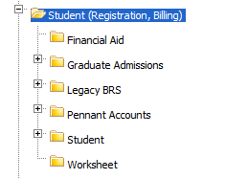
Why you need to start getting ready
For people who write their own SQL: the schema, table, and column names will be different in the Pennant Records’ new student data collection.
For people who use Business Objects: the universe structure will be different. You will not be able to take an existing query and simply “point” it to a new universe.
The canned queries in the Public “Student” folder and subfolders will be re-written, but you will need to re-do all of your own queries.

Slide 3
4. The existing data structures, universes, and canned queries will not be deleted, and they will be useful to help during the transition.
However, all new information going forward will be in the new tables, new universes, and new canned queries.
We will be converting the historic information into the new tables, so after the initial transition period you should be able to do all of your querying from the new tables.
5. Don’t Panic.
The Student Data team in Enterprise Information & Analytics is here to help:
We will have documentation and examples for you to follow
Once we have a test database up and running, you can get started ahead of time
We will hold workshops and office hours
There will be a more extensive library of corporate documents for you to use

Slide 4
What you should start to do now
Business Objects Infoview only users:
Let us know which documents in the public folders you currently use, and whether/how they could better suit your needs
Webi Users:
Take an inventory of all your personal documents, and
Prioritize what you have: What’s old and no longer needed? What’s critical and will need to be converted asap? What’s probably needed but can wait till later to convert?
Consider consolidating similar queries.
Compare what you have in your personal documents with the list of proposed Pennant Records corporate documents: are there things on the list you might be able to just use and/or build from, instead of re-writing your own?
Developers and people who write their own SQL:
Similar inventory & prioritization activities: What’s critical, what can wait, etc.
Take a look at the list of proposed Pennant Records corporate documents: there may be sql used by those that you can build from.

Slide 5
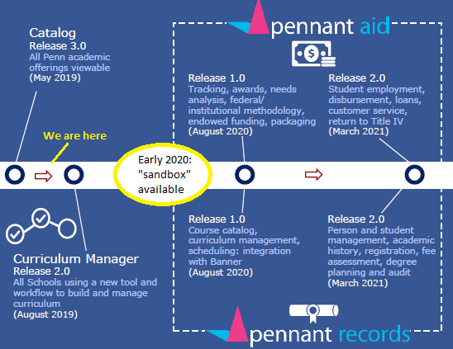
High level timeline: http://ngss.srfs.upenn.edu/pdf/NGSS-path-to-completion.pdf
Here is a (slightly modified) section of that timeline:
Other NGSS project information can be found in ngss.srfs.upenn.edu

Slide 6
proposed Pennant Records corporate documents: https://upenn.box.com/s/mckd0oxbcop64i3bu6bl06cjr6xin444
The list has a short name and description of the proposed report, what user-supplied parameters might be available, and other properties like the intended audience, etc.

Slide 7
For example, if you have a query that looks at enrollment in a term for a specific population…
…you might be able to use the new “Course Enrollment” query:

Slide 8
Use an existing query or rebuild from scratch? It’s up to you, but here are some suggestions:
Start from an existing one if
You have not yet had the chance to become familiar with the new table and column names, and or
One exists that you can use, and you only have a few changes to make
Start from scratch if
You are comfortable building/testing in the new environment, or
You have a highly customized report that is unlike any existing one

Slide 9
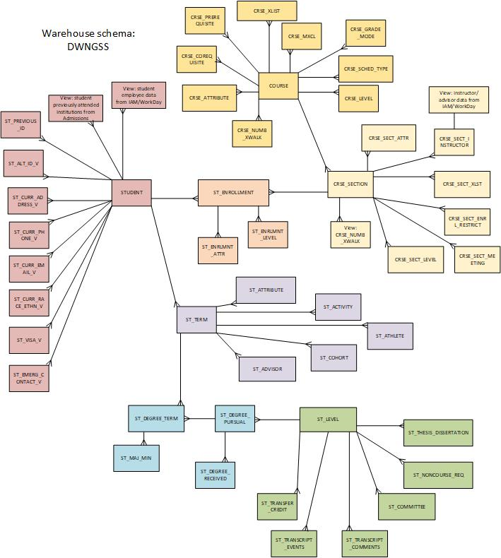
DWNGSS_PS tables and how they are related to each other
STUDENT (ST_*)
COURSE (CRSE_*)
CRSE_SECTION (CRSE_SECT_*)
ST_ENROLLMENT
ST_TERM
ST_DEGREE_TERM
ST_LEVEL

Slide 10
Example 1
If your query looks like this:
SELECT PENN_ID, TERM, SECTION_ID, REGISTERED_CREDIT, CREDIT_TYPE, STATUS
FROM DWADMIN.ENROLLMENT_ALL_V WHERE
TERM = ‘2019C’
AND SUBJECT_AREA = ‘ENGL’
It will need to change to this:
SELECT PENN_ID, TERM, SECTION_ID, REGISTERED_CREDIT, CREDIT_TYPE, REG_STATUS
FROM DWNGSS_PS.ST_ENROLLMENT
WHERE
TERM = ‘201930’
AND SUBJECT_AREA = ‘ENGL’

Slide 11
Example 2
If your query looks like this:
SELECT TERM, SECTION_ID, SECTION_SCHOOL, TITLE
FROM DWADMIN.COURSE_SECTION
WHERE
(TERM like '%B'
AND COURSE_ID = 'FNAR264')
It will need to change to this:
SELECT TERM, SECTION_ID, SECTION_SCHOOL, TITLE
FROM
DWNGSS_PS.CRSE_SECT
WHERE
(TERM like ‘%2%'
AND COURSE_ID = 'FNAR2640')

Slide 12
Example 3
If your query looks like this:
SELECT DEGREE_TERM_ALL_V.PENN_ID, DEGREE_TERM_ALL_V.TERM, MAJOR_MINOR, MAJOR_MINOR_ORDER, JOINT_DEGREE_FLAG
FROM DWADMIN.MAJOR_MINOR_TERM, DWADMIN.DEGREE_TERM_ALL_V
WHERE
MAJOR_MINOR_TERM.PENN_ID = DEGREE_TERM_ALL_V.PENN_ID and MAJOR_MINOR_TERM.TERM = DEGREE_TERM_ALL_V.TERM
and
DEGREE_TERM_ALL_V.TERM = ‘2020A'
AND DEGREE_TERM_ALL_V.DIVISION = 'EAS'
AND MAJOR_MINOR_TYPE = 'M'
and DEGREE_TERM_ALL_V.JOINT_DEGREE_FLAG = 'M'
You would probably change it to this:
SELECT ST_DEGREE_TERM.PENN_ID, ST_DEGREE_TERM.TERM, MAJOR_MINOR, MAJOR_MINOR_ORDER, PROGRAM
FROM DWNGSS_PS.ST_MAJOR_MINOR, DWNGSS_PS.ST_DEGREE_TERM
WHERE
ST_MAJOR_MINOR.PENN_ID = ST_DEGREE_TERM.PENN_ID and ST_MAJOR_MINOR.TERM = ST_DEGREE_TERM.TERM
and
DEGREE_TERM_ALL_V.TERM = ‘202010'
AND DEGREE_TERM_ALL_V.DIVISION = ‘EU'
AND MAJOR_MINOR_TYPE = 'M'
and PROGRAM = ‘EU_BSE_MANDT’

Slide 13
… not a comprehensive list, just some examples:
If you used to look here | Now look here
PERSON_ALL_V | STUDENT
PERSON_ALL_V (for email) | ST_EMAIL
ADDRESS | ST_ADDRESS
ADDRESS (for phone numbers) | ST_PHONE
STUDENT_TERM | ST_TERM
DEGREE_TERM_ALL_V | ST_DEGREE_TERM
DEGREE_PURSUAL_ALL_V | ST_DEGREE_PURSUAL
COURSE_INVENTORY | COURSE
COURSE_SECTION | CRSE_SECTION
COURSE_SECTION_INSTRUCTOR | CRSE_SECT_INSTRUCTOR
Etc.
We will have documentation on the EI&A Data Warehouse website with old-to-new navigation help

Slide 14
Validation tables “lookup” tables, for lists of valid code values and their descriptions (… again, not a comprehensive list, just some examples):
Slightly different but very similar table names for the ones you are used to seeing:
GTV_SCHOOL
STV_DIVISION
STV_DEGREE
STV_MAJOR
Etc.
… and lots of new ones, that were not available in the legacy data collection, but will be in the Pennant Student Records:
STV_ACTIVITY
GTV_EMAIL
STV_SITE
STV_VETERAN_TYPE
Etc.

Slide 15
There will be cross-walks of old-to-new validation values, such as the ones for school and division
LEGACY_DIVISION_ CODE | BANNER_DIVISION_ CODE | LEGACY_SCHOOL_ CODE | BANNER_SCHOOL_ CODE
ASC | CM | AN | C
ASP | CP | AN | C
CGS | AL | AS | A
COL | AU | AS | A
GAS | AP | AS | A
SPC | AE | AS | A
DEN | DM | DM | D
DPH | DY | DM | D
EDG | GM | ED | G
EDP | GP | ED | G
EAS | EU | EG | E
GEN | EM | EG | E
GEP | EP | EG | E
GEX | EX | EG | E
GFA | FM | FA | F
etc….
These will live in the database, and will also be available in the Business Object universe.

Slide 16
Help us help you
Take a look at the list of proposed Pennant Records corporate documents
Do you have any reports that you use all the time, that aren’t really related to anything on the list? Are they things that might have a wider audience – people other than your office or division who might be able to use it? If so, let us know: they might be potential reports for the new “library.”
Watch for invitations to workshops and office hours, and rsvp so we know who’s coming.
Send your suggestions and questions to da-staff@isc.upenn.edu
Thanks! From the Student Data reporting team:
Lourdes Brolly, Bill Branan, Mike Budischak, Susan Collins

