Slide 1
Data Warehouse
Student Data User Group
Meeting
October 4, 2018

Slide 2
Data Warehouse Student Data Users Group
Agenda
Business Objects Upgrade to BI4.2 – New features demonstration
Preview of the new Curriculum Management data collection
NGSS Project Updates – Student Records & Financial Aid
DW Development schedule for new Student data collection
Data Warehouse Student Data Users Group
October 4, 2018

Slide 3
Data Warehouse Student Data Users Group
Business Objects BI4.2 - New Features
  Ability to reference cells (like Excel)
  Geo mapping feature – by Country Name or GPS coordinates
  Merge variables (not just universe data elements)
  Instructions for some of the new features here:
      Recycle Bin for deleted report recovery
      Geo Mapping
      Reference Cells (similar to excel)
Data Warehouse Student Data Users Group
October 4, 2018

Slide 4
Data Warehouse Student Data Users Group
Business Objects BI4.2 - New Features
  Recycle Bin – can recover deleted Webi documents
  Parallelized data providers – shortens query execution time
  You can maximize the Query Panel to fit the whole screen and it remembers that you did it next time you go in.
  You can also turn off the data preview if you want and toggle it back on only when you need it (rather than each time).
Data Warehouse Student Data Users Group
October 4, 2018

Slide 5
Data Warehouse Student Data Users Group
Business Objects BI4.2 - Fixes
  HTML Parity – Things previously only available in Java are now available in HTML mode
    Creating and editing subqueries
    Data Access > Tools tab and related functions:
      Changing a query's source universe
      Exporting query data
      Custom formatting of numbers in tables
      Conditional formatting options
  Firefox – No longer get "JavaScript error while calling onChangeDocID"
  when trying to create a new document
  More details in Miscellaneous & Browser Troubleshooting section at https://www.isc.upenn.edu/businessobjects-tips-faqs
Data Warehouse Student Data Users Group
October 4, 2018

Slide 6
Data Warehouse Student Data Users Group
Curriculum Management data collection
CIM is a course inventory and curriculum management platform, with customized online forms and automated workflows, designed to ensure accuracy across an institution's courses and programs.
Currently pilot/testing with School of Arts & Sciences
Vendor name: Leapfrog
For the next couple of years, CIM will be sending data to and receiving data from SRS.
CIM will interface with Banner when Pennant Records goes live.
In the Data Warehouse, the data collection will be in the DWCAT_CM schema, and all tables will start with CM_
The data collection, including a new Business Objects universe, will go into production later this year.
Data Warehouse Student Data Users Group
October 4, 2018

Slide 7
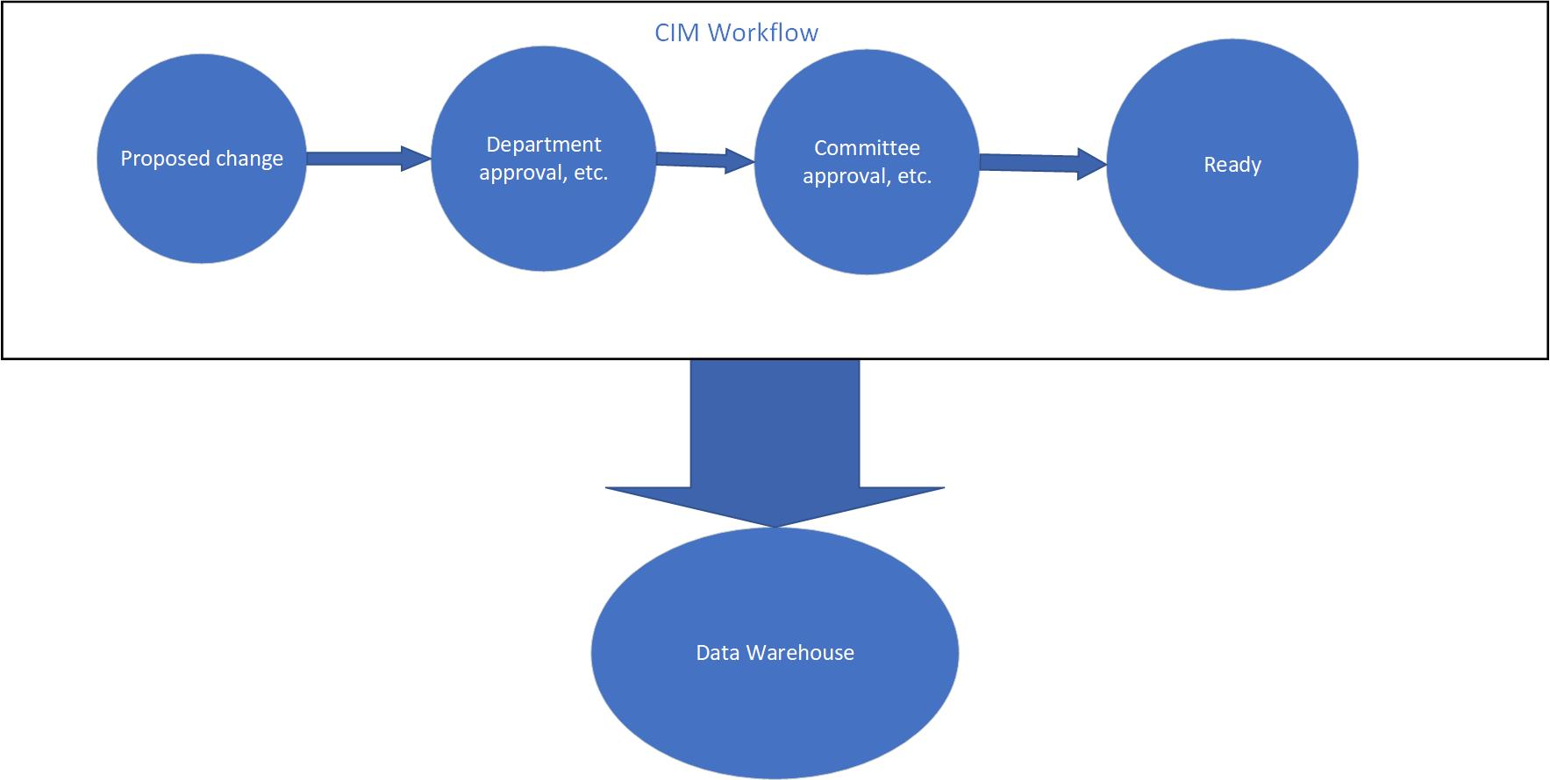
Data Warehouse Student Data Users Group
Curriculum Management data collection
Proposals for changes to courses work their way through the workflow. Each night, the status of the proposal will get updated in the DW.
Data Warehouse Student Data Users Group
October 4, 2018

Slide 8
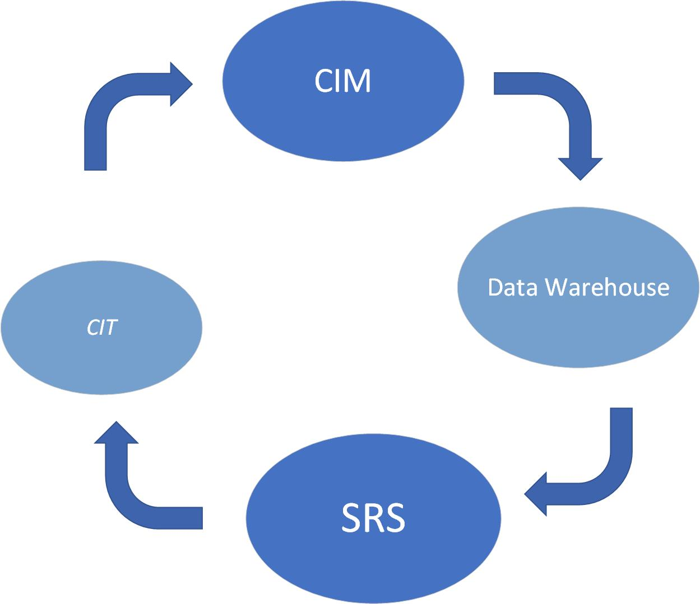
Data Warehouse Student Data Users Group
Curriculum Management data collection
As soon as the nightly update sends a “ready” status, another job picks up the record from the DW and sends it to SRS.
From there, a batch load from SRS goes first to Courses in Touch, and then back
to CIM.
Data Warehouse Student Data Users Group
October 4, 2018

Slide 9
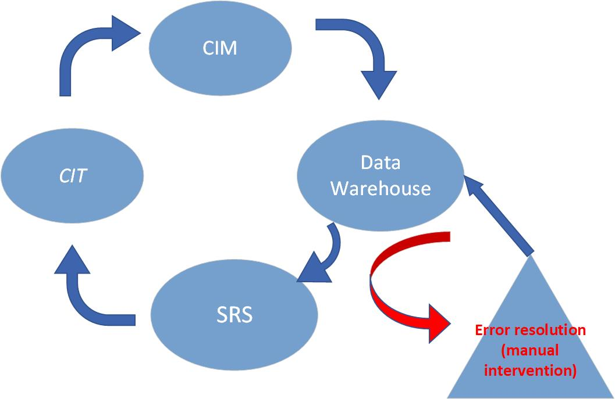
Data Warehouse Student Data Users Group
Curriculum Management data collection
If the “ready” record has a problem that prohibits it from passing through the bridge, it will go into an error status, and a notification will be sent to the designated person(s), with information about the error. The error will need to be resolved in CIM, and the error resolution site will need to be manually updated, indicating the record is once again ready to be sent.
Data Warehouse Student Data Users Group
October 4, 2018

Slide 10
Data Warehouse Student Data Users Group
NGSS Project Updates
Fall 2020 – 1st major release
Pennant Records
Course Catalog
Exam and Event Scheduling
DW course inventory components replaced with new course catalog data, including crosswalk data for old to new course numbering
Financial Aid
Tracking, Packaging, Notification for incoming Fall 2021 Students
Data Warehouse Student Data Users Group
October 4, 2018

Slide 11
Data Warehouse Student Data Users Group
NGSS Project Updates
Spring 2021 – 2nd major release
Pennant Records
  Person and Student Management
  Academic History and Transcripts
  Fee Assessment
  Degree Planning and Audit
  Transfer Credit
  Student Self Service
  Advanced Registration for Fall of 2021
Data Warehouse Student Data Users Group
October 4, 2018

Slide 12
Data Warehouse Student Data Users Group
NGSS Project Updates
Spring 2021 – 2nd major release (continued)
Pennant Records
  Last class graduates from SRS Spring 2021
  Replace remaining student DW components with Banner-sourced data
  1-time conversion of students not converted into Banner into the new student DW
Financial Aid
  Tracking, Packaging, Notification for continuing students
  Compliance, end of year reporting
Data Warehouse Student Data Users Group
October 4, 2018

Slide 13
Data Warehouse Student Data Users Group
DW Development schedule new Student collection
Note – For Student only, Financial Aid TBD
December 2018: preliminary design of new student DW complete and reviewed with DW working group
Spring 2019: broader review of new student DW design with Student Data User Group
December 2019: (Depends on development conversion schedule)
  Full load of both converted and non-converted data in new student DW structures in Test environment
Data Warehouse Student Data Users Group
October 4, 2018

Slide 14
Data Warehouse Student Data Users Group
Wrap Up
  Questions on topics presented today?
  Other topics / Suggestions for future meetings?
Data Warehouse Student Data Users Group
October 4, 2018

