Slide 1
Data Warehouse
Student Data User Group
Meeting
September 20, 2017

Slide 2
Data Warehouse Student Data Users Group
Agenda
Project status updates
News / Tips / Tricks
Business Objects Webi Report – Combining data collections
Q and A
Data Warehouse Student Data Users Group
September 20, 2017

Slide 3
Data Warehouse Student Data Users Group
Project status updates
  Pennant Records – at a future SDUG
  Penn IDs for graduate applicants using CollegeNet
  (New) Data Standards group
Data Warehouse Student Data Users Group
September 20, 2017

Slide 4
Data Warehouse Student Data Users Group
News / Tips / Tricks
  Reconciling Pennant Accounts to the GL
  Using Data Tracking visuals in Webi
  Using Excel as a data provider in Webi
  Warehouse website changes – preview
Data Warehouse Student Data Users Group
September 20, 2017

Slide 5
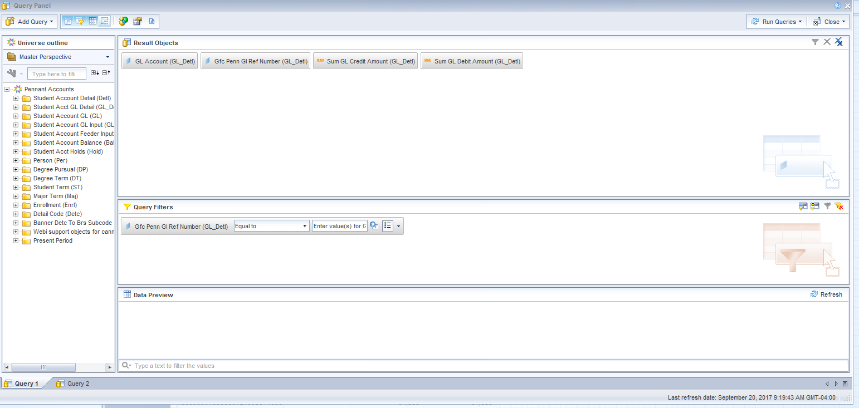
Data Warehouse Student Data Users Group
Reconciling Pennant Accounts to GL
Data Warehouse Student Data Users Group
September 20, 2017

Slide 6
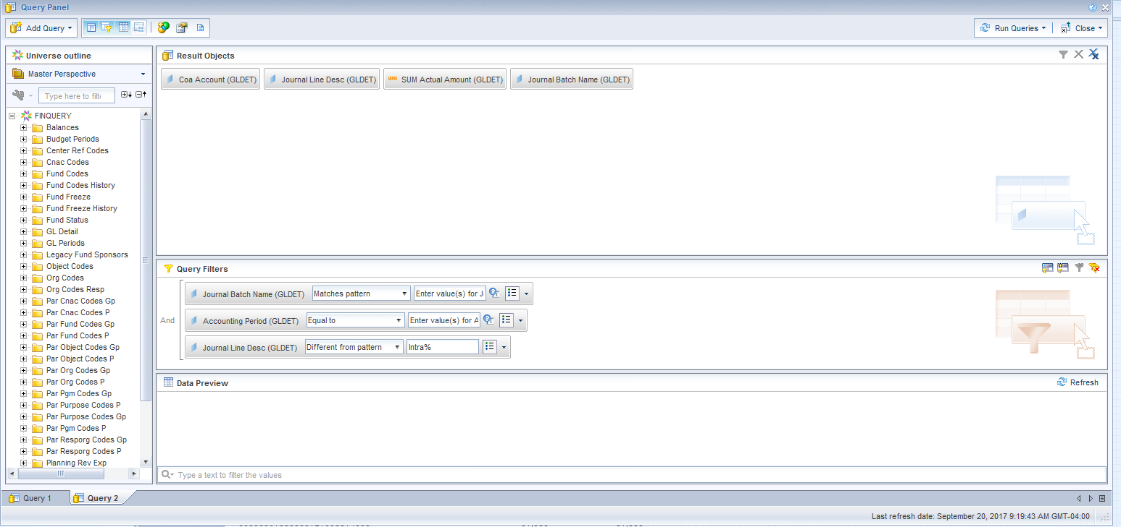
Data Warehouse Student Data Users Group
Reconciling Pennant Accounts to GL
Data Warehouse Student Data Users Group
September 20, 2017

Slide 7
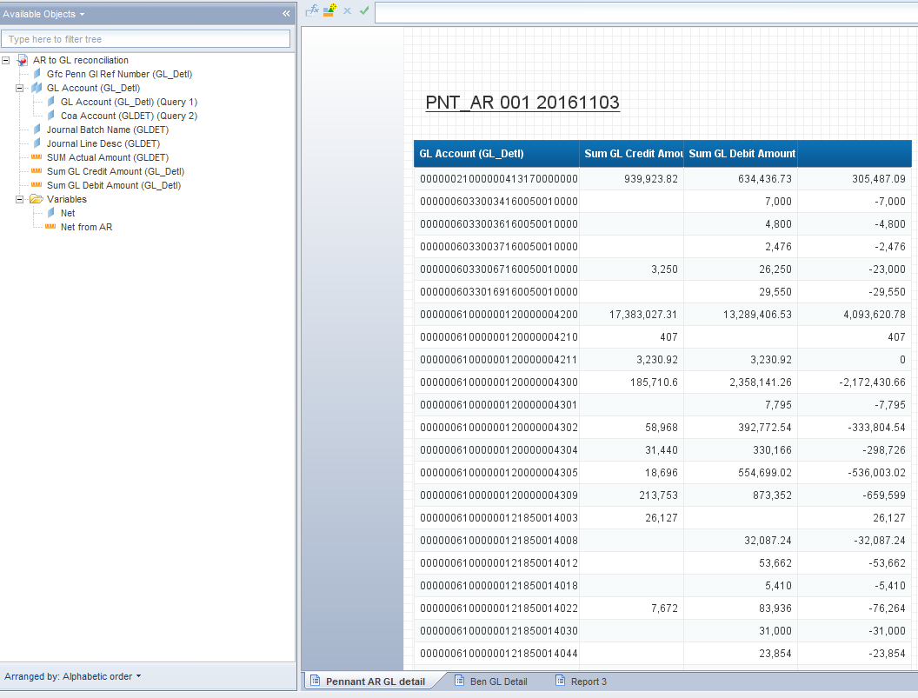
Data Warehouse Student Data Users Group
Reconciling Pennant Accounts to GL
Data Warehouse Student Data Users Group
September 20, 2017

Slide 8
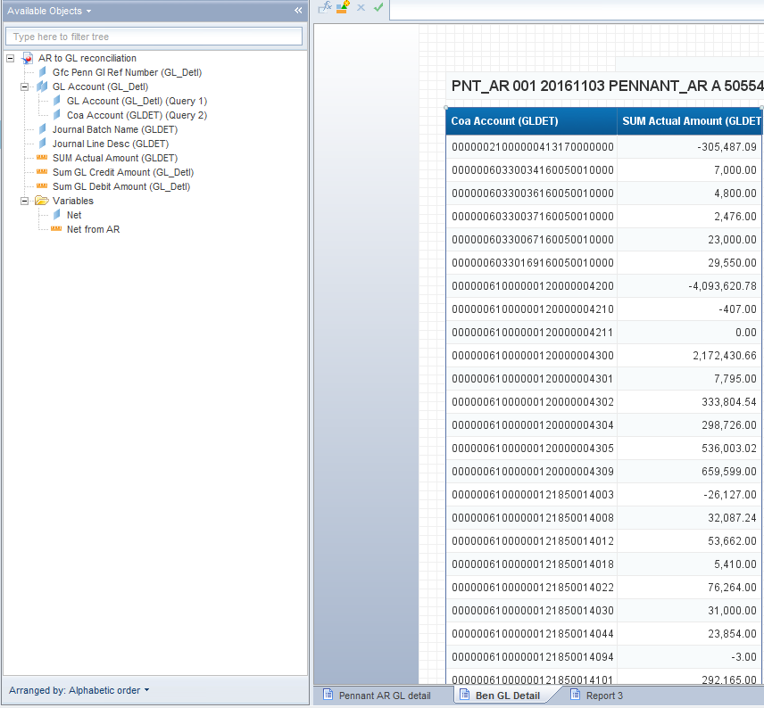
Data Warehouse Student Data Users Group
Reconciling Pennant Accounts to GL
Data Warehouse Student Data Users Group
September 20, 2017

Slide 9
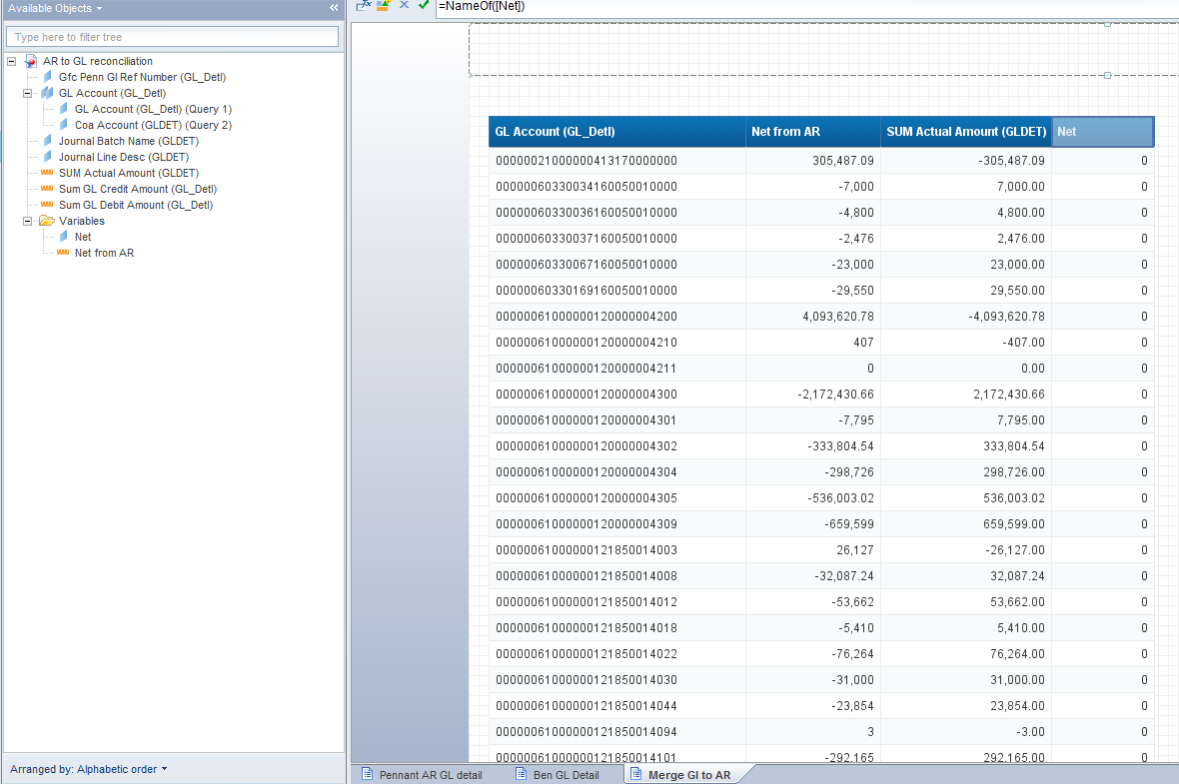
Data Warehouse Student Data Users Group
Reconciling Pennant Accounts to GL
Data Warehouse Student Data Users Group
September 20, 2017

Slide 10
Data Warehouse Student Data Users Group
News / Tips / Tricks
  Using Data Tracking visuals in Webi
Data Warehouse Student Data Users Group
September 20, 2017

Slide 11
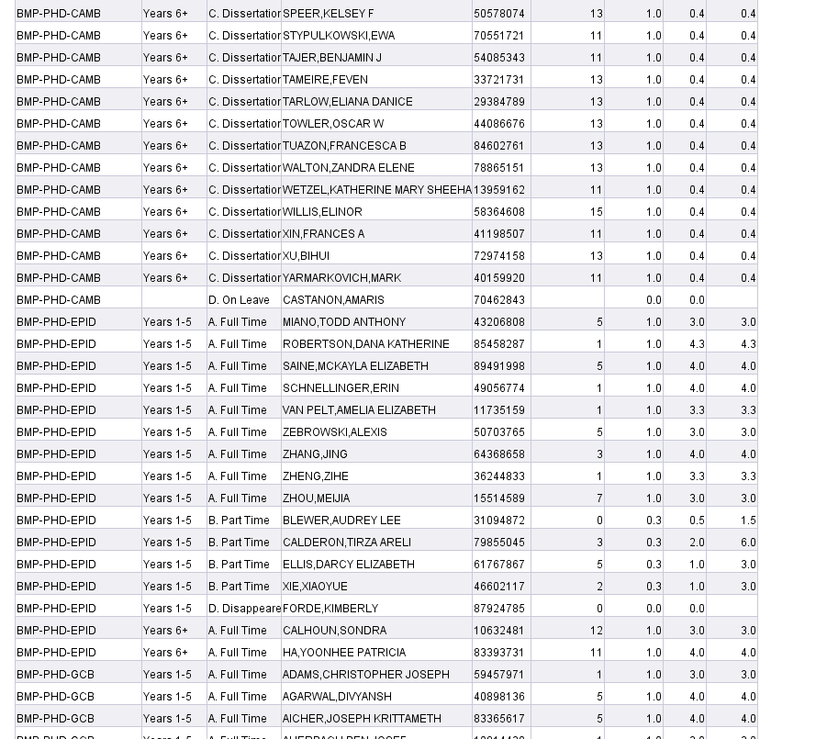
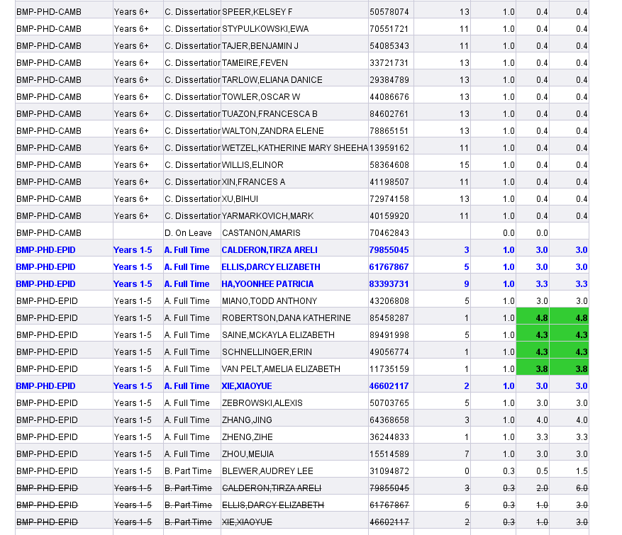
Using “Data Tracking” to visually point out deltas
Refresh on 9/15/2017
Refresh on 9/19/2017

Slide 12
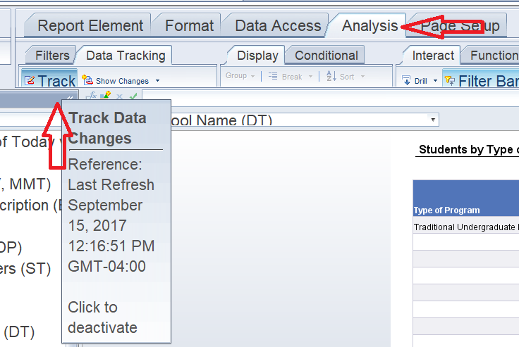
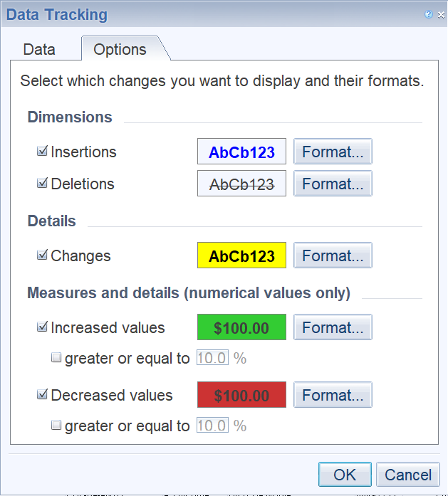
Tips: When you click to activate Tracking, select the options to “Compare to last data refresh” and then choose “Refresh data now”
In Design mode, on the Analysis tab, select Track:
From the drop-down next to “Show Changes” you can select the Display Options to choose how to show the changed data:

Slide 13
Data Warehouse Student Data Users Group
News / Tips / Tricks
  Using Excel as a data provider in Webi
Data Warehouse Student Data Users Group
September 20, 2017

Slide 14
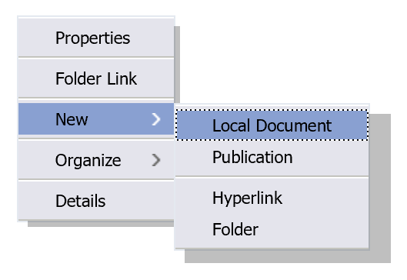
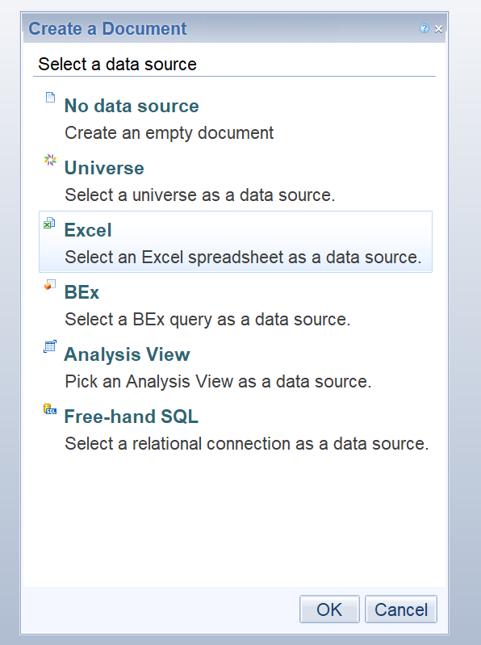
Using Excel as a Data Provider
In your folder, right click and choose New -> Local Document
Browse to the Excel file on your desktop and select it. It will upload and save a static copy of that spreadsheet in your InfoView folder.
Create a new Webi document, and choose Excel as the data source:
Run and save the results.

Slide 15
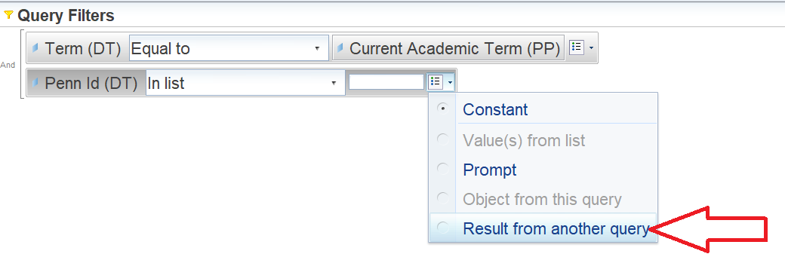
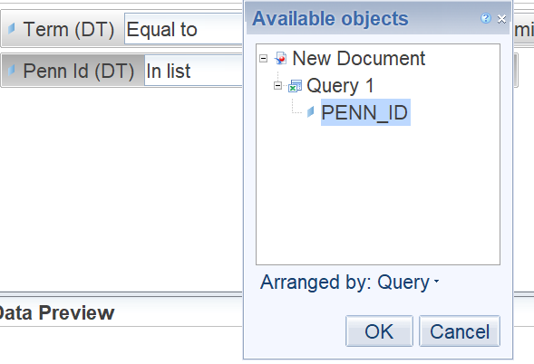
Using your spreadsheet data with other warehouse data
In the same Webi query where you retrieved the data from your spreadsheet, create a second query that uses a data warehouse universe.
In your second query, have a query condition that looks for the data in your spreadsheet. In this case, the second query will return data for any Penn_ID in the spreadsheet (Query 1).

Slide 16
Data Warehouse Student Data Users Group
News / Tips / Tricks
  Warehouse website changes – preview
Data Warehouse Student Data Users Group
September 20, 2017

Slide 17
Data Warehouse Student Data Users Group
Business Objects Report
  Total Graduate Funding - report consolidating 4 data sources
Data Warehouse Student Data Users Group
September 20, 2017

Slide 18
OVERVIEW
Problem
Basic Variables
Basic Reports
Report Focus
Questions

Slide 19
PROBLEM
SRFS request / Audience
4 Disparate Universes
  Student
  Graduate Funding (GF)
  Student Aid Management (SAM)
  Penn Loan System (PLS)
Terms
Merging
Access / Security

Slide 20
BASIC REPORTS
Detail
  Students
    Dual Degree
    Bridge
  SAM
  PLS
  GF Disbursed
Summaries
Previews
  Total Funding
  Loan Burden (SAM + PLS)

Slide 21
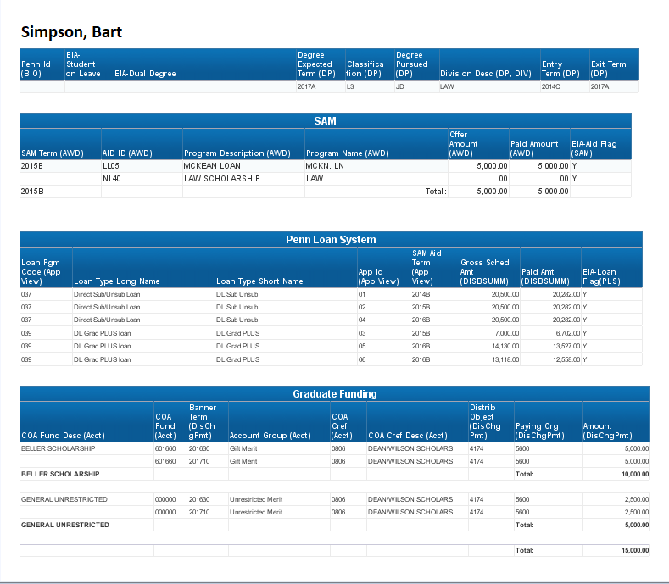
TOTAL FUNDING

Slide 22
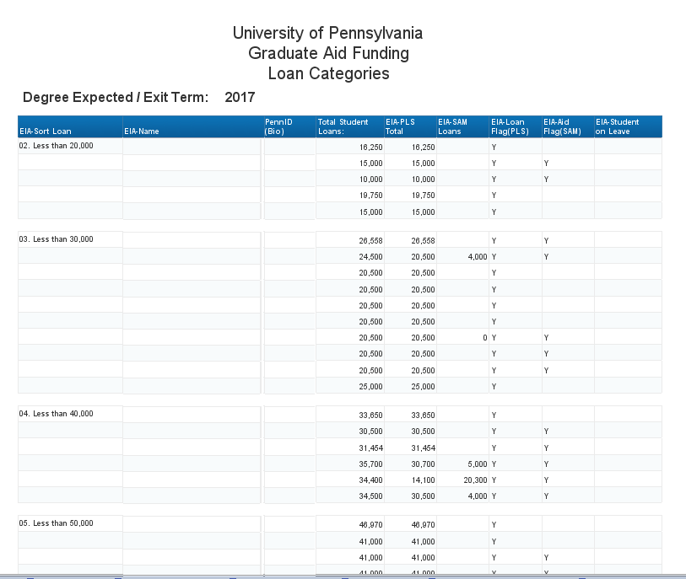
LOAN BURDEN

Slide 23
REPORT FOCUS
Minimal Student Detail
BEN / GL detail not included
PLS Detail (Gross Amount only)
GF Allocations Detail not included
Future merging (NGSS, future report deprecation)

Slide 24
Data Warehouse Student Data Users Group
Wrap Up
  Questions on any topics presented today?
  Other topics / Suggestions for future meeting topics?
Data Warehouse Student Data Users Group
September 20, 2017

