Slide 1
Financial Data User Group Meeting
Terrace Room, Claudia Cohen Hall – October 21, 2013

Slide 2
Agenda
In the works: BRIM changes
Refresher on Penn/Works Payroll distributions and encumbrances timing
Introducing: Travel & Expense Management (TEM) data
Tips & Tricks:
InfoView & Webi reminders for new and not-so-new folks
Report show and tell – relating results from multiple queries

Slide 3
BRIM changes in the works
BEN Billing and Receivables - fourth quarter, FY 2014
Data Warehouse effects:
switch from BRIM data collection to new data collection
special budget changes in the General Ledger data collection
Object Codes PBUD, PBIL, PTCS, FSRD, FSRI, PIND, & 9300
Please take the survey:
https://upenn.co1.qualtrics.com/SE/?SID=SV_cNrJmvbmwdhbxY1
requires a Web browser that has Javascript

Slide 5
Monitoring PennWorks/Payroll distributions
PennWorks reports – available in the Payroll/Salary Management folder:
Distributions Review: any PennWorks final/projected distributions and those currently in Payroll
Distributions Ending Review: PennWorks/Payroll distributions ending during a given date range.
Distributions vs Pay End Date: review whether distributions are active for employees as of the desired pay period end date.
RSALMGT Employee General - Current Dist Indicator:
Indicates (with Y/N) whether there are any current distributions for the employee. Recalculated nightly, based on distribution start/end date relative to the date on which the nightly jobstream began.
Fund status
Keep in mind that in order for encumbrances to be generated, Current Budget End Date must not be past, and fund must not be frozen for Payroll

Slide 6
TEM Data Collection Preview
Updated daily:
Standard Accounting Extract (SAE) details
Concur TEM report detail, advances, card transactions, etc.
Access:
Granted automatically to General Ledger collection users
Access available to non-GL data users with approved eForm
Security based on access to Cost Object ORG or RespORG or Person (employee traveler) Home ORG
In BusinessObjects:
Travel and Expense Management universe
Starter reports to review basics about reports, international travel, advances; others to come
Pilot users needed!

Slide 7
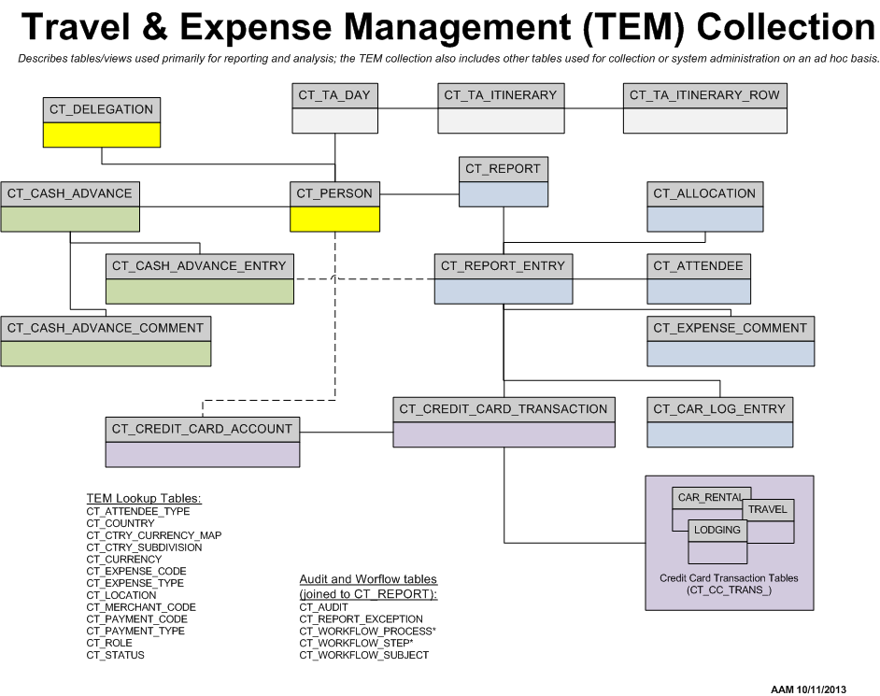

Slide 8
TEM Data Collection Preview
Standard Accounting Extract (SAE)
Only transactions that are fed to BEN
Summarized at report entry-level
Reports vs Report Entries
Parent and Child transaction types
Personal Travel is included – distinguished by flag
Credit Card tables include further detail, for Penn Travel Card only

Slide 9
BusinessObjects InfoView/Webi – Tips & Tricks
InfoView & Webi reminders for new and not-so-new folks
How Tos and FAQs available at http://www.upenn.edu/computing/da/bo/webi/faq_tips.html
Self-directed learning options: http://www.upenn.edu/computing/da/dw/self-directed.html
General Tips:
Working with filters: http://www.upenn.edu/computing/da/bo/webi/qna/iv_viewAllFilters.html
Aligning objects to the margin
Report show and tell – relating results from multiple queries
Reporting on PennWorks/Payroll distributions and encumbrances

Slide 10
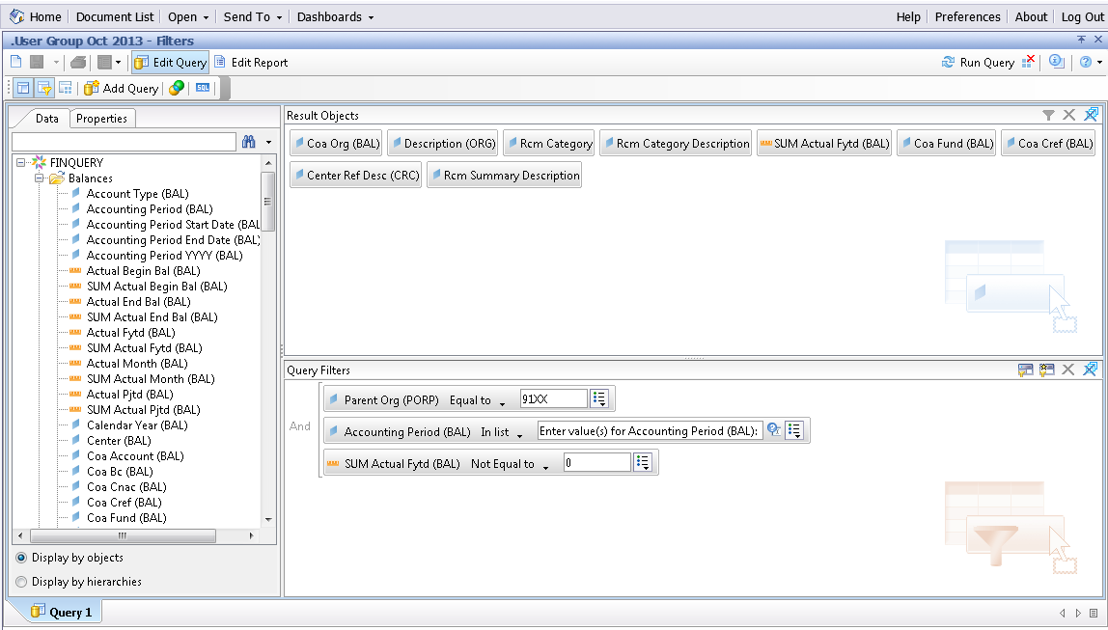
Query Filters

Slide 11
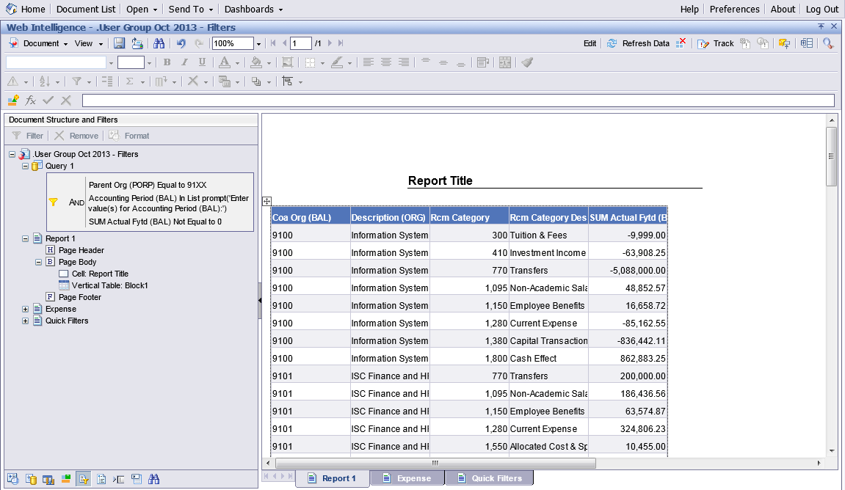
Document Structure and Filters Pane

Slide 12
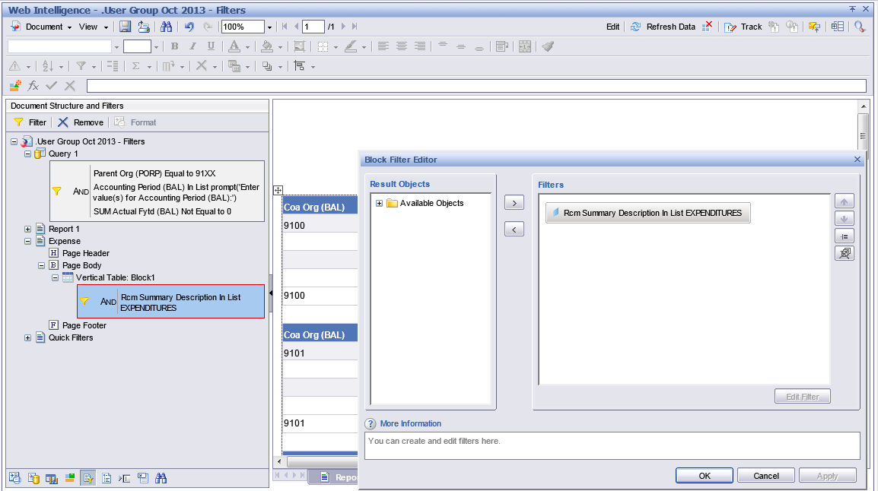
Document Structure and Filters Pane

Slide 13
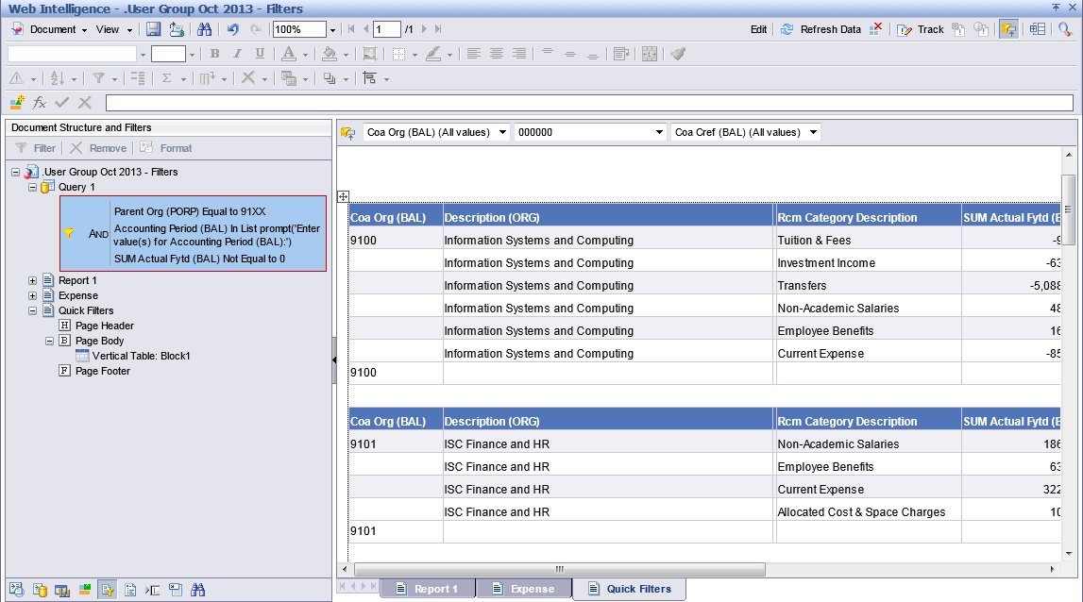
Quick Filters (on Report Filter Toolbar)

Slide 14
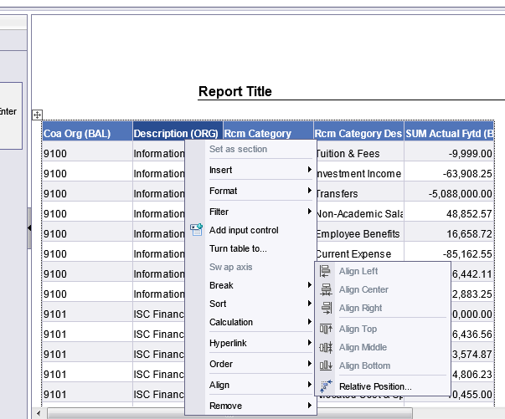
Relative Positioning – Align to margin

Slide 15
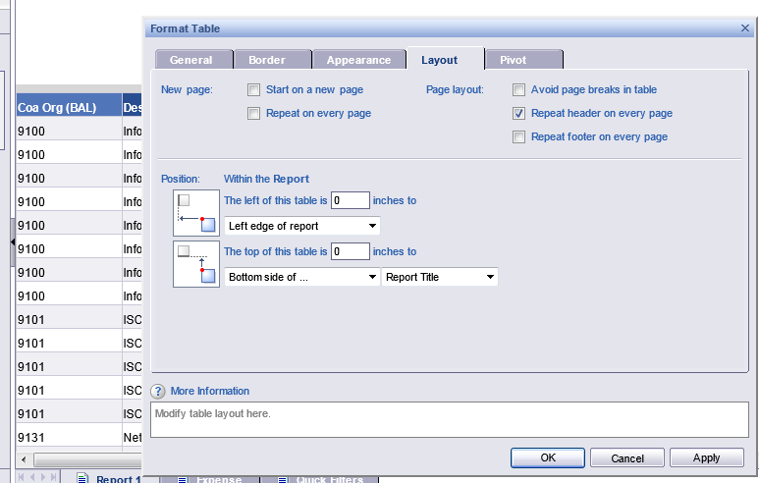
Relative Positioning – Align to margin

Slide 16
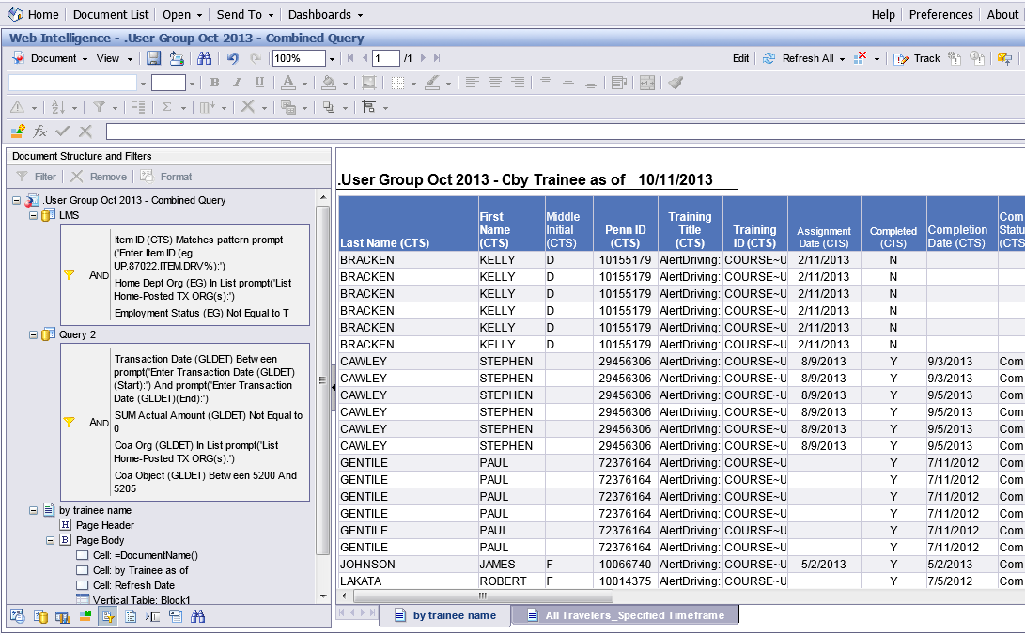
Combining Results – Separate Queries

Slide 17
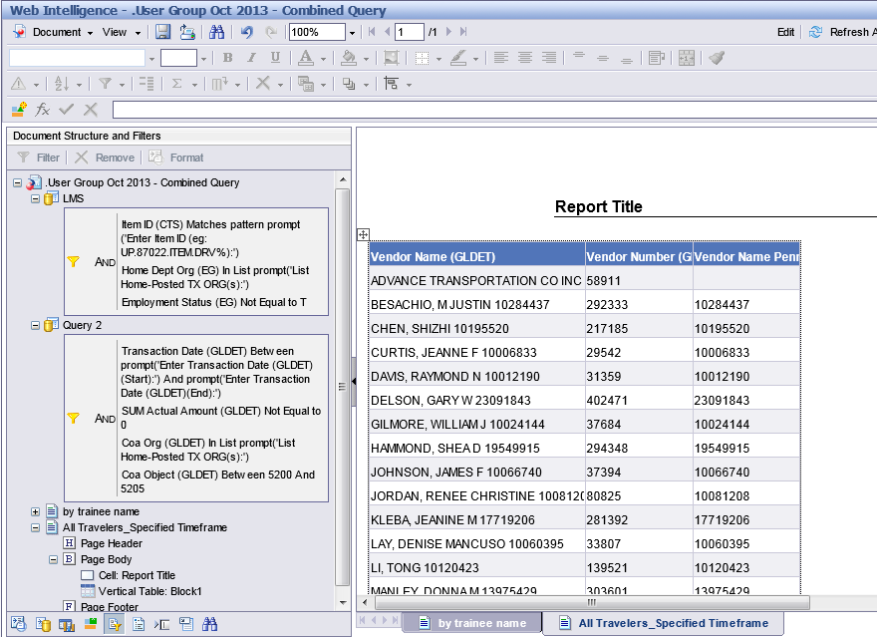
Combining Results – Separate Queries

Slide 18
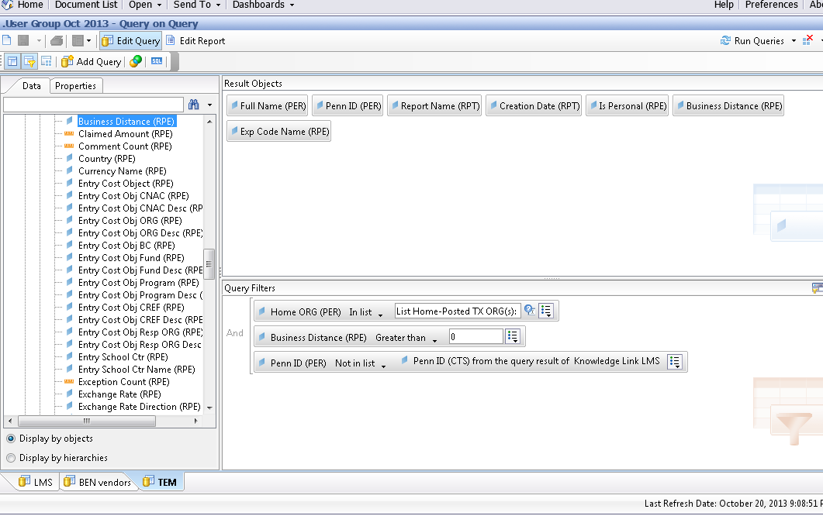
Combining Results – Query on Query

Slide 19
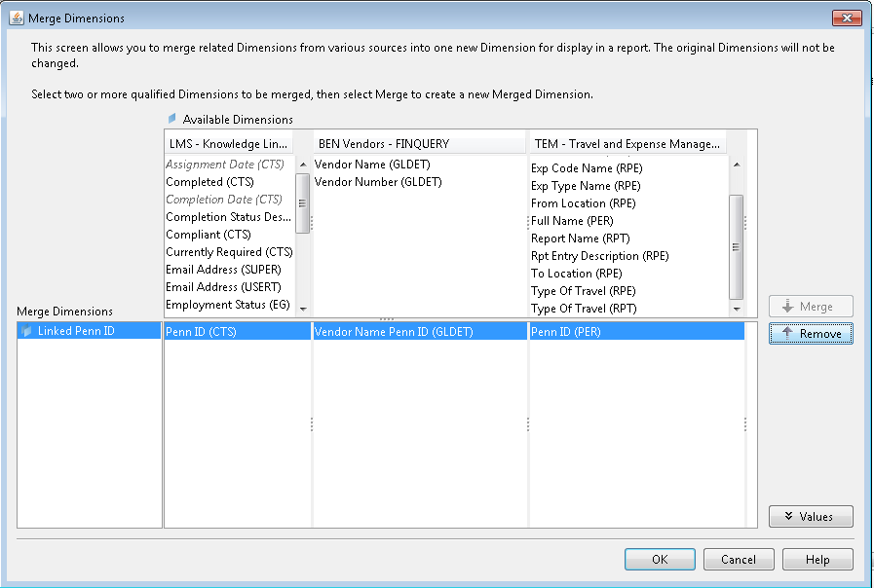
Combining Results – Linked Dimensions

Slide 20
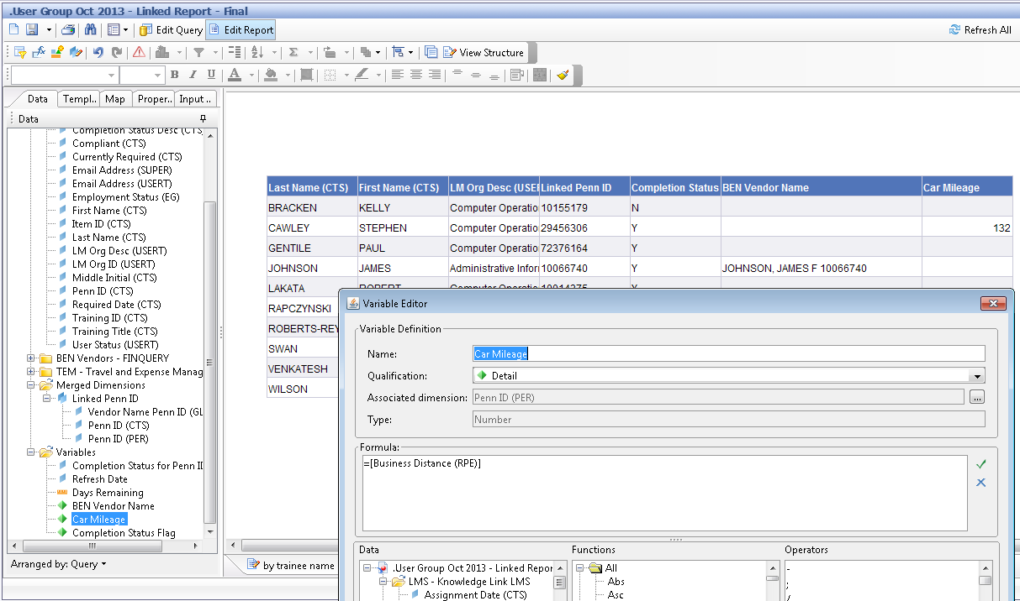
Combining Results – Linked Dimensions

